Slide 1




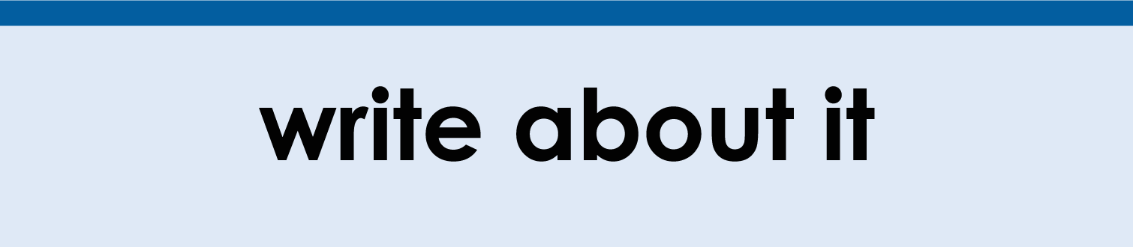
(click on a button to go directly to that step)
Notes:
The thinkalong toolkit includes assessment-style items with answer keys. A digital version (poster) of the thinkalong routine and daily questions for teacher and students’ reference is also included.

Slide 2
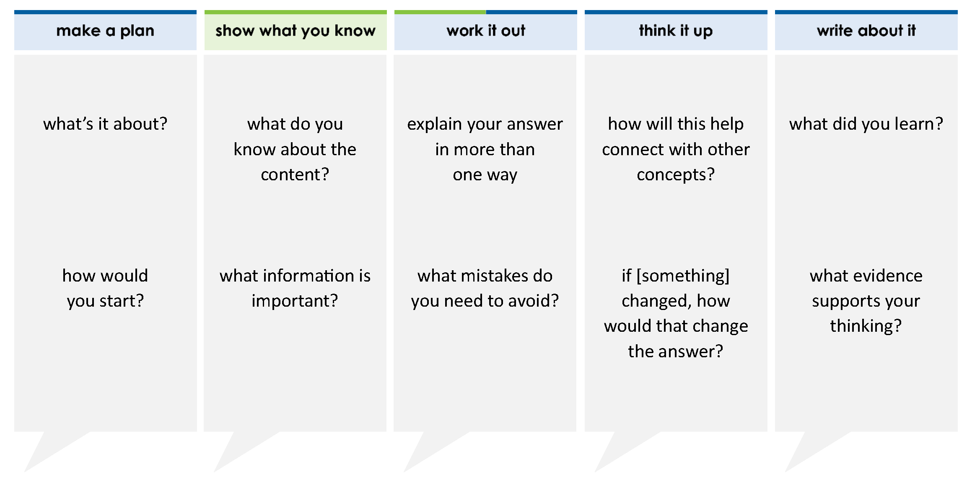
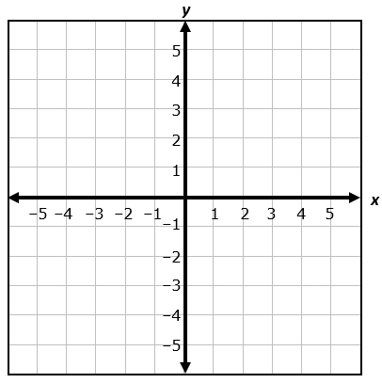
Graph the line represented by the equation 3x – 2y = 4.
Select two points on the coordinate grid. Draw a line to connect the points.
thinkalong routine
stimulus
Notes:
Throughout the week, use the guiding questions from the thinkalong routine to lead student thinking and discussion around the selected stimulus (problem, text, or visual) aligned to a high-impact standard/concept.

Slide 3
make a plan
Notes:
make a plan
The goal of the first 5-10 minutes of the routine is just for students to explore. We are engaging the “tools to know” process standards and using the selected problem, text, or visual to activate memory around the designated content for the week.
If you’re using a problem as the stimulus, students don’t solve the problem or even see the answer choices yet! In this part of the routine, students practice making a plan, getting started, and thinking about what they will need to answer the question based on the vocabulary and/or visuals included.

Slide 4
Graph the line represented by the equation 3x – 2y = 4.
what’s it about?
how would you start?
Notes:
make a plan: Use the guiding questions on the routine to drive the thinking and discussion with students as you explore the selected stimulus.
This item was selected to address, loopback, or intervene on graphing lines because:
It’s a skill with connections to prior learning and prepares students for future learning.
Students will graph lines in all high school math courses and in college.
Graphed lines are a useful tool when determining other features of lines such as the intercepts, the zeros, and the slope.

Slide 5
show what you know
Notes:
show what you know
The goal of the second 10 minutes in the routine is for students to talk using the problem, text, or visual to show what they know about this concept! This part of the routine allows students and teacher to talk about, share, and clarify the content (vocabulary, visuals, activities, common mistakes, connections, key ideas, important info/details, etc.).

Slide 6
Graph the line represented by the equation 3x – 2y = 4.
what do you know about the content?
what information is important?
Notes:
show what you know - option 1: Use these questions from the routine, along with the selected stimulus, to activate memory, review content, correct learning mistakes, and clarify misconceptions. Be sure discussion includes important information related to the selected stimulus.
important information about this item:
Clues include and require an understanding of important academic vocabulary: graph, line, represented, equation, x, y.
Students must read and clarify all of the clues:
Students must graph the line on a coordinate grid.
The equation for the line is 3x – 2y = 4.
Students would benefit from:
Reviewing the information needed to graph a line.
Reviewing different methods of graphing a line.
Thinking about which method they prefer to use when graphing a line.

Slide 7



FACT
FIB
Notes:
show what you know - option 2: fact or fib (rehearsal and practice instructional strategy)
purpose
Students review important content and clarify misconceptions by determining which statements are facts and which are fibs in a fact or fib showdown game. Fact or fib is an effective strategy for brain dumping and to activate memory, review content, correct learning mistakes, and clarify misconceptions and that will engage students with the guiding questions from the “show what you know” column and selected weekly stimulus.
instructions
Students create FACT and FIB cards using post it notes, index cards, scratch paper, white boards or use their fingers.
They hold their cards while teacher presents students with a statement (fact or fib) relating to the concept, visual, text, or test item.
Allow students 5-8 seconds to infer if the statement is a fact or a fib.
Students think and prepare to justify their answer until the teacher calls out, “One! Two! Three! Showdown!” at which time all students hold up either the fact or fib card to represent their choice.
Students then take turns explaining and justifying their thinking with a partner or small group.
Observe students’ thinking and clarify/verify as appropriate.
Reveal correct answer and provide rationale.

Slide 8
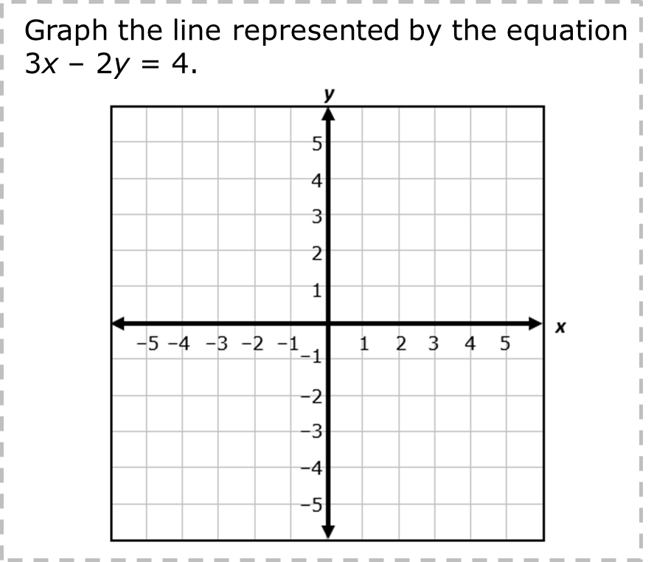
3
2
The slope of the line is . The y-intercept is 2.
3x – 2y = 4
–2y = –3x + 4
y = x – 2
3
2
y-intercept
point where line touches the
y-axis
slope
ratio of difference in y’s to difference in x’s
y = mx + b
FIB!
1-2-3 SHOWDOWN
Notes:
show what you know - option 2, round 1 rationale
This is a FIB. To find the slope and y-intercept, students must change the equation to slope-intercept form.
[Click] Then the coefficient of x is the slope. The constant is the y-intercept. Be sure to include the sign with the constant.

Slide 9

The points (–2, –5) and (4,4) may be used to graph the line.
FACT!
3(–2) – 2(–5) = 4
–6 + 10 = 4
4 = 4
3(4) – 2(4) = 4
12 – 8 = 4
4 = 4
1-2-3 SHOWDOWN
Notes:
show what you know - option 2, round 2 rationale
This is a FACT. When the points are plugged into the equation, the resulting equation is true.

Slide 10
work it out
Notes:
work it out
The goal of the third 10 minutes of the routine is for students to work out the problem and defend their answer. We want students to prove why their chosen response is right and explain why the incorrect answers are wrong.

Slide 11
Graph the line represented by the equation 3x – 2y = 4.
Select two points on the coordinate grid. Draw a line to connect the points.
explain your answer in more than one way
what mistakes do you need to avoid?
Notes:
work it out - option 1: Correct learning mistakes and clarify misconceptions by answering the question but be sure students not only solve but also prove why their chosen response is right and explain why the incorrect answers are wrong.
Be sure discussion includes:
How to choose points to graph the correct equation.
How to know that the points selected will yield the correct graph.

Slide 12
  make the case
Graph the line represented by the equation 3x – 2y = 4.
Select two points on the coordinate grid. Draw a line to connect the points.
Could you use the points to draw the line?
Draw the line on the coordinate grid.
(0, 2) and (2, 1)
(2, 1) and (–4, –5)
(–4, 1) and (6, 5)
(4, 4) and (0, –2)
defend why your answer might be correct/incorrect
what 1-2 pieces of evidence do you have?
Notes:
work it out - option 2: make the case (learning from mistakes instructional strategy)
free virtual dice available in the lead4ward app and at: www.lead4ward.com/dice
purpose
Students correct learning mistakes and clarify misconceptions by justifying/proving why their assigned response is right OR explain why their assigned response is an incorrect answer.
instructions
Organize students into groups (no larger than 4).
Assign each team a potential answer (choice).
Groups huddle to determine if their answer choice is “correct/innocent” by explaining why and providing (at most) 2 pieces of evidence…or “incorrect/guilty” by explaining why and providing (at most) 2 pieces of evidence.
Students prosecute and defend arguments.
Observe students’ thinking/responses and clarify/verify as appropriate.
be sure discussion includes:
Visuals or models students might use to prove their justification.
Discourse around strategies, clues and/or vocabulary that support their justification.
The chosen incorrect answer(s) suggests a common misconception, guessing pattern, clue picking, stopping too soon, and relying on tricks.
Student-driven discourse.
Green: Incorrect; (0,2) does not make the equation true.
Blue: Incorrect; (-4,-5) does not make the equation true.
Orange: Incorrect; (-4,1) and (6,5) do not make the equation true.
Purple: Correct. Both points make the equation true.

Slide 13
think it up
Notes:
think it up
The goal of the fourth 10 minutes of the routine is for us to change things up so students can practice with novelty and transfer.

Slide 14
Graph the line represented by the equation 3x – 2y = 4.
Select two points on the coordinate grid. Draw a line to connect the points.
Could you use the points to draw the line?
Draw the line on the coordinate grid.
(0, 2) and (2, 1)
(2, 1) and (–4, –5)
(–4, 1) and (6, 5)
(4, 4) and (0, –2)
how will this help connect with other concepts?
if the equation was in slope-intercept form, how would that change the process?
Notes:
think it up - option 1: Use the guiding questions on the routine to drive the thinking and discussion with students as they reflect on the work of the routine so far -- the thinking around the content and the problem, text or visual. Then, have students analyze how all of that can help them as they work on or think through other content or solving future problems.
Additional/optional questions:
Once you’ve drawn the line, how can you use the slope-intercept form of the equation to check if the line is drawn correctly?
What could you change the points to so that, when it’s graphed, the pair of points yields the correct line?

Slide 15
  odd one out
Graph the line
represented by
the equation
3x – 2y = 4.
What is the x-intercept of the line represented by the equation
3x – 2y = 4?
A 2 and B 2 and –
C –2 and D –2 and –
4
3
4
3
4
3
4
3
What is the y-intercept of the line represented by the equation
3x – 2y = 4?
A 2 and B 2 and –
C –2 and D –2 and –
What is the slope of the line represented by the equation
3x – 2y = 4?
A – B
C – D
4
3
4
3
2
3
2
3
4
3
4
3
3
2
3
2
Notes:
think it up - option 2: odd one out (extending thinking instructional strategy)
purpose
Students compare/contrast four visuals, assessment questions, words, characters, historical figures, etc. and justify their thinking by defending which they think is the odd one out.
instructions
Divide students into groups of 4.
In each group, students divide the images/problems amongst their group and take turns describing their image/problem.
Students compare and contrast the images/problems.
Students determine which one is the odd one out and why.
Groups share out their selected odd one out and justification.
Observe and listen to students’ thinking and clarify/verify as appropriate.
Upper right: This is the original problem.
Lower right: 3/2 is the slope. The distractors are common mistakes made by students.
Upper left: The x-intercept is -4/3. The distractors are common mistakes made by students.
Lower left: The y-intercept is -2. The distractors are common mistakes made by students.

Slide 16
write about it
Notes:
write about it
The goal of the last 10 minutes of the routine is for students to reflect on the routine and write about how it affected their understanding and confidence around the content and problem-solving process.

Slide 17
what did you learn?
Graph the line represented by the equation 3x – 2y = 4.
what was confusing but you now understand?
what evidence supports your thinking?
what is your favorite method for graphing equations? why?
Notes:
write about it: The goal of the last 10 minutes of the routine is to solidify learning and have students practice communicating what they know in writing.
Ask students to:
think about the activities, questions, discussions, and the selected problem, text or visual for this week’s thinkalong routine
talk with a partner or in a small group about what they learned and the evidence that supports their thinking
write their answers on a piece of paper or in their notebooks
Review areas in which students may need more support.

