Slide 1





(click on a button to go directly to that step)
Notes:
The thinkalong toolkit includes assessment-style items with answer keys. A digital version (poster) of the thinkalong routine and daily questions for teacher and students’ reference is also included.

Slide 2
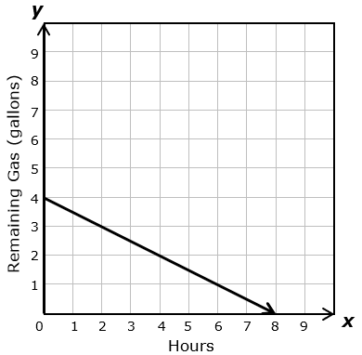
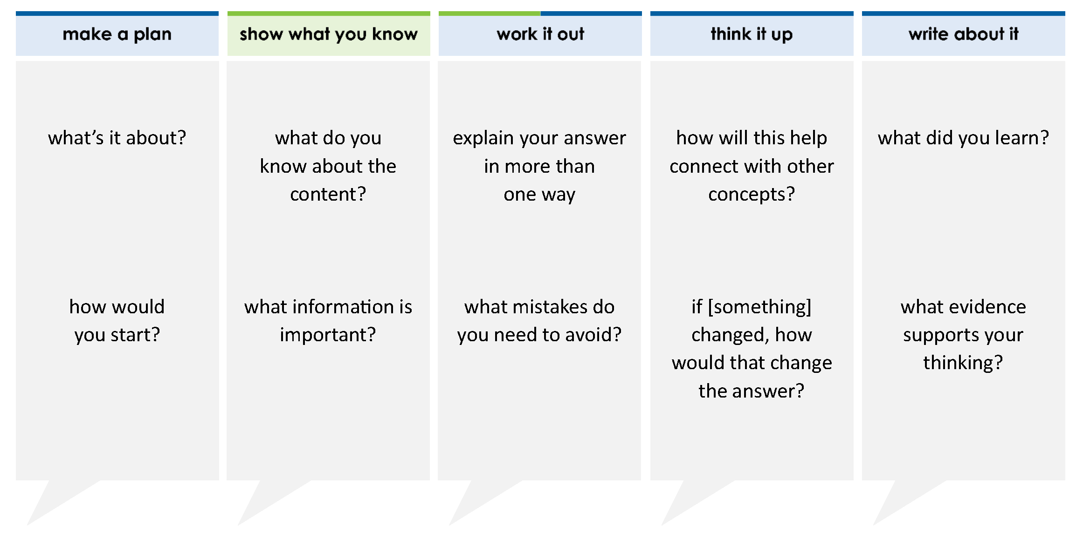
The graph models the linear relationship between the number of hours mowed and the amount of gas remaining in the gas tank.
Which statement describes the x-intercept of the graph?
A The x-intercept is 4, which represents the initial amount of gas in the tank.
B The x-intercept is 8, which represents the initial amount of gas in the tank
C The x-intercept is 4, which represents the number of hours until the tank is empty.
D The x-intercept is 8, which represents the number of hours until the tank is empty.
thinkalong routine
stimulus
Notes:
Throughout the week, use the guiding questions from the thinkalong routine to lead student thinking and discussion around the selected stimulus (problem, text, or visual) aligned to a high-impact standard/concept.

Slide 3
make a plan
Notes:
make a plan
The goal of the first 5-10 minutes of the routine is just for students to explore. We are engaging the “tools to know” process standards and using the selected problem, text, or visual to activate memory around the designated content for the week.
If you’re using a problem as the stimulus, students don’t solve the problem or even see the answer choices yet! In this part of the routine, students practice making a plan, getting started, and thinking about what they will need to answer the question based on the vocabulary and/or visuals included.

Slide 4
The graph models the linear relationship between the number of hours mowed and the amount of gas remaining in the gas tank.
what’s it about?
how would you start?
Notes:
make a plan: Use the guiding questions on the routine to drive the thinking and discussion with students as you explore the selected stimulus.
This item was selected to address, loopback, or intervene identifying the key features of a graph because:
It’s a skill/concept with longevity.
Being able to read a graph is a life skill.
Graphs are useful tools in all high school and college math classes.
Graphs contain a lot of information about problem situations.

Slide 5
show what you know
Notes:
show what you know
The goal of the second 10 minutes in the routine is for students to talk using the problem, text, or visual to show what they know about this concept! This part of the routine allows students and teacher to talk about, share, and clarify the content (vocabulary, visuals, activities, common mistakes, connections, key ideas, important info/details, etc.).

Slide 6
The graph models the linear relationship between the number of hours mowed and the amount of gas remaining in the gas tank.
what do you know about the content?
what information is important?
Notes:
show what you know - option 1: Use these questions from the routine, along with the selected stimulus, to activate memory, review content, correct learning mistakes, and clarify misconceptions. Be sure discussion includes important information related to the selected stimulus.
important information about this item:
Clues include and require an understanding of important academic vocabulary: graph, models, linear relationship, relationship between, number of hours, amount of gas, remaining gas (gallons).
Students must read and clarify all of the clues:
The x-axis represents the number of hours of mowing.
The y-axis represents the number of gallons of gas left in the gas tank.
The line represents the amount gas in a tank based on how long a person has been mowing.
Students would benefit from:
Identifying points on the line and what they mean to the problem situation.
Predicting what question will be asked about the graph.

Slide 7



just the facts
The graph models the linear relationship between the number of hours mowed and the amount of gas remaining in the gas tank.
Notes:
show what you know - option 2: just the facts (rehearsal and practice instructional strategy)
purpose
The purpose is to help student identify the most important details from a problem or visual.
instructions
Students read a text and observe an image.
They determine 3 facts (interesting, useful, most important) from the stem.
With a thinking partner, students justify why they chose a particular fact.
Observe students’ thinking and clarify/verify as appropriate.
Students may observe different facts about this problem situation and/or may label them differently.
Interesting fact: The line goes down because the amount of gas is decreasing. After 4 hours, there are 2 gallons of gas left.
Useful and/or most important fact: The gas tank starts with 4 gallons of gas. The mower runs out of gas after 8 hours.

Slide 8
work it out
Notes:
work it out
The goal of the third 10 minutes of the routine is for students to work out the problem and defend their answer. We want students to prove why their chosen response is right and explain why the incorrect answers are wrong.

Slide 9
The graph models the linear relationship between the number of hours mowed and the amount of gas remaining in the gas tank.
Which statement describes the x-intercept of the graph?
A The x-intercept is 4, which represents the initial amount of gas in the tank.
B The x-intercept is 8, which represents the initial amount of gas in the tank
C The x-intercept is 4, which represents the number of hours until the tank is empty.
D The x-intercept is 8, which represents the number of hours until the tank is empty.
explain your answer in more than one way
what mistakes do you need to avoid?
Notes:
work it out - option 1: Correct learning mistakes and clarify misconceptions by answering the question but be sure students not only solve but also prove why their chosen response is right and explain why the incorrect answers are wrong.
Be sure discussion includes:
The labels on the axes and how they relate to the ordered pair
What an x-intercept is vs. a y-intercept
The x-intercept has to be correct in the answer choice as does the reason that it’s the x-intercept

Slide 10


IQ slap down
A
B
C
D
Round 1 - Worst Answer
Round 2 - Best Distractor
Round 3 - Correct Answer
Notes:
work it out - option 2: IQ slap down (learning from mistakes instructional strategy)
purpose
Students analyze or practice assessment questions by determining the worst answer, the distractor, and the correct answer through a slap-down game.
instructions
Students create a set of A-B-C-D cards using sticky notes, index cards, or scratch paper.
Organize students into thinking partners or small groups.
Facilitate 3 rounds of IQ Slap Down with the selected weekly assessment item:
Round 1: At teacher’s signal, students slap down the WORST answer, justify with their partner, and pick up their cards. Teacher clarifies.
Round 2: At teacher’s signal, students slap down the DISTRACTOR answer, justify with their partner, and pick up their cards. Teacher clarifies.
Round 3: At teacher’s signal, students slap down the CORRECT answer, justify with their partner, and pick up their cards. Teacher clarifies.
Observe students’ thinking and clarify/verify as appropriate.
Answer “work it out questions” from think along routine.

Slide 11
The graph models the linear relationship between the number of hours mowed and the amount of gas remaining in the gas tank.
Which statement describes the x-intercept of the graph?
A The x-intercept is 4, which represents the initial amount of gas in the tank.
B The x-intercept is 8, which represents the initial amount of gas in the tank.
C The x-intercept is 4, which represents the number of hours until the tank is empty.
D The x-intercept is 8, which represents the number of hours until the tank is empty.
Round 1 Worst Answer
1-2-3 Slap Down
Notes:
work it out - option 2: round 1 rationale
A is the worst answer because:
[Click] The x-intercept is incorrect, and the reason is incorrect.
[Click] Notice that the label on the axis, which relates to the reason given in answer choice A, and the point are related to the y-axis, not the x-axis.
The word initial means beginning.

Slide 12
The graph models the linear relationship between the number of hours mowed and the amount of gas remaining in the gas tank.
Which statement describes the x-intercept of the graph?
A The x-intercept is 4, which represents the initial amount of gas in the tank.
B The x-intercept is 8, which represents the initial amount of gas in the tank.
C The x-intercept is 4, which represents the number of hours until the tank is empty.
D The x-intercept is 8, which represents the number of hours until the tank is empty.
Round 2 Best Distractor
1-2-3 Slap Down
Notes:
work it out - option 2: round 2 rationale
B is the best distractor because the x-intercept is correct but the reason is wrong. Notice that the label is on the y-axis, which is the reason used in answer choice B, while the point is on the x-axis.

Slide 13
The graph models the linear relationship between the number of hours mowed and the amount of gas remaining in the gas tank.
Which statement describes the x-intercept of the graph?
A The x-intercept is 4, which represents the initial amount of gas in the tank.
B The x-intercept is 8, which represents the initial amount of gas in the tank.
C The x-intercept is 4, which represents the number of hours until the tank is empty.
D The x-intercept is 8, which represents the number of hours until the tank is empty.
Round 3 Correct Answer
1-2-3 Slap Down
Notes:
work it out - option 2: round 3 rationale
D is the correct answer. 8 hours is when the mower runs out of gas, and you’d have to push the mower home or call someone to bring you gas. Notice that the reason given in D is related to the x-axis and the point is on the x-axis.
After IQ slap down, answer the “work it out” questions from the thinkalong routine:
explain your answer in more than one way
what mistakes do you need to avoid?

Slide 14
think it up
Notes:
think it up
The goal of the fourth 10 minutes of the routine is for us to change things up so students can practice with novelty and transfer.

Slide 15
The graph models the linear relationship between the number of hours mowed and the amount of gas remaining in the gas tank.
Which statement describes the x-intercept of the graph?
A The x-intercept is 4, which represents the initial amount of gas in the tank.
B The x-intercept is 8, which represents the initial amount of gas in the tank
C The x-intercept is 4, which represents the number of hours until the tank is empty.
D The x-intercept is 8, which represents the number of hours until the tank is empty.
how will this help connect with other concepts?
how does the structure of the answer choices relate to other problems?​
if the initial amount of gas was 8 gallons and the mower ran out of gas at 4 hours, how would that change the answer?
Notes:
think it up - option 1: Use the guiding questions on the routine to drive the thinking and discussion with students as they reflect on the work of the routine so far -- the thinking around the content and the problem, text or visual. Then, have students analyze how all of that can help them as they work on or think through other content or solving future problems.

Slide 16
compare/contrast model
The graph models the linear relationship between the number of hours mowed and the amount of gas remaining in the gas tank.
Which statement describes the x-intercept of the graph?
A The x-intercept is 4, which represents the initial amount of gas in the tank.
B The x-intercept is 8, which represents the initial amount of gas in the tank.
C The x-intercept is 4, which represents the number of hours until the tank is empty.
D The x-intercept is 8, which represents the number of hours until the tank is empty.
Which statement describes the y-intercept of the graph?
A The y-intercept is 4, which represents the initial amount of gas in the tank.
B The y-intercept is 8, which represents the initial amount of gas in the tank.
C The y-intercept is 4, which represents the number of hours until the tank is empty.
D The y-intercept is 8, which represents the number of hours until the tank is empty.
Notes:
think it up - option 2: compare/contrast model (extending thinking instructional strategy)
purpose
This is an effective strategy to facilitate a structured, supported, and engaging way for kids to answer the “think it up” questions and analyze 2 similar yet different items or visuals aligned to the same standard.
instructions
Divide students into groups of 3.
In each group, students CONTRAST the items by discussing/writing 2-3 attributes of each item.
In each group, students COMPARE the items by discussing/writing 2-3 attributes both items share.
Groups share out 1 of their differences and 1 of their similarities.
Observe and listen to students’ thinking and clarify/verify as appropriate.
The original problem is on the left. The only change between the problems is to change the focus to the y-intercept.

Slide 17
write about it
Notes:
write about it
The goal of the last 10 minutes of the routine is for students to reflect on the routine and write about how it affected their understanding and confidence around the content and problem-solving process.

Slide 18
what did you learn?
The graph models the linear relationship between the number of hours mowed and the amount of gas remaining in the gas tank.
Which statement describes the x-intercept of the graph?
A The x-intercept is 4, which represents the initial amount of gas in the tank.
B The x-intercept is 8, which represents the initial amount of gas in the tank
C The x-intercept is 4, which represents the number of hours until the tank is empty.
D The x-intercept is 8, which represents the number of hours until the tank is empty.
what confused you before but you now understand?
what evidence supports your thinking?
what other questions could be asked about this problem context?
Notes:
write about it: The goal of the last 10 minutes of the routine is to solidify learning and have students practice communicating what they know in writing.
Ask students to:
think about the activities, questions, discussions, and the selected problem, text or visual for this week’s thinkalong routine
talk with a partner or in a small group about what they learned and the evidence that supports their thinking
write their answers on a piece of paper or in their notebooks
Review areas in which students may need more support.

