Slide 1





(click on a button to go directly to that step)
Notes:
The thinkalong toolkit includes assessment-style items with answer keys. A digital version (poster) of the thinkalong routine and daily questions for teacher and students’ reference is also included.

Slide 2
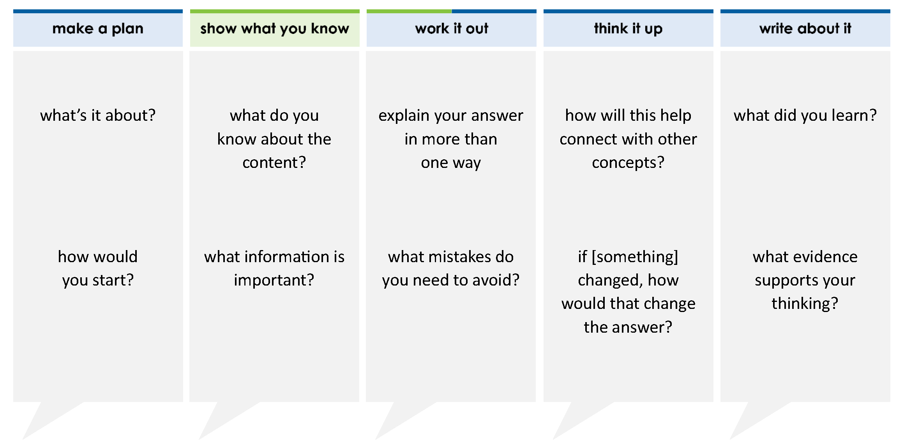
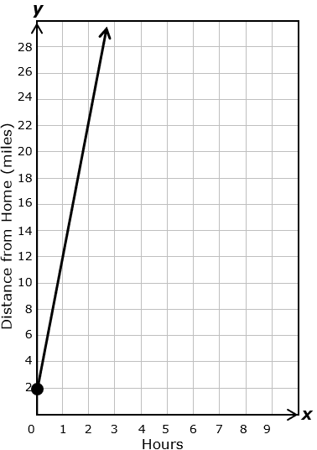
Aaron rode his bike 2 miles from his house to his bike club. The graph shows the linear relationship between y, the distance from home in miles, and x, the number of hours ridden from the bike club. Which equation best represents this relationship?
A y = x + 10
B y = x + 2
C y = 2x + 10
D y = 10x + 2
1
2
1
10
thinkalong routine
stimulus
Notes:
Throughout the week, use the guiding questions from the thinkalong routine to lead student thinking and discussion around the selected stimulus (problem, text, or visual) aligned to a high-impact standard/concept.

Slide 3
make a plan
Notes:
make a plan
The goal of the first 5-10 minutes of the routine is just for students to explore. We are engaging the “tools to know” process standards and using the selected problem, text, or visual to activate memory around the designated content for the week.
If you’re using a problem as the stimulus, students don’t solve the problem or even see the answer choices yet! In this part of the routine, students practice making a plan, getting started, and thinking about what they will need to answer the question based on the vocabulary and/or visuals included.

Slide 4
Aaron rode his bike 2 miles from his house to his bike club. The graph shows the linear relationship between y, the distance from home in miles, and x, the number of hours ridden from the bike club.
what’s it about?
how would you start?
Notes:
make a plan: Use the guiding questions on the routine to drive the thinking and discussion with students as you explore the selected stimulus.
This item was selected to address, loopback, or intervene on writing equations of lines because:
It’s a skill/concept with application to the real world.
It’s set in a real-world situation.
The context of the problem doesn’t provide the question. Students must make sense of the problem situation before they can begin to answer a question about it.
Without a question, it is not apparently obvious what will have to be done with the information. Students may have to write an equation or choose a table or graph that matches it.

Slide 5
show what you know
Notes:
show what you know
The goal of the second 10 minutes in the routine is for students to talk using the problem, text, or visual to show what they know about this concept! This part of the routine allows students and teacher to talk about, share, and clarify the content (vocabulary, visuals, activities, common mistakes, connections, key ideas, important info/details, etc.).

Slide 6
Aaron rode his bike 2 miles from his house to his bike club. The graph shows the linear relationship between y, the distance from home in miles, and x, the number of hours ridden from the bike club.
what do you know about the content?
what information is important?
Notes:
show what you know - option 1: Use these questions from the routine, along with the selected stimulus, to activate memory, review content, correct learning mistakes, and clarify misconceptions. Be sure discussion includes important information related to the selected stimulus.
important information about this item:
Clues include and require an understanding of important academic vocabulary: graph, linear relationship between, y (the distance from home in miles), x (the number of hours ridden from the bike club), distance, hours, x, y.
Students must read and clarify all of the clues:
Aaron rides his bike from home to the bike club. The bike club is 2 miles from home.
Once he arrives at the bike club, he rides his bike at a steady rate.
The graph gives the relationship between the number of hours ridden from the bike club and his distance from home (not the distance from the bike club). How would the graph be different if y stood for the distance from the bike club? The line would intersect the y-axis at (0,0).
Students would benefit from:
Predicting what they will have to do with the problem situation and the graph.
Determining what points are on the line and their meaning.

Slide 7



FACT
FIB
Notes:
show what you know - option 2: fact or fib (rehearsal and practice instructional strategy)
purpose
Students review important content and clarify misconceptions by determining which statements are facts and which are fibs in a fact or fib showdown game. Fact or fib is an effective strategy for brain dumping and to activate memory, review content, correct learning mistakes, and clarify misconceptions and that will engage students with the guiding questions from the “show what you know” column and selected weekly stimulus.
instructions
Students create FACT and FIB cards using post it notes, index cards, scratch paper, white boards or use their fingers.
They hold their cards while teacher presents students with a statement (fact or fib) relating to the concept, visual, text, or test item.
Allow students 5-8 seconds to infer if the statement is a fact or a fib.
Students think and prepare to justify their answer until the teacher calls out, “One! Two! Three! Showdown!” at which time all students hold up either the fact or fib card to represent their choice.
Students then take turns explaining and justifying their thinking with a partner or small group.
Observe students’ thinking and clarify/verify as appropriate.
Reveal correct answer and provide rationale.

Slide 8
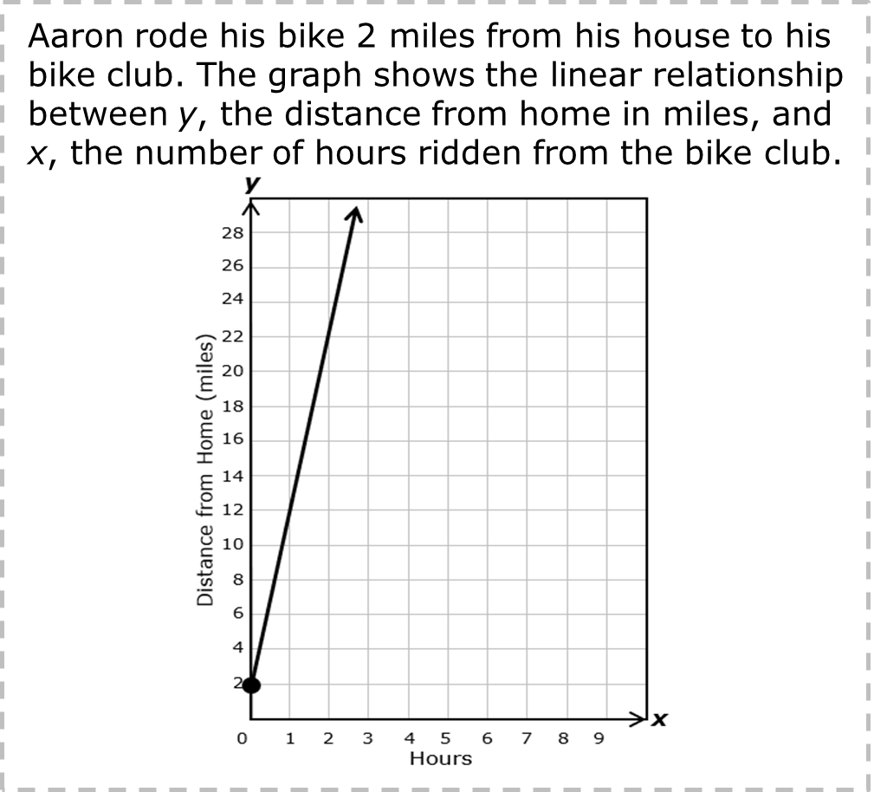
y = mx + b and y – y₁ = m(x - x₁)
are two forms of the equation of a line.
FACT!
y-intercept
point where line touches the y-axis
slope
ratio of difference in y’s to difference in x’s
y = mx + b
y – y₁ = m(x - x₁)
a point on the line
1-2-3 SHOWDOWN
Notes:
show what you know - option 2, round 1 rationale
This is a FACT.
[Click] The slope-intercept form of the equation of a line is y = mx + b. The point-slope form of the equation of a line is y – y₁ = m(x – x₁).
[Click] The m stands for the slope.
[Click] The b stands for the y-intercept.
[Click] The x₁ and the y₁ stand for a point on the line. Does it matter which point is chosen when writing the equation? No

Slide 9
(0,2) means that Aaron started two miles from the bike club. This is the slope of the line that represents this relationship.
FIB!
1-2-3 SHOWDOWN
Notes:
show what you know - option 2, round 2 rationale
This is a FIB.
[Click] 2 is the y-intercept. It’s the starting point. The slope is the ratio between the difference in y’s and difference in x’s.

Slide 10
To find the slope of the line, use two points on the line like (12,1) and (22,2).
FIB!
FACT!
1-2-3 SHOWDOWN
Notes:
show what you know - option 2, round 3 rationale
This is a FACT and a FIB. It’s a...
[Click] FACT that you use two points to find the slope.
[Click] It’s a FIB that using the two points listed will give you the slope of the line in the graph shown. What points could you use? (1,12), (2,22), (0,2)

Slide 11
work it out
Notes:
work it out
The goal of the third 10 minutes of the routine is for students to work out the problem and defend their answer. We want students to prove why their chosen response is right and explain why the incorrect answers are wrong.

Slide 12
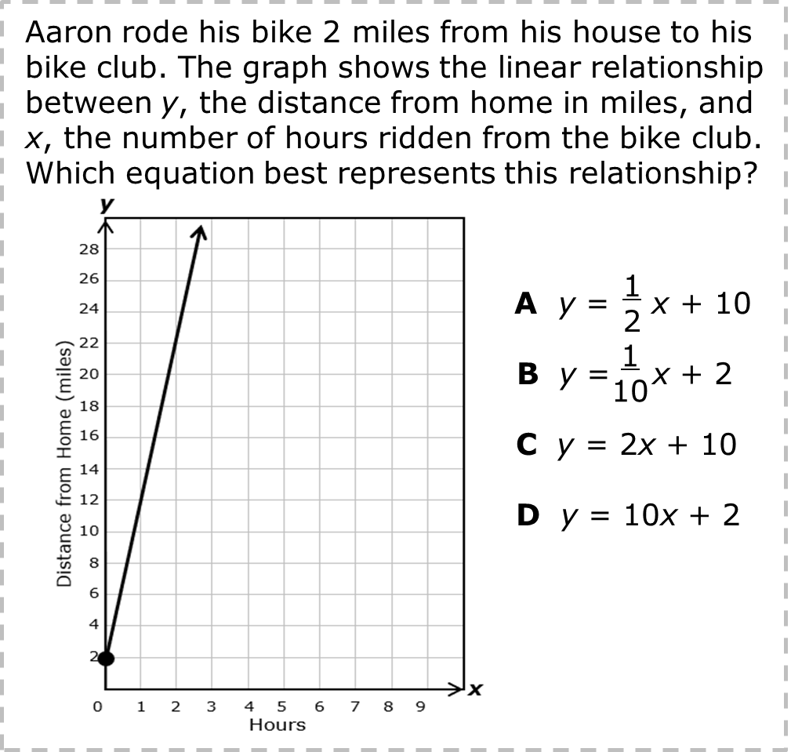
explain your answer in more than one way
what mistakes do you need to avoid?
Notes:
work it out - option 1: Correct learning mistakes and clarify misconceptions by answering the question but be sure students not only solve but also prove why their chosen response is right and explain why the incorrect answers are wrong.
Be sure discussion includes:
The elements needed to write the equation of a line, m and b.
How to use the information from the graph to write the slope of the line.
How to use the information from the graph to write the y-intercept.
When the equation is finished, it must be written in slope-intercept form.

Slide 13
make the case
Aaron rode his bike 2 miles from his house to his bike club. The graph shows the linear relationship between y, the distance from home in miles, and x, the number of hours ridden from the bike club. Which equation best represents this relationship?
A y = x + 10
B y = x + 2
C y = 2x + 10
D y = 10x + 2
defend why your answer might be correct/incorrect
what 1-2 pieces of evidence do you have?
1
2
1
10
Notes:
work it out - option 2: make the case (learning from mistakes instructional strategy)
free virtual dice available in the lead4ward app and at: www.lead4ward.com/dice
purpose
Students correct learning mistakes and clarify misconceptions by justifying/proving why their assigned response is right OR explain why their assigned response is an incorrect answer.
instructions
Organize students into groups (no larger than 4).
Assign each team a potential answer (choice).
Groups huddle to determine if their answer choice is “correct/innocent” by explaining why and providing (at most) 2 pieces of evidence…or “incorrect/guilty” by explaining why and providing (at most) 2 pieces of evidence.
Students prosecute and defend arguments.
Observe students’ thinking/responses and clarify/verify as appropriate.
be sure discussion includes:
Visuals or models students might use to prove their justification.
Discourse around strategies, clues and/or vocabulary that support their justification.
The chosen incorrect answer(s) suggests a common misconception, guessing pattern, clue picking, stopping too soon, and relying on tricks.
Student-driven discourse.
A is incorrect. The slope and y-intercept are “switched,” and the slope is incorrectly calculated as x/y.
B is incorrect. The slope is calculated at x/y, but the y-intercept is correct.
C is incorrect. The slope and y-intercept are switched.
D is correct.

Slide 14
think it up
Notes:
think it up
The goal of the fourth 10 minutes of the routine is for us to change things up so students can practice with novelty and transfer.

Slide 15
how will this help connect with other concepts?
how do you find the slope on a graph? ​how do you find the y-intercept?
if the answer choice was C, how would that change the graph?
Notes:
think it up - option 1: Use the guiding questions on the routine to drive the thinking and discussion with students as they reflect on the work of the routine so far -- the thinking around the content and the problem, text or visual. Then, have students analyze how all of that can help them as they work on or think through other content or solving future problems.

Slide 16

compare/contrast model
The table represents some points on the graph of linear function f.
Which equation represents f?
A y = x + 10
B y = x + 2
C y = 2x + 10
D y = 10x + 2
x | 0 | 1 | 2 | 4
f(x) | 2 | 12 | 22 | 42
1
2
1
10
Notes:
think it up - option 2: compare/contrast model (extending thinking instructional strategy)
purpose
This is an effective strategy to facilitate a structured, supported, and engaging way for kids to answer the “think it up” questions and analyze 2 similar yet different items or visuals aligned to the same standard.
instructions
Divide students into groups of 3.
In each group, students CONTRAST the items by discussing/writing 2-3 attributes of each item.
In each group, students COMPARE the items by discussing/writing 2-3 attributes both items share.
Groups share out 1 of their differences and 1 of their similarities.
Observe and listen to students’ thinking and clarify/verify as appropriate.
These are essentially the same problem. The problem on the left is set in a real-world situation. The problem on the right gives the same information in table form. Also the problem on the right is written in function form.

Slide 17
write about it
Notes:
write about it
The goal of the last 10 minutes of the routine is for students to reflect on the routine and write about how it affected their understanding and confidence around the content and problem-solving process.

Slide 18
what did you learn?
what was confusing but you now understand?
what evidence supports your thinking?
how do you choose where to start when writing equations of lines?
Notes:
write about it: The goal of the last 10 minutes of the routine is to solidify learning and have students practice communicating what they know in writing.
Ask students to:
think about the activities, questions, discussions, and the selected problem, text or visual for this week’s thinkalong routine
talk with a partner or in a small group about what they learned and the evidence that supports their thinking
write their answers on a piece of paper or in their notebooks
Review areas in which students may need more support.

