Slide 1





(click on a button to go directly to that step)
Notes:
The thinkalong toolkit includes assessment-style items with answer keys. A digital version (poster) of the thinkalong routine and daily questions for teacher and students’ reference is also included.

Slide 2
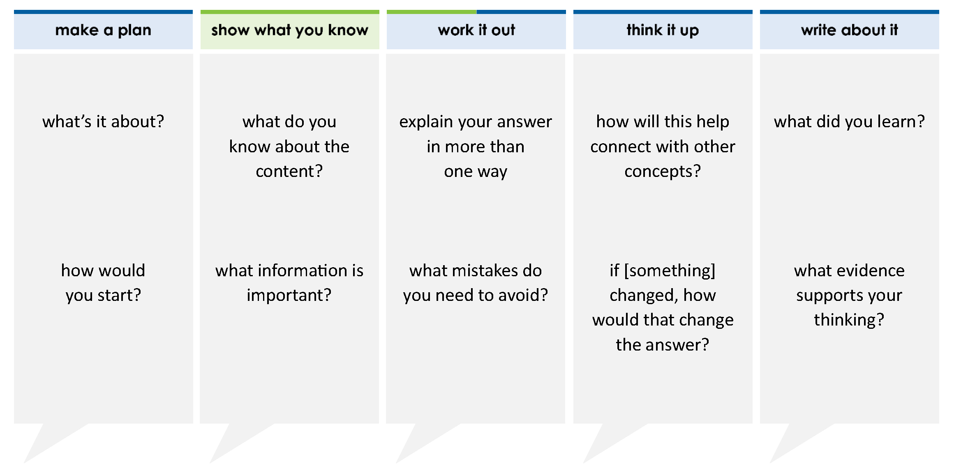
The table represents some points on the graph of a linear function.
Which equation best represents this table?
A y + 23 = 15(x + 1)
B y – 8 = 15x
C y – 37 = 15(x + 3)
D y – 6 = 15(x – 82)
x | y
–1 | –23
0 | –8
3 | 37
6 | 82
thinkalong routine
stimulus
Notes:
Throughout the week, use the guiding questions from the thinkalong routine to lead student thinking and discussion around the selected stimulus (problem, text, or visual) aligned to a high-impact standard/concept.

Slide 3
make a plan
Notes:
make a plan
The goal of the first 5-10 minutes of the routine is just for students to explore. We are engaging the “tools to know” process standards and using the selected problem, text, or visual to activate memory around the designated content for the week.
If you’re using a problem as the stimulus, students don’t solve the problem or even see the answer choices yet! In this part of the routine, students practice making a plan, getting started, and thinking about what they will need to answer the question based on the vocabulary and/or visuals included.

Slide 4
what’s it about?
The table represents some points on the graph of a linear function.
x | y
–1 | –23
0 | –8
3 | 37
6 | 82
how would you start?
Notes:
make a plan: Use the guiding questions on the routine to drive the thinking and discussion with students as you explore the selected stimulus.
This item was selected to address, loopback, or intervene on writing equations of lines because:
It’s a skill that students have previously used and will continue to use.
It starts with a table.
Without a question, it is not apparently obvious what students will have to do with the information. They may have to write an equation, choose a graph, or choose a word problem that matches it.

Slide 5
show what you know
Notes:
show what you know
The goal of the second 10 minutes in the routine is for students to talk using the problem, text, or visual to show what they know about this concept! This part of the routine allows students and teacher to talk about, share, and clarify the content (vocabulary, visuals, activities, common mistakes, connections, key ideas, important info/details, etc.).

Slide 6
what do you know about the content?
The table represents some points on the graph of a linear function.
x | y
–1 | –23
0 | –8
3 | 37
6 | 82
what information is important?
Notes:
show what you know - option 1: Use these questions from the routine, along with the selected stimulus, to activate memory, review content, correct learning mistakes, and clarify misconceptions. Be sure discussion includes important information related to the selected stimulus.
important information about this item:
Clues include and require an understanding of important academic vocabulary: table, represents, points, graph of a linear function, x, y.
Students must read and clarify all of the clues:
There is a table with points.
The table represents a graph.
The points are (–1, –23), (0, –8), (3, 37), and (6,82). Are there other points on the line? Yes. How would you find other points on the line? You’d need to know the equation, be able to follow the pattern in the table, or have a graph.
Students would benefit from:
Predicting what they will have to do with the table.
Looking for algebraic relationships in the table.

Slide 7



FACT
FIB
Notes:
show what you know - option 2: fact or fib (rehearsal and practice instructional strategy)
purpose
Students review important content and clarify misconceptions by determining which statements are facts and which are fibs in a fact or fib showdown game. Fact or fib is an effective strategy for brain dumping and to activate memory, review content, correct learning mistakes, and clarify misconceptions and that will engage students with the guiding questions from the “show what you know” column and selected weekly stimulus.
instructions
Students create FACT and FIB cards using post it notes, index cards, scratch paper, white boards or use their fingers.
They hold their cards while teacher presents students with a statement (fact or fib) relating to the concept, visual, text, or test item.
Allow students 5-8 seconds to infer if the statement is a fact or a fib.
Students think and prepare to justify their answer until the teacher calls out, “One! Two! Three! Showdown!” at which time all students hold up either the fact or fib card to represent their choice.
Students then take turns explaining and justifying their thinking with a partner or small group.
Observe students’ thinking and clarify/verify as appropriate.
Reveal correct answer and provide rationale.

Slide 8

To find the slope of the line, simplify this expression:
–8 – 0
–23 – (–1)
y₂ – y₁
x₂ – x₁
–8 – (–23) 15
0 – (–1) 1
=
= 15
The table represents some points on the graph of a linear function.
x | y
–1 | –23
0 | –8
3 | 37
6 | 82
FIB!
1-2-3 SHOWDOWN
Notes:
show what you know - option 2, round 1 rationale
This is a FIB.
[Click] This expression subtracts x’s from y’s, a common mistake when finding the slope from a table.
[Click] Students must subtract the y’s from two points and the x’s from two points and divide them or simplify the fraction.
The points (0, -8) and (-1,-23) were specifically chosen to work with. Why? The numbers are pretty “easy.” There’s less chance of making an arithmetic error.
Do you have to choose specific points? No; you can choose whatever points work for you.

Slide 9
y = mx + b
and
y – y₁ = m(x - x₁)
are two forms of the equation of a line.
FACT!
The table represents some points on the graph of a linear function.
y-intercept
point where line touches the y-axis
slope
ratio of difference in y’s to difference in x’s
x | y
–1 | –23
0 | –8
3 | 37
6 | 82
y = mx + b
y – y₁ = m(x - x₁)
a point on the line
1-2-3 SHOWDOWN
Notes:
show what you know - option 2, round 2 rationale
This is a FACT.
[Click] The slope-intercept form of the equation of a line is y = mx + b. The point-slope form of the equation of a line is y – y₁ = m(x – x₁).
[Click] The m stands for the slope.
[Click] The b stands for the y-intercept.
[Click] The x₁ and the y₁ stand for a point on the line. Does it matter which point you choose when you write the equation? No

Slide 10
work it out
Notes:
work it out
The goal of the third 10 minutes of the routine is for students to work out the problem and defend their answer. We want students to prove why their chosen response is right and explain why the incorrect answers are wrong.

Slide 11
The table represents some points on the graph of a linear function.
Which equation best represents this table?
A y + 23 = 15(x + 1)
B y – 8 = 15x
C y – 37 = 15(x + 3)
D y – 6 = 15(x – 82)
explain your answer in more than one way
x | y
–1 | –23
0 | –8
3 | 37
6 | 82
what mistakes do you need to avoid?
Notes:
work it out - option 1: Correct learning mistakes and clarify misconceptions by answering the question but be sure students not only solve but also prove why their chosen response is right and explain why the incorrect answers are wrong.
Be sure discussion includes:
The form of the line’s equation required by the problem
What the slope is and where it is in the equation

Slide 12
make the case
The table represents some points on the graph of a linear function.
Which equation best represents this table?
A y + 23 = 15(x + 1)
B y – 8 = 15x
C y – 37 = 15(x + 3)
D y – 6 = 15(x – 82)
defend why your answer might be correct/incorrect
what 1-2 pieces of evidence do you have?
x | y
–1 | –23
0 | –8
3 | 37
6 | 82
Notes:
work it out - option 2: make the case (learning from mistakes instructional strategy)
free virtual dice available in the lead4ward app and at: www.lead4ward.com/dice
purpose
Students correct learning mistakes and clarify misconceptions by justifying/proving why their assigned response is right OR explain why their assigned response is an incorrect answer.
instructions
Organize students into groups (no larger than 4).
Assign each team a potential answer (choice).
Groups huddle to determine if their answer choice is “correct/innocent” by explaining why and providing (at most) 2 pieces of evidence…or “incorrect/guilty” by explaining why and providing (at most) 2 pieces of evidence.
Students prosecute and defend arguments.
Observe students’ thinking/responses and clarify/verify as appropriate.
be sure discussion includes:
Visuals or models students might use to prove their justification.
Discourse around strategies, clues and/or vocabulary that support their justification.
The chosen incorrect answer(s) suggests a common misconception, guessing pattern, clue picking, stopping too soon, and relying on tricks.
Student-driven discourse.
A is correct. It uses the first point in the table.
B is incorrect. It uses the second point in the table. The sign on the 8 is incorrect.
C is incorrect. It uses the third point in the table. The sign on the 3 is incorrect.
D is incorrect. It switches the x and the y. The signs are correct though.

Slide 13
think it up
Notes:
think it up
The goal of the fourth 10 minutes of the routine is for us to change things up so students can practice with novelty and transfer.

Slide 14
The table represents some points on the graph of a linear function.
Which equation best represents this table?
A y + 23 = 15(x + 1)
B y – 8 = 15x
C y – 37 = 15(x + 3)
D y – 6 = 15(x – 82)
how will this help connect with other concepts?
x | y
–1 | –23
0 | –8
3 | 37
6 | 82
how do you find the slope in a table?
if the negative x values were positive and the positive x values were negative, how would that change the answer?
once you find the slope, what do you need to do next?​
Notes:
think it up - option 1: Use the guiding questions on the routine to drive the thinking and discussion with students as they reflect on the work of the routine so far -- the thinking around the content and the problem, text or visual. Then, have students analyze how all of that can help them as they work on or think through other content or solving future problems.

Slide 15
odd one out
The table represents some points on the graph of a linear function.
Which equation does NOT represent this table?
A y + 23 = 15(x + 1)
B y + 8 = 15x
C y – 37 = 15(x – 3)
D y – 6 = 15(x – 82)
The table represents some points on the graph of a linear function.
Which equation best represents this table?
A y + 23 = 15(x + 1)
B y – 8 = 15x
C y – 37 = 15(x + 3)
D y – 6 = 15(x – 82)
x | y
–1 | –23
0 | –8
3 | 37
6 | 82
x | y
–1 | –23
0 | –8
3 | 37
6 | 82
The table represents some points on the graph of a linear function.
Which equation best represents this table?
A y = 15(x + 8)
B y = 8(x – 15)
C y = 8x – 15
D y = 15x – 8
The table represents some points on the graph of a linear function.
Which equations could represent this table?
Choose THREE equations.
y + 23 = 15(x + 1)
y + 8 = 15x
y – 37 = 15(x + 3)
y – 82 = 15(x – 6)
x | y
–1 | –23
0 | –8
3 | 37
6 | 82
x | y
–1 | –23
0 | –8
3 | 37
6 | 82
Notes:
think it up - option 2: odd one out (extending thinking instructional strategy)
purpose
Students compare/contrast four visuals, assessment questions, words, characters, historical figures, etc. and justify their thinking by defending which they think is the odd one out.
instructions
Divide students into groups of 4.
In each group, students divide the images/problems amongst their group and take turns describing their image/problem.
Students compare and contrast the images/problems.
Students determine which one is the odd one out and why.
Groups share out their selected odd one out and justification.
Observe and listen to students’ thinking and clarify/verify as appropriate.
Each of these problems is essentially the same. Students are looking for equation(s) that represent the table.
Upper right: This is the original problem.
Lower right: Students look for 3 equations that represent the table and one that does not. Each equation uses a different point from the table and the equations are in point-slope form. The third equation in incorrect.
Upper left: Students look for 3 equations that represent the table and one that does not. Each equation uses a different point from the table and the equations are in point-slope form. D is incorrect.
Lower left: Students look for 1 equation that represents the table. The equation choices are in either slope-intercept form or point-slope form. D is correct.

Slide 16
write about it
Notes:
write about it
The goal of the last 10 minutes of the routine is for students to reflect on the routine and write about how it affected their understanding and confidence around the content and problem-solving process.

Slide 17
what did you learn?
The table represents some points on the graph of a linear function.
Which equation best represents this table?
A y + 23 = 15(x + 1)
B y – 8 = 15x
C y – 37 = 15(x + 3)
D y – 6 = 15(x – 82)
x | y
–1 | –23
0 | –8
3 | 37
6 | 82
what was confusing but you now understand?
what evidence supports your thinking?
how do you know where to start when writing equations of lines?
Notes:
write about it: The goal of the last 10 minutes of the routine is to solidify learning and have students practice communicating what they know in writing.
Ask students to:
think about the activities, questions, discussions, and the selected problem, text or visual for this week’s thinkalong routine
talk with a partner or in a small group about what they learned and the evidence that supports their thinking
write their answers on a piece of paper or in their notebooks
Review areas in which students may need more support.

