Slide 1





(click on a button to go directly to that step)
Notes:
The thinkalong toolkit includes assessment-style items with answer keys. A digital version (poster) of the thinkalong routine and daily questions for teacher and students’ reference is also included.

Slide 2
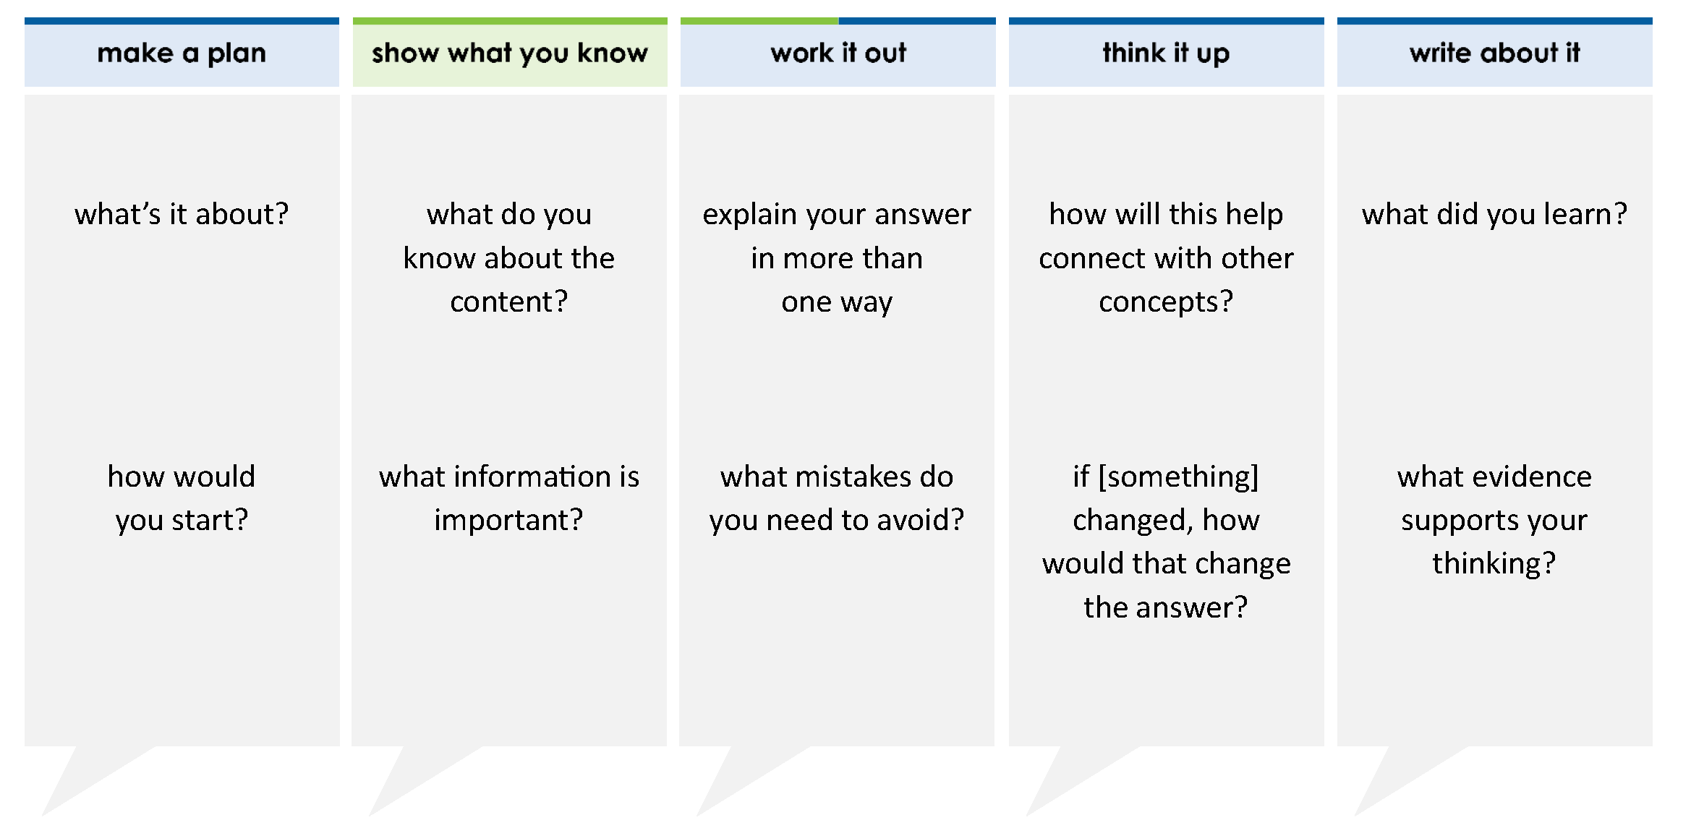
The table shows the average inches of rainfall per year of four different cities.
A meteorologist listed the cities in order from the one that has the least amount of rainfall to the one that has the greatest amount of rainfall. Which city will the meteorologist list second?
A City A
B City B
C City C
D City D
City | A | B | C | D
Rainfall (inches) | 39.23 | 34.25 | 34.7 | 39.4
thinkalong routine
stimulus
Notes:
Throughout the week, use the guiding questions from the thinkalong routine to lead student thinking and discussion around the selected stimulus (problem, text, or visual) aligned to a high-impact standard/concept.

Slide 3
make a plan
Notes:
make a plan
The goal of the first 5-10 minutes of the routine is just for students to explore. We are engaging the “tools to know” process standards and using the selected problem, text, or visual to activate memory around the designated content for the week.
If you’re using a problem as the stimulus, students don’t solve the problem or even see the answer choices yet! In this part of the routine, students practice making a plan, getting started, and thinking about what they will need to answer the question based on the vocabulary and/or visuals included.

Slide 4
what’s it about?
average inches of rainfall per year
City | A | B | C | D
Rainfall (inches) | 39.23 | 34.25 | 34.7 | 39.4
how would you start?
Notes:
make a plan: Use the guiding questions on the routine to drive the thinking and discussion with students as you explore the selected stimulus.
This item was selected to address, loopback, or intervene on comparing decimals because:
Comparing and ordering decimals requires students to have a grasp on place value of decimals.
Comparing/ordering decimals supports and scaffolds students’ ability to order rational numbers in secondary grades.

Slide 5
show what you know
Notes:
show what you know
The goal of the second 10 minutes in the routine is for students to talk using the problem, text, or visual to show what they know about this concept! This part of the routine allows students and teacher to talk about, share, and clarify the content (vocabulary, visuals, activities, common mistakes, connections, key ideas, important info/details, etc.).

Slide 6
what do you know about the content?
average inches of rainfall per year
City | A | B | C | D
Rainfall (inches) | 39.23 | 34.25 | 34.7 | 39.4
what information is important?
Notes:
show what you know - option 1: Use these questions from the routine, along with the selected stimulus, to activate memory, review content, correct learning mistakes, and clarify misconceptions. Be sure discussion includes important information related to the selected stimulus.
important information about this item:
Clues include and require an understanding of important academic vocabulary: tenths, hundredths, thousandths, greater, less, equal.
Students must read and clarify all of the clues:
Some values are missing a hundredths place so we will need to fill those in with zeros
Line up the decimals to ensure comparing similar place values
Students would benefit from creating a place value chart, identifying the place values of each digit, representing these values multiple ways (base 10 blocks, expanded form, expanded notation, etc.).

Slide 7



just the facts
average inches of rainfall per year
City | A | B | C | D
Rainfall (inches) | 39.23 | 34.25 | 34.7 | 39.4
Notes:
show what you know - option 2: just the facts (rehearsal and practice instructional strategy)
purpose
The purpose is to help student identify the most important details from a problem or visual.
instructions
Students read a text and observe an image.
They determine 3 facts (interesting, useful, most important) from the stem.
An interesting fact might be that C and D are missing hundredths place.
A useful fact might be that all of the tens place values are the same.
A most important fact might be that the numbers are horizontal and could be vertical to help see it better.
With a thinking partner, students justify why they chose a particular fact.
Observe students’ thinking and clarify/verify as appropriate.

Slide 8
work it out
Notes:
work it out
The goal of the third 10 minutes of the routine is for students to work out the problem and defend their answer. We want students to prove why their chosen response is right and explain why the incorrect answers are wrong.

Slide 9
The table shows the average inches of rainfall per year of four different cities.
A meteorologist listed the cities in order from the one that has the least amount of rainfall to the one that has the greatest amount of rainfall. Which city will the meteorologist list second?
A City A
B City B
C City C
D City D
explain your answer in more than one way
City | A | B | C | D
Rainfall (inches) | 39.23 | 34.25 | 34.7 | 39.4
what mistakes do you need to avoid?
Notes:
work it out - option 1: Correct learning mistakes and clarify misconceptions by answering the question but be sure students not only solve but also prove why their chosen response is right and explain why the incorrect answers are wrong.
Be sure discussion includes:
A is incorrect - students likely listed the cities in order from greatest to least rather than least to greatest
B is incorrect - students likely ordered cities B and D by using the digits after the decimal point rather than beginning with the largest place value
C is incorrect - students likely ordered the cities from greatest to least and likely used the digits after the decimal points rather than starting with the greatest place value
D is correct

Slide 10
make the case
The table shows the average inches of rainfall per year of four different cities.
A meteorologist listed the cities in order from the one that has the least amount of rainfall to the one that has the greatest amount of rainfall. Which city will the meteorologist list second?
A City A
B City B
C City C
D City D
defend why your answer might be correct/incorrect
what 1-2 pieces of evidence do you have?
City | A | B | C | D
Rainfall (inches) | 39.23 | 34.25 | 34.7 | 39.4
Notes:
work it out - option 2: make the case (learning from mistakes instructional strategy)
free virtual dice available in the lead4ward app and at: www.lead4ward.com/dice
purpose
Students correct learning mistakes and clarify misconceptions by justifying/proving why their assigned response is right OR explain why their assigned response is an incorrect answer.
instructions
Organize students into groups (no larger than 4).
Assign each team a potential answer (choice).
Groups huddle to determine if their answer choice is “correct/innocent” by explaining why and providing (at most) 2 pieces of evidence…or “incorrect/guilty” by explaining why and providing (at most) 2 pieces of evidence.
Students prosecute and defend arguments.
Observe students’ thinking/responses and clarify/verify as appropriate.
be sure discussion includes:
Visuals or models students might use to prove their justification.
Discourse around strategies, clues and/or vocabulary that support their justification.
The chosen incorrect answer(s) suggests a common misconception, guessing pattern, clue picking, stopping too soon, and relying on tricks.
Student-driven discourse.

Slide 11
think it up
Notes:
think it up
The goal of the fourth 10 minutes of the routine is for us to change things up so students can practice with novelty and transfer.

Slide 12
The table shows the average inches of rainfall per year of four different cities.
A meteorologist listed the cities in order from the one that has the least amount of rainfall to the one that has the greatest amount of rainfall. Which city will the meteorologist list second?
A City A
B City B
C City C
D City D
how will this help connect with decimal place value?
City | A | B | C | D
Rainfall (inches) | 39.23 | 34.25 | 34.7 | 39.4
if you listed greatest to least, how would that change the answer?
Notes:
think it up - option 1: Use the guiding questions on the routine to drive the thinking and discussion with students as they reflect on the work of the routine so far -- the thinking around the content and the problem, text or visual. Then, have students analyze how all of that can help them as they work on or think through other content or solving future problems.

Slide 13
compare/contrast model
The table shows the average inches of rainfall per year of four different cities.
A meteorologist listed the cities in order from the one that has the least amount of rainfall to the one that has the greatest amount of rainfall. Which city will the meteorologist list second?
A City A
B City B
C City C
D City D
The table shows how fast each competitor completed a race.
If the times are ordered from least to greatest number of minutes, in what position would Ervin’s time be?
A second
B third
C fourth
D fifth
City | A | B | C | D
Rainfall (inches) | 39.23 | 34.25 | 34.7 | 39.4
competitor | time
Nancy | 8.069
Gayla | 7.360
Kim | 8.584
Jose | 7.40
Ervin | 8.096
Notes:
think it up - option 2: compare/contrast model (extending thinking instructional strategy)
purpose
This is an effective strategy to facilitate a structured, supported, and engaging way for kids to answer the “think it up” questions and analyze 2 similar yet different items or visuals aligned to the same standard.
instructions
Divide students into groups of 3.
In each group, students CONTRAST the items by discussing/writing 2-3 attributes of each item.
In each group, students COMPARE the items by discussing/writing 2-3 attributes both items share.
Groups share out 1 of their differences and 1 of their similarities.
Observe and listen to students’ thinking and clarify/verify as appropriate.

Slide 14
write about it
Notes:
write about it
The goal of the last 10 minutes of the routine is for students to reflect on the routine and write about how it affected their understanding and confidence around the content and problem-solving process.

Slide 15
The table shows the average inches of rainfall per year of four different cities.
A meteorologist listed the cities in order from the one that has the least amount of rainfall to the one that has the greatest amount of rainfall. Which city will the meteorologist list second?
A City A
B City B
C City C
D City D
what did you learn?
City | A | B | C | D
Rainfall (inches) | 39.23 | 34.25 | 34.7 | 39.4
what content is important to remember?
what evidence supports your thinking?
write about an important strategy to remember when ordering decimals
Notes:
write about it: The goal of the last 10 minutes of the routine is to solidify learning and have students practice communicating what they know in writing.
Ask students to:
think about the activities, questions, discussions, and the selected problem, text or visual for this week’s thinkalong routine
talk with a partner or in a small group about what they learned and the evidence that supports their thinking
write their answers on a piece of paper or in their notebooks
Review areas in which students may need more support.

