Slide 1





(click on a button to go directly to that step)
Notes:
The thinkalong toolkit includes assessment-style items with answer keys. A digital version (poster) of the thinkalong routine and daily questions for teacher and students’ reference is also included.

Slide 2
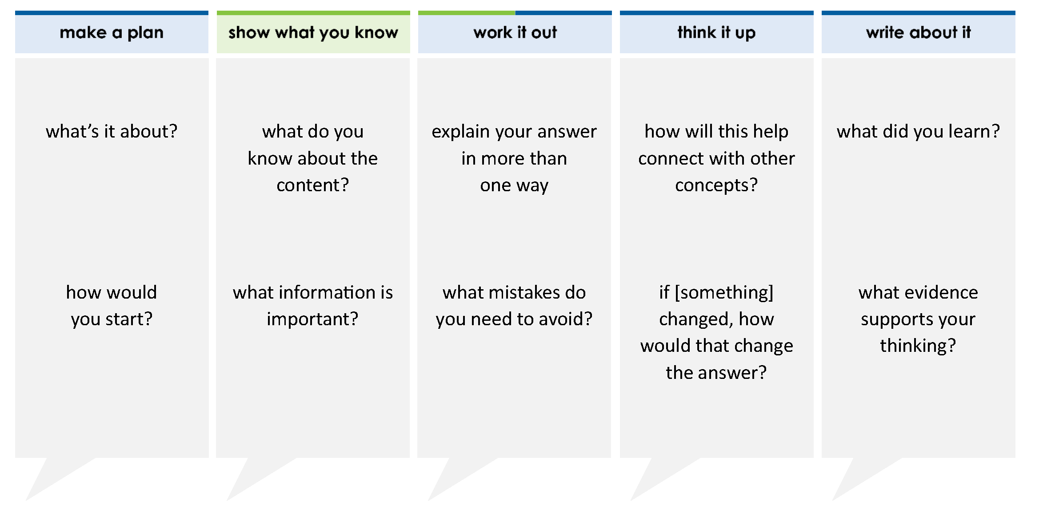
Two numbers are shown. A number in between is missing.
19.034 19.007
Which number can be placed in the box to show the numbers in order from greatest to least?
A 19.32
B 19.03
C 19.004
D 19.035
thinkalong routine
stimulus
Notes:
Throughout the week, use the guiding questions from the thinkalong routine to lead student thinking and discussion around the selected stimulus (problem, text, or visual) aligned to a high-impact standard/concept.

Slide 3
make a plan
Notes:
make a plan
The goal of the first 5-10 minutes of the routine is just for students to explore. We are engaging the “tools to know” process standards and using the selected problem, text, or visual to activate memory around the designated content for the week.
If you’re using a problem as the stimulus, students don’t solve the problem or even see the answer choices yet! In this part of the routine, students practice making a plan, getting started, and thinking about what they will need to answer the question based on the vocabulary and/or visuals included.

Slide 4
what’s it about?
Two numbers are shown. A number in between is missing.
19.034 19.007
how would you start?
Notes:
make a plan: Use the guiding questions on the routine to drive the thinking and discussion with students as you explore the selected stimulus.
This item was selected to address, loopback, or intervene on comparing decimals because students can often compare and/or order numbers, but this higher order thinking of generating a number that fits between two numbers requires students to have a grasp on linear thinking related to comparing/ordering.

Slide 5
show what you know
Notes:
show what you know
The goal of the second 10 minutes in the routine is for students to talk using the problem, text, or visual to show what they know about this concept! This part of the routine allows students and teacher to talk about, share, and clarify the content (vocabulary, visuals, activities, common mistakes, connections, key ideas, important info/details, etc.).

Slide 6
what do you know about the content?
Two numbers are shown. A number in between is missing.
19.034 19.007
what information is important?
Notes:
show what you know - option 1: Use these questions from the routine, along with the selected stimulus, to activate memory, review content, correct learning mistakes, and clarify misconceptions. Be sure discussion includes important information related to the selected stimulus.
important information about this item:
Clues include and require an understanding of important academic vocabulary: between, greater, less, thousandths, hundredths.
Students must read and clarify all of the clues:
The number must be less than 19.034 but greater than 19.007
19.034 is actually greater than 19.007 since 34 thousandths is greater than 7 thousandths
Students would benefit from:
Building a place value chart
Discussing why 34 thousandths is greater than 7 thousandths and how they know
Viewing the numbers on a number line

Slide 7



just the facts
Two numbers are shown. A number in between is missing.
19.034 19.007
Notes:
show what you know - option 2: just the facts (rehearsal and practice instructional strategy)
purpose
The purpose is to help student identify the most important details from a problem or visual.
instructions
Students read a text and observe an image.
They determine 3 facts (interesting, useful, most important) from the stem.
An interesting fact might be that 34 thousandths is first and 7 thousandths is last.
A useful fact might be that both numbers have tenths, hundredths, and thousandths place.
A most important fact might be that the numbers are side by side instead of vertical.
With a thinking partner, students justify why they chose a particular fact.
Observe students’ thinking and clarify/verify as appropriate.

Slide 8
work it out
Notes:
work it out
The goal of the third 10 minutes of the routine is for students to work out the problem and defend their answer. We want students to prove why their chosen response is right and explain why the incorrect answers are wrong.

Slide 9
Two numbers are shown. A number in between is missing.
19.034 19.007
Which number can be placed in the box to show the numbers in order from greatest to least?
A 19.32
B 19.03
C 19.004
D 19.035
explain your answer in more than one way
what mistakes do you need to avoid?
Notes:
work it out - option 1: Correct learning mistakes and clarify misconceptions by answering the question but be sure students not only solve but also prove why their chosen response is right and explain why the incorrect answers are wrong.
Be sure discussion includes:
The stimulus is greatest to least (left to right).
We could add a thousandths place to answers A and B to line them up and determine if they are less than 19.034 but greater than 19.007.
Identifying any numbers less than 19.007 or any numbers greater than 19.035 (i.e. C and D) that can be eliminated.

Slide 10
make the case
Two numbers are shown. A number in between is missing.
19.034 19.007
Which number can be placed in the box to show the numbers in order from greatest to least?
A 19.32
B 19.03
C 19.004
D 19.035
defend why your answer might be correct/incorrect
what 1-2 pieces of evidence do you have?
Notes:
work it out - option 2: make the case (learning from mistakes instructional strategy)
free virtual dice available in the lead4ward app and at: www.lead4ward.com/dice
purpose
Students correct learning mistakes and clarify misconceptions by justifying/proving why their assigned response is right OR explain why their assigned response is an incorrect answer.
instructions
Organize students into groups (no larger than 4).
Assign each team a potential answer (choice).
Groups huddle to determine if their answer choice is “correct/innocent” by explaining why and providing (at most) 2 pieces of evidence…or “incorrect/guilty” by explaining why and providing (at most) 2 pieces of evidence.
Students prosecute and defend arguments.
Observe students’ thinking/responses and clarify/verify as appropriate.
be sure discussion includes:
Visuals or models students might use to prove their justification.
Discourse around strategies, clues and/or vocabulary that support their justification.
The chosen incorrect answer(s) suggests a common misconception, guessing pattern, clue picking, stopping too soon, and relying on tricks.
Student-driven discourse.

Slide 11
think it up
Notes:
think it up
The goal of the fourth 10 minutes of the routine is to change things up so students can practice with novelty and transfer.

Slide 12
Two numbers are shown. A number in between is missing.
19.034 19.007
Which number can be placed in the box to show the numbers in order from greatest to least?
A 19.32
B 19.03
C 19.004
D 19.035
how will this help connect with number lines?
if the first number was a whole number ONLY, how would that change the answer?
Notes:
think it up - option 1: Use the guiding questions on the routine to drive the thinking and discussion with students as they reflect on the work of the routine so far -- the thinking around the content and the problem, text or visual. Then, have students analyze how all of that can help them as they work on or think through other content or solving future problems.
If 19.034 was just 19, then students be looking for a number greater than 19.000 but less than 19.007 (19.001-19.006), making C the answer.

Slide 13
compare/contrast model
Four friends are keeping track of how much water they drink each day. The table shows the amount of water each friend drinks in a day.
Miguel drank less than Olivia but more than Tiana. Which number could be the amount of water Miguel drank?
A 44.08
B 41.79
C 44.81
D 44.699
Two numbers are shown. A number in between is missing.
19.034 19.007
Which number can be placed in the box to show the numbers in order from greatest to least?
A 19.32
B 19.03
C 19.004
D 19.035
friend | Brett | Tiana | Miguel | Olivia
oz of water | 41.504 | 44.7 |  | 44.86
Notes:
think it up - option 2 compare/contrast model (extending thinking instructional strategy)
purpose
This is an effective strategy to facilitate a structured, supported, and engaging way for kids to answer the “think it up” questions and analyze 2 similar yet different items or visuals aligned to the same standard.
instructions
Divide students into groups of 3.
In each group, students CONTRAST the items by discussing/writing 2-3 attributes of each item.
In each group, students COMPARE the items by discussing/writing 2-3 attributes both items share.
Groups share out 1 of their differences and 1 of their similarities.
Observe and listen to students’ thinking and clarify/verify as appropriate.

Slide 14
write about it
Notes:
write about it
The goal of the last 10 minutes of the routine is for students to reflect on the routine and write about how it affected their understanding and confidence around the content and problem-solving process.

Slide 15
Two numbers are shown. A number in between is missing.
19.034 19.007
Which number can be placed in the box to show the numbers in order from greatest to least?
A 19.32
B 19.03
C 19.004
D 19.035
what did you learn?
what evidence supports your thinking?
Notes:
write about it: The goal of the last 10 minutes of the routine is to solidify learning and have students practice communicating what they know in writing.
Ask students to:
think about the activities, questions, discussions, and the selected problem, text or visual for this week’s thinkalong routine
talk with a partner or in a small group about what they learned and the evidence that supports their thinking
write their answers on a piece of paper or in their notebooks
Review areas in which students may need more support.

