Slide 1





(click on a button to go directly to that step)
Notes:
The thinkalong toolkit includes assessment-style items with answer keys. A digital version (poster) of the thinkalong routine and daily questions for teacher and students’ reference is also included.

Slide 2
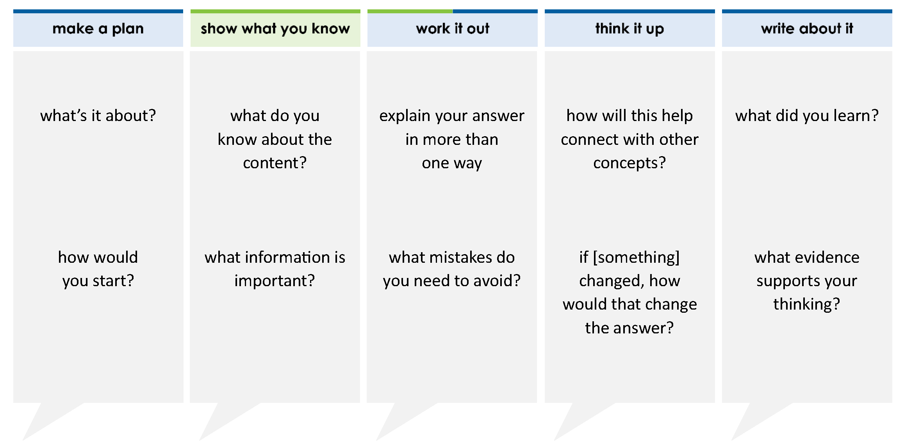
A list of numbers is shown.
83.6 83 83.74 82.362
Which comparison is true?
A 82.362 > 83.74 > 83.6 > 83
B 83.6 > 83.74 > 82.362 > 83
C 82.362 > 83 > 83.6 > 83.74
D 83.74 > 83.6 > 83 > 82.362
thinkalong routine
stimulus
Notes:
Throughout the week, use the guiding questions from the thinkalong routine to lead student thinking and discussion around the selected stimulus (problem, text, or visual) aligned to a high-impact standard/concept.

Slide 3
make a plan
Notes:
make a plan
The goal of the first 5-10 minutes of the routine is just for students to explore. We are engaging the “tools to know” process standards and using the selected problem, text, or visual to activate memory around the designated content for the week.
If you’re using a problem as the stimulus, students don’t solve the problem or even see the answer choices yet! In this part of the routine, students practice making a plan, getting started, and thinking about what they will need to answer the question based on the vocabulary and/or visuals included.

Slide 4
what’s it about?
A list of numbers is shown.
83.6 83 83.74 82.362
how would you start?
Notes:
make a plan: Use the guiding questions on the routine to drive the thinking and discussion with students as you explore the selected stimulus.
This item was selected to address, loopback, or intervene on comparing decimals because:
Students must have a grasp on comparing decimals before comparing/ordering rational numbers.
Decimals of equal value are often misunderstood (e.g., 83 and 83.00) or (83.6 and 83.60).

Slide 5
show what you know
Notes:
show what you know
The goal of the second 10 minutes in the routine is for students to talk using the problem, text, or visual to show what they know about this concept! This part of the routine allows students and teacher to talk about, share, and clarify the content (vocabulary, visuals, activities, common mistakes, connections, key ideas, important info/details, etc.).

Slide 6
what do you know about the content?
A list of numbers is shown.
83.6 83 83.74 82.362
what information is important?
Notes:
show what you know - option 1: Use these questions from the routine, along with the selected stimulus, to activate memory, review content, correct learning mistakes, and clarify misconceptions. Be sure discussion includes important information related to the selected stimulus.
important information about this item:
Clues include and require an understanding of important academic vocabulary: tenths, hundredths, thousandths, compare, order, greater, less.
Students must read and clarify all of the clues.
Students would benefit from:
Building a place value chart to place the numbers in order
Then fill in any missing values to make each number have tens, ones, tenths, hundredths, and thousandths places
Making sure the decimal places are aligned might help if a student chooses not to use a place value chart

Slide 7



FACT
FIB
Notes:
show what you know - option 2: fact or fib (rehearsal and practice instructional strategy)
purpose
Students review important content and clarify misconceptions by determining which statements are facts and which are fibs in a fact or fib showdown game. Fact or fib is an effective strategy for brain dumping and to activate memory, review content, correct learning mistakes, and clarify misconceptions and that will engage students with the guiding questions from the “show what you know” column and selected weekly stimulus.
instructions
Students create FACT and FIB cards using post it notes, index cards, scratch paper, white boards or use their fingers.
They hold their cards while teacher presents students with a statement (fact or fib) relating to the concept, visual, text, or test item.
Allow students 5-8 seconds to infer if the statement is a fact or a fib.
Students think and prepare to justify their answer until the teacher calls out, “One! Two! Three! Showdown!” at which time all students hold up either the fact or fib card to represent their choice.
Students then take turns explaining and justifying their thinking with a partner or small group.
Observe students’ thinking and clarify/verify as appropriate.
Reveal correct answer and provide rationale.

Slide 8
FACT!
all the numbers have the same value in the tens place
A list of numbers is shown.
83.6 83 83.74 82.362
10s | 1s | . | 0.1ths | 0.01ths | 0.001ths
8 | 3 | . | 6
8 | 3 | .
8 | 3 | . | 7 | 4
8 | 2 | . | 3 | 6 | 2
1-2-3 SHOWDOWN
Notes:
show what you know - option 2, round 1 rationale
This is a FACT because all numbers have the digit 8 in the tens place. Starting with the largest place value will also help set up students for success as they navigate this problem.

Slide 9
83.74 = 83.740
FACT!
A list of numbers is shown.
83.6 83 83.74 82.362
10s | 1s | . | 0.1ths | 0.01ths | 0.001ths
8 | 3 | . | 7 | 4
8 | 3 | . | 7 | 4 | 0
1-2-3 SHOWDOWN
Notes:
show what you know - option 2, round 2 rationale
This is a FACT because if 83.74 is extended to the thousandths place, it would have a 0 in that place value. 74 hundredths is equivalent to 740 thousandths.
This thinking is helpful when students solve the problem. They may need to extend all decimals to the thousandths place by placing “0”s as needed.

Slide 10
83.600 > 83.6
10s | 1s | . | 0.1ths | 0.01ths | 0.001ths
8 | 3 | . | 6 | 0 | 0
8 | 3 | . | 6
A list of numbers is shown.
83.6 83 83.74 82.362
83.600 = 83.600
FIB!
1-2-3 SHOWDOWN
Notes:
show what you know - option 2, round 3 rationale
This is a FIB because the two values are equivalent.
This thinking is helpful when students solve the problem. They may need to extend all decimals to the thousandths place by placing “0”s as needed.

Slide 11
work it out
Notes:
work it out
The goal of the third 10 minutes of the routine is for students to work out the problem and defend their answer. We want students to prove why their chosen response is right and explain why the incorrect answers are wrong.

Slide 12
A list of numbers is shown.
83.6 83 83.74 82.362
Which comparison is true?
A 82.362 > 83.74 > 83.6 > 83
B 83.6 > 83.74 > 82.362 > 83
C 82.362 > 83 > 83.6 > 83.74
D 83.74 > 83.6 > 83 > 82.362
explain your answer in more than one way
what mistakes do you need to avoid?
Notes:
work it out - option 1: Correct learning mistakes and clarify misconceptions by answering the question but be sure students not only solve but also prove why their chosen response is right and explain why the incorrect answers are wrong.
Be sure discussion includes:
That the answers are all reading greatest to least
A strategy that might help when analyzing various numbers like this in horizontal form (e.g., ordering the stimulus vertically first then finding the answer choice that matches)

Slide 13
make the case
A list of numbers is shown.
83.6 83 83.74 82.362
Which comparison is true?
A 82.362 > 83.74 > 83.6 > 83
B 83.6 > 83.74 > 82.362 > 83
C 82.362 > 83 > 83.6 > 83.74
D 83.74 > 83.6 > 83 > 82.362
defend why your answer might be correct/incorrect
what 1-2 pieces of evidence do you have?
Notes:
work it out - option 2: make the case (learning from mistakes instructional strategy)
free virtual dice available in the lead4ward app and at: www.lead4ward.com/dice
purpose
Students correct learning mistakes and clarify misconceptions by justifying/proving why their assigned response is right OR explain why their assigned response is an incorrect answer.
instructions
Organize students into groups (no larger than 4).
Assign each team a potential answer (choice).
Groups huddle to determine if their answer choice is “correct/innocent” by explaining why and providing (at most) 2 pieces of evidence…or “incorrect/guilty” by explaining why and providing (at most) 2 pieces of evidence.
Students prosecute and defend arguments.
Observe students’ thinking/responses and clarify/verify as appropriate.
be sure discussion includes:
Visuals or models students might use to prove their justification.
Discourse around strategies, clues and/or vocabulary that support their justification.
The chosen incorrect answer(s) suggests a common misconception, guessing pattern, clue picking, stopping too soon, and relying on tricks.
Student-driven discourse.

Slide 14
think it up
Notes:
think it up
The goal of the fourth 10 minutes of the routine is for us to change things up so students can practice with novelty and transfer.

Slide 15
how will this help connect with place value?
A list of numbers is shown.
83.6 83 83.74 82.362
Which comparison is true?
A 82.362 > 83.74 > 83.6 > 83
B 83.6 > 83.74 > 82.362 > 83
C 82.362 > 83 > 83.6 > 83.74
D 83.74 > 83.6 > 83 > 82.362
if the comparison symbols were changed to read least to greatest, how would that change the answer?
Notes:
think it up - option 1: Use the guiding questions on the routine to drive the thinking and discussion with students as they reflect on the work of the routine so far -- the thinking around the content and the problem, text or visual. Then, have students analyze how all of that can help them as they work on or think through other content or solving future problems.
If the comparison symbols were changed to read least to greatest then answer choice C would be correct.

Slide 16
odd one out
A list of numbers is shown.
83.6 83 83.74 82.362
Which comparison is true?
A 82.362 > 83.74 > 83.6 > 83
B 83.6 > 83.74 > 82.362 > 83
C 82.362 > 83 > 83.6 > 83.74
D 83.74 > 83.6 > 83 > 82.362
A list of numbers is shown.
3.87 3.9 3.862 3.904
The numbers will be listed from greatest to least. Which number should be listed third?
A 3.87
B 3.9
C 3.862
D 3.904
Two numbers are shown. A number in between is missing.
5.047 5.003
Which number can be placed in the box to show the numbers in order from greatest to least?
A 5.24
B 5.02
C 5.002
D 5.025
The table shows the weight in tons of four different types of whales.
Which statement is true?
A The weight of whale V is less than the weight of whale X
B The weight of whale T is greater than the weight of whale U
C The weight of whale U is less than the weight of whale X
D The weight of whale V is greater than the weight of whale T
whale | T | U | V | X
weight (tons) | 42.158 | 42.203 | 42.17 | 42.127
Notes:
think it up - option 2 odd one out (extending thinking instructional strategy)
purpose
Students compare/contrast four visuals, assessment questions, words, characters, historical figures, etc. and justify their thinking by defending which they think is the odd one out.
instructions
Divide students into groups of 4.
In each group, students divide the images/problems amongst their group and take turns describing their image/problem.
Students compare and contrast the images/problems.
Students determine which one is the odd one out and why.
Groups share out their selected odd one out and justification.
Observe and listen to students’ thinking and clarify/verify as appropriate.

Slide 17
write about it
Notes:
write about it
The goal of the last 10 minutes of the routine is for students to reflect on the routine and write about how it affected their understanding and confidence around the content and problem-solving process.

Slide 18
what did you learn?
A list of numbers is shown.
83.6 83 83.74 82.362
Which comparison is true?
A 82.362 > 83.74 > 83.6 > 83
B 83.6 > 83.74 > 82.362 > 83
C 82.362 > 83 > 83.6 > 83.74
D 83.74 > 83.6 > 83 > 82.362
what evidence supports your thinking?
why might a student accidentally think A is correct?
Notes:
write about it: The goal of the last 10 minutes of the routine is to solidify learning and have students practice communicating what they know in writing.
Ask students to:
think about the activities, questions, discussions, and the selected problem, text or visual for this week’s thinkalong routine
talk with a partner or in a small group about what they learned and the evidence that supports their thinking
write their answers on a piece of paper or in their notebooks
Review areas in which students may need more support.

