Slide 1





(click on a button to go directly to that step)
Notes:
The thinkalong toolkit includes assessment-style items with answer keys. A digital version (poster) of the thinkalong routine and daily questions for teacher and students’ reference is also included.

Slide 2
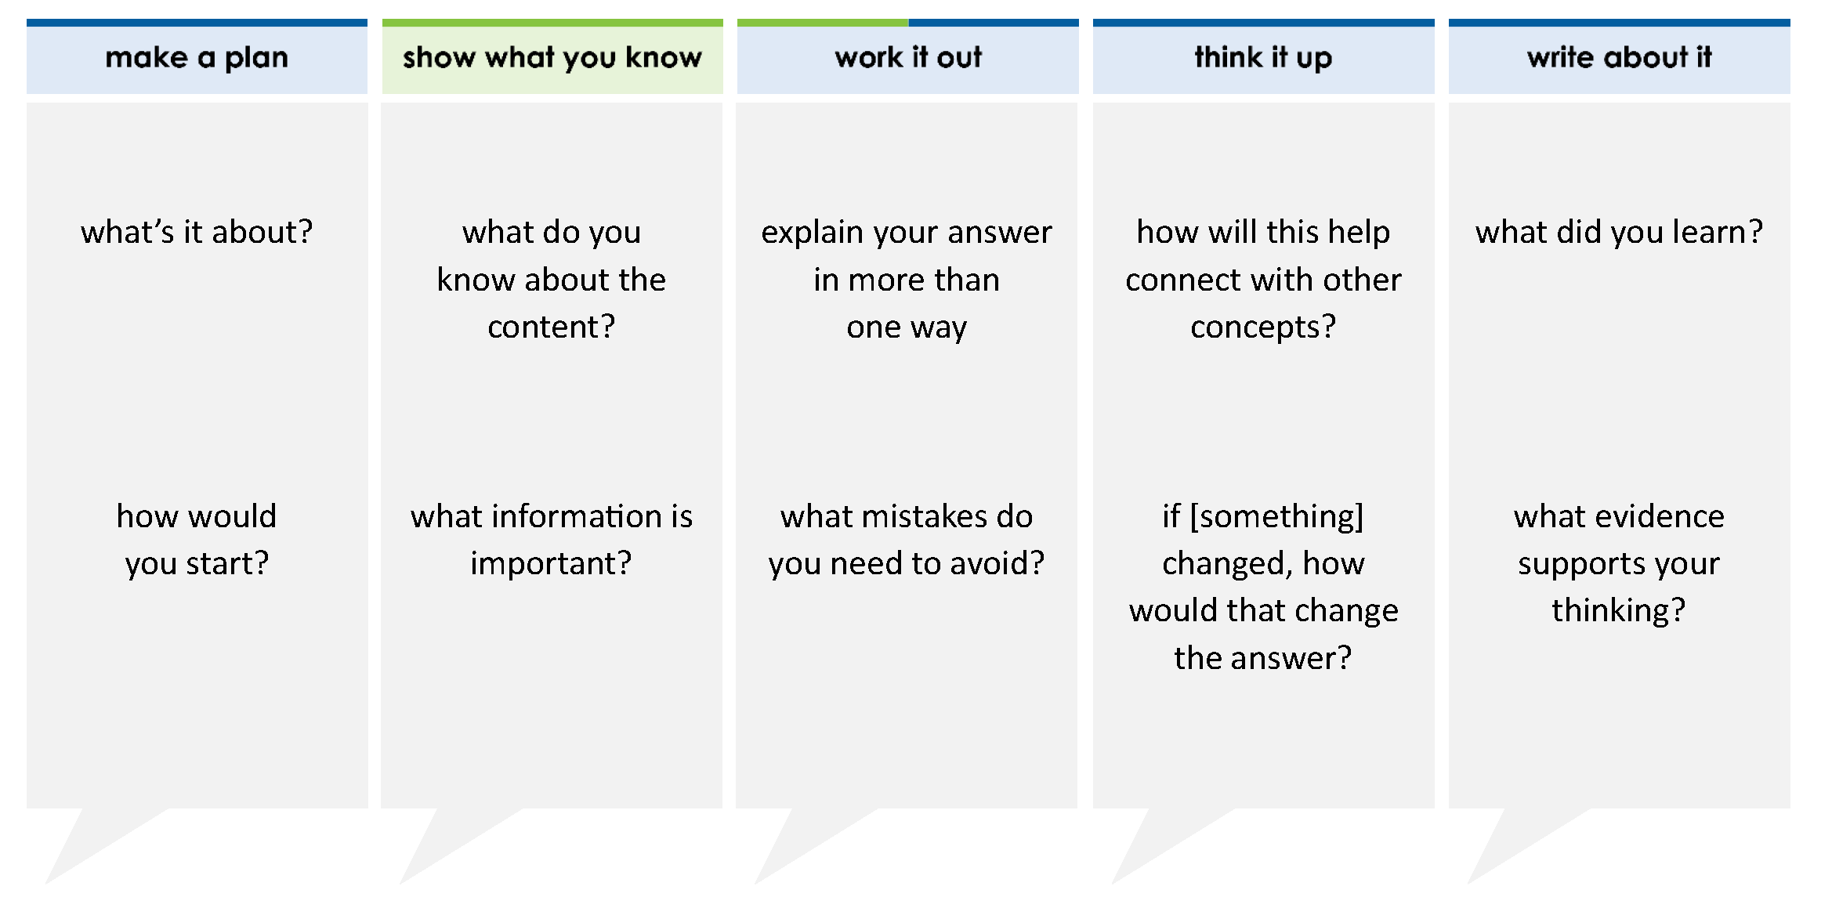
Caleb has a roll of wrapping paper that is 100 inches long. While wrapping gifts, he cuts 4 pieces that are each 22 inches long.
Which equation can be used to find w, the length of wrapping paper left over in inches?
A 100 = (22 × 4) – w
B 100 = (22 + 4) × w
C 100 = (22 × 4) + w
D 100 = (22 × 4) ÷ w
thinkalong routine
stimulus
Notes:
Throughout the week, use the guiding questions from the thinkalong routine to lead student thinking and discussion around the selected stimulus (problem, text, or visual) aligned to a high-impact standard/concept.

Slide 3
make a plan
Notes:
make a plan
The goal of the first 5-10 minutes of the routine is just for students to explore. We are engaging the “tools to know” process standards and using the selected problem, text, or visual to activate memory around the designated content for the week.
If you’re using a problem as the stimulus, students don’t solve the problem or even see the answer choices yet! In this part of the routine, students practice making a plan, getting started, and thinking about what they will need to answer the question based on the vocabulary and/or visuals included.

Slide 4
what’s it about?
Caleb has a roll of wrapping paper that is 100 inches long. While wrapping gifts, he cuts 4 pieces that are each 22 inches long.
how would you start?
Notes:
make a plan: Use the guiding questions on the routine to drive the thinking and discussion with students as you explore the selected stimulus.
This item was selected to address, loopback, or intervene on whole number operations because it asks students to represent a multi-step problem using an equation with a variable. This is a concept that will continue into future learning.

Slide 5
show what you know
Notes:
show what you know
The goal of the second 10 minutes in the routine is for students to talk using the problem, text, or visual to show what they know about this concept! This part of the routine allows students and teacher to talk about, share, and clarify the content (vocabulary, visuals, activities, common mistakes, connections, key ideas, important info/details, etc.).

Slide 6
what do you know about the content?
Caleb has a roll of wrapping paper that is 100 inches long. While wrapping gifts, he cuts 4 pieces that are each 22 inches long.
what information is important?
Notes:
show what you know - option 1: Use these questions from the routine, along with the selected stimulus, to activate memory, review content, correct learning mistakes, and clarify misconceptions. Be sure discussion includes important information related to the selected stimulus.
important information about this item:
Clues include and require an understanding of important academic vocabulary: multiplication, subtraction (any operation vocabulary that connects to actions implied).
Students must read and clarify all the clues:
Total length of the paper is 100 inches
Cuts 4 pieces implies he separates it from the whole (which could mean subtraction but if we consider the left over it could also mean addition)
Each piece is 22 inches long implies that we can multiply 4 pieces by 22 inches
This is a multi-step problem
Students would benefit from drawing a visual, such as a strip diagram, to represent this information.

Slide 7



just the facts
Caleb has a roll of wrapping paper that is 100 inches long. While wrapping gifts, he cuts 4 pieces that are each 22 inches long.
Notes:
show what you know - option 2: just the facts (rehearsal and practice instructional strategy)
purpose
The purpose is to help student identify the most important details from a problem or visual.
instructions
Students read a text and observe an image.
They determine 3 facts (interesting, useful, most important) from the stem.
An interesting fact could be that he cuts 4 pieces from the main roll.
A useful fact can be that each piece is 22 inch long.
An important fact can be that we started with 100 in and now 88 in have been cut from it.
With a thinking partner, students justify why they chose a particular fact.
Observe students’ thinking and clarify/verify as appropriate.

Slide 8
work it out
Notes:
work it out
The goal of the third 10 minutes of the routine is for students to work out the problem and defend their answer. We want students to prove why their chosen response is right and explain why the incorrect answers are wrong.

Slide 9
Caleb has a roll of wrapping paper that is 100 inches long. While wrapping gifts, he cuts 4 pieces that are each 22 inches long.
Which equation can be used to find w, the length of wrapping paper left over in inches?
A 100 = (22 × 4) – w
B 100 = (22 + 4) × w
C 100 = (22 × 4) + w
D 100 = (22 × 4) ÷ w
explain your answer in more than one way
what mistakes do you need to avoid?
Notes:
work it out - option 1: Correct learning mistakes and clarify misconceptions by answering the question but be sure students not only solve but also prove why their chosen response is right and explain why the incorrect answers are wrong.
Be sure discussion includes:
A is incorrect - students most likely thought “left over” meant to subtract.
B is incorrect - students multiplied rather than added; they most likely confused the two operations of saw the word “each” and assumed multiplication.
C is CORRECT. We already know the amount cut so we are looking for a way to find what's left - this is the commutative property (fact family). If the problem was written as w = 100 - (22 x 4) then we would need subtraction. Exploring multiple ways to represent the problem is essential.
D is incorrect - students most likely thought they needed to divide since Caleb cut the wrapping paper into 4 equal pieces.

Slide 10
make the case
Caleb has a roll of wrapping paper that is 100 inches long. While wrapping gifts, he cuts 4 pieces that are each 22 inches long.
Which equation can be used to find w, the length of wrapping paper left over in inches?
A 100 = (22 × 4) – w
B 100 = (22 + 4) × w
C 100 = (22 × 4) + w
D 100 = (22 × 4) ÷ w
defend why your answer might be correct/incorrect
what 1-2 pieces of evidence do you have?
Notes:
work it out - option 2: make the case (learning from mistakes instructional strategy)
free virtual dice available in the lead4ward app and at: www.lead4ward.com/dice
purpose
Students correct learning mistakes and clarify misconceptions by justifying/proving why their assigned response is right OR explain why their assigned response is an incorrect answer.
instructions
Organize students into groups (no larger than 4).
Assign each team a potential answer (choice).
Groups huddle to determine if their answer choice is “correct/innocent” by explaining why and providing (at most) 2 pieces of evidence…or “incorrect/guilty” by explaining why and providing (at most) 2 pieces of evidence.
Students prosecute and defend arguments.
Observe students’ thinking/responses and clarify/verify as appropriate.
be sure discussion includes:
Visuals or models students might use to prove their justification.
Discourse around strategies, clues and/or vocabulary that support their justification.
The chosen incorrect answer(s) suggests a common misconception, guessing pattern, clue picking, stopping too soon, and relying on tricks.
Student-driven discourse.

Slide 11
think it up
Notes:
think it up
The goal of the fourth 10 minutes of the routine is for us to change things up so students can practice with novelty and transfer.

Slide 12
Caleb has a roll of wrapping paper that is 100 inches long. While wrapping gifts, he cuts 4 pieces that are each 22 inches long.
Which equation can be used to find w, the length of wrapping paper left over in inches?
A 100 = (22 × 4) – w
B 100 = (22 + 4) × w
C 100 = (22 × 4) + w
D 100 = (22 × 4) ÷ w
how will this help connect with strip diagrams?
if the variable (w) switched places with 100, how would that change the answer?
Notes:
think it up - option 1: Use the guiding questions on the routine to drive the thinking and discussion with students as they reflect on the work of the routine so far -- the thinking around the content and the problem, text or visual. Then, have students analyze how all of that can help them as they work on or think through other content or solving future problems.
w = 100 - (22 x 4) is another way to represent the equation.

Slide 13
compare/contrast model
Caleb has a roll of wrapping paper that is 100 inches long. While wrapping gifts, he cuts 4 pieces that are each 22 inches long.
Which equation can be used to find w, the length of wrapping paper left over in inches?
A 100 = (22 × 4) – w
B 100 = (22 + 4) × w
C 100 = (22 × 4) + w
D 100 = (22 × 4) ÷ w
Khalissi earned $595 for selling artwork
she sold 3 paintings for $33 each
she sold 4 sculptures
each sculpture was sold for the same price
The equation shown can be used to find s, the amount of money she earned from each sculpture sold.
s = [595 – (3 × 33)] ÷ 8
What was the amount of money Khalissi earned from each sculpture sold?
A $62
B $496
C $2,442
D none of these
Notes:
think it up - option 2 compare/contrast model (extending thinking instructional strategy)
purpose
This is an effective strategy to facilitate a structured, supported, and engaging way for kids to answer the “think it up” questions and analyze 2 similar yet different items or visuals aligned to the same standard.
instructions
Divide students into groups of 3.
In each group, students CONTRAST the items by discussing/writing 2-3 attributes of each item.
In each group, students COMPARE the items by discussing/writing 2-3 attributes both items share.
Groups share out 1 of their differences and 1 of their similarities.
Observe and listen to students’ thinking and clarify/verify as appropriate.

Slide 14
write about it
Notes:
write about it
The goal of the last 10 minutes of the routine is for students to reflect on the routine and write about how it affected their understanding and confidence around the content and problem-solving process.

Slide 15
what did you learn?
Caleb has a roll of wrapping paper that is 100 inches long. While wrapping gifts, he cuts 4 pieces that are each 22 inches long.
Which equation can be used to find w, the length of wrapping paper left over in inches?
A 100 = (22 × 4) – w
B 100 = (22 + 4) × w
C 100 = (22 × 4) + w
D 100 = (22 × 4) ÷ w
explain why this is a reasonable answer
what evidence supports your thinking?
how will you start when you approach another problem like this?
Notes:
write about it: The goal of the last 10 minutes of the routine is to solidify learning and have students practice communicating what they know in writing.
Ask students to:
think about the activities, questions, discussions, and the selected problem, text or visual for this week’s thinkalong routine
talk with a partner or in a small group about what they learned and the evidence that supports their thinking
write their answers on a piece of paper or in their notebooks
Review areas in which students may need more support.

