Slide 1





(click on a button to go directly to that step)
Notes:
The thinkalong toolkit includes assessment-style items with answer keys. A digital version (poster) of the thinkalong routine and daily questions for teacher and students’ reference is also included.

Slide 2
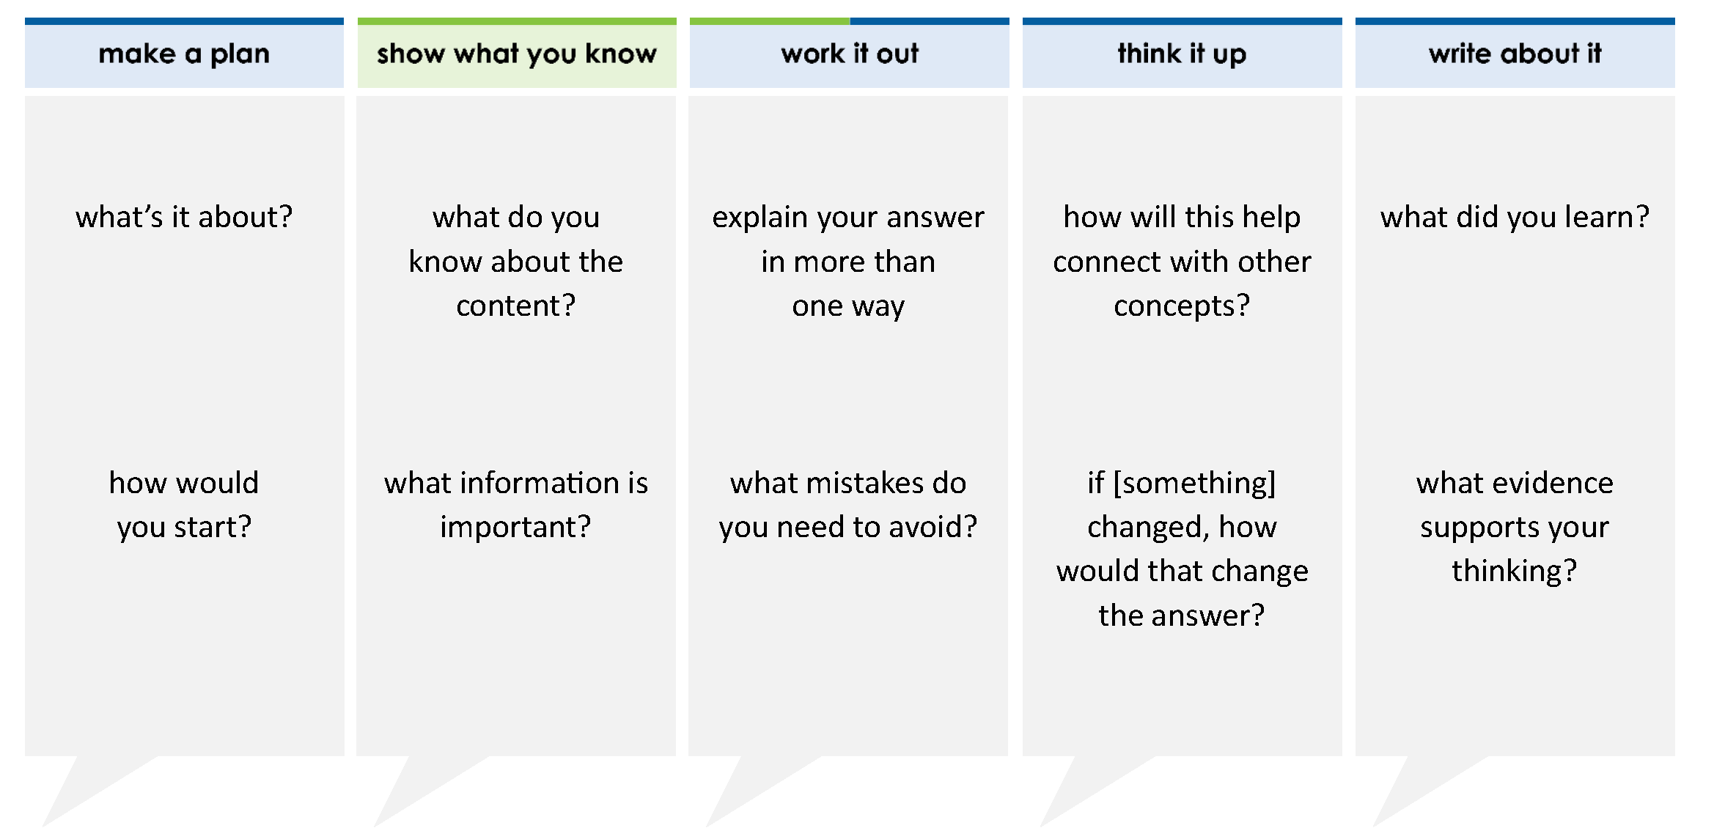
An equation is shown.
r = 1,440 ÷ 15 + 1
What is the value of r?
A 90
B 97
C 96
D 1,426
thinkalong routine
stimulus
Notes:
Throughout the week, use the guiding questions from the thinkalong routine to lead student thinking and discussion around the selected stimulus (problem, text, or visual) aligned to a high-impact standard/concept.

Slide 3
make a plan
Notes:
make a plan
The goal of the first 5-10 minutes of the routine is just for students to explore. We are engaging the “tools to know” process standards and using the selected problem, text, or visual to activate memory around the designated content for the week.
If you’re using a problem as the stimulus, students don’t solve the problem or even see the answer choices yet! In this part of the routine, students practice making a plan, getting started, and thinking about what they will need to answer the question based on the vocabulary and/or visuals included.

Slide 4
what’s it about?
An equation is shown.
r = 1,440 ÷ 15 + 1
how would you start?
Notes:
make a plan: Use the guiding questions on the routine to drive the thinking and discussion with students as you explore the selected stimulus.
This item was selected to address, loopback, or intervene on whole number operations because:
As students progress into more advanced mathematics, they will need to understand the correct order of operations.
This problem provides the equation and asks students to find the value of the variable.

Slide 5
show what you know
Notes:
show what you know
The goal of the second 10 minutes in the routine is for students to talk using the problem, text, or visual to show what they know about this concept! This part of the routine allows students and teacher to talk about, share, and clarify the content (vocabulary, visuals, activities, common mistakes, connections, key ideas, important info/details, etc.).

Slide 6
what do you know about the content?
An equation is shown.
r = 1,440 ÷ 15 + 1
what information is important?
Notes:
show what you know - option 1: Use these questions from the routine, along with the selected stimulus, to activate memory, review content, correct learning mistakes, and clarify misconceptions. Be sure discussion includes important information related to the selected stimulus.
important information about this item:
Clues include and require an understanding of important academic vocabulary: order of operations, multiply, divide, grouping, add, subtract.
Students must read and clarify all of the clues:
When no grouping symbols are evident, do NOT work left to right; go by order of operations
Division precedes addition
Students would benefit from recording their mnemonic (PEMDAS or GEMDAS).

Slide 7



FACT
FIB
Notes:
show what you know - option 2: fact or fib (rehearsal and practice instructional strategy)
purpose
Students review important content and clarify misconceptions by determining which statements are facts and which are fibs in a fact or fib showdown game. Fact or fib is an effective strategy for brain dumping and to activate memory, review content, correct learning mistakes, and clarify misconceptions and that will engage students with the guiding questions from the “show what you know” column and selected weekly stimulus.
instructions
Students create FACT and FIB cards using post it notes, index cards, scratch paper, white boards or use their fingers.
They hold their cards while teacher presents students with a statement (fact or fib) relating to the concept, visual, text, or test item.
Allow students 5-8 seconds to infer if the statement is a fact or a fib.
Students think and prepare to justify their answer until the teacher calls out, “One! Two! Three! Showdown!” at which time all students hold up either the fact or fib card to represent their choice.
Students then take turns explaining and justifying their thinking with a partner or small group.
Observe students’ thinking and clarify/verify as appropriate.
Reveal correct answer and provide rationale.

Slide 8
it does not matter which operation I use first because the final answer will be the same
FIB!
An equation is shown.
r = 1,440 ÷ 15 + 1
1,440 ÷ 15 + 1
1,440 ÷ 15 + 1
1,440 ÷ 16
96 + 1
= 90
= 97
final answers are different
1-2-3 SHOWDOWN
Notes:
show what you know - option 2, round 1 rationale
This is a FIB because order of operations implies that order DOES matter.
This sets the precedence and reminds students that there is a correct order for solving this equation.

Slide 9
GEMDAS
to solve this expression, I would first add 15 + 1
grouping symbols [()]
exponents
multiplication & division
addition & subtraction
An equation is shown.
r = 1,440 ÷ 15 + 1
FIB!
1-2-3 SHOWDOWN
Notes:
show what you know - option 2, round 2 rationale
This is a FIB because addition comes AFTER division in order of operations.
A common error for this problem would be for students to add first or not realize that the order in which they solve the equation impacts the answer.

Slide 10
my first step is to divide 1,440 by 15 then add one to my quotient
FACT!
An equation is shown.
r = 1,440 ÷ 15 + 1
GEMDAS
1,440 ÷ 15 + 1
grouping symbols [()]
exponents
multiplication & division
addition & subtraction
96 + 1
= 97
1-2-3 SHOWDOWN
Notes:
show what you know - option 2, round 3 rationale
This is a FACT because division and multiplication precede addition and subtraction.
Students need to keep in mind that there are 2 steps to solving this problem. They also need opportunities to engage with academic vocabulary.

Slide 11
work it out
Notes:
work it out
The goal of the third 10 minutes of the routine is for students to work out the problem and defend their answer. We want students to prove why their chosen response is right and explain why the incorrect answers are wrong.

Slide 12
An equation is shown.
r = 1,440 ÷ 15 + 1
What is the value of r?
A 90
B 97
C 96
D 1,426
explain your answer in more than one way
what mistakes do you need to avoid?
Notes:
work it out - option 1: Correct learning mistakes and clarify misconceptions by answering the question but be sure students not only solve but also prove why their chosen response is right and explain why the incorrect answers are wrong.
Be sure discussion includes:
A is incorrect - students most likely added 15 + 1 first and then divided 1,440 by the sum
B is correct
C is incorrect - students most likely did not complete all steps and forgot to add 1 to the quotient of 1,440 ÷ 15
D is incorrect - students most likely subtracted 15 from 1,440 rather than dividing

Slide 13

  IQ slap down
A
B
C
D
Round 1 - Worst Answer
Round 2 - Best Distractor
Round 3 - Correct Answer
Notes:
work it out - option 2: IQ slap down (learning from mistakes instructional strategy)
purpose
Students analyze or practice assessment questions by determining the worst answer, the distractor, and the correct answer through a slap-down game.
instructions
Students create a set of A-B-C-D cards using sticky notes, index cards, or scratch paper.
Organize students into thinking partners or small groups.
Facilitate 3 rounds of IQ Slap Down with the selected weekly assessment item:
Round 1: At teacher’s signal, students slap down the WORST answer, justify with their partner, and pick up their cards. Teacher clarifies.
Round 2: At teacher’s signal, students slap down the DISTRACTOR answer, justify with their partner, and pick up their cards. Teacher clarifies.
Round 3: At teacher’s signal, students slap down the CORRECT answer, justify with their partner, and pick up their cards. Teacher clarifies.
Observe students’ thinking and clarify/verify as appropriate.
Answer “work it out questions” from think along routine.

Slide 14
An equation is shown.
r = 1,440 ÷ 15 + 1
What is the value of r?
A 90
B 97
C 96
D 1,426
Round 1 Worst Answer
1-2-3 Slap Down
Notes:
work it out - option 2: round 1 rationale
D is incorrect - students most likely subtracted 15 from 1,440 rather than dividing.

Slide 15
student forgot to multiply/divide BEFORE adding or subtracting
An equation is shown.
r = 1,440 ÷ 15 + 1
What is the value of r?
A 90
B 97
C 96
D 1,426
1,440 ÷ 15 + 1
1,440 ÷ 16
= 90
Round 2 Best Distractor
1-2-3 Slap Down
Notes:
work it out - option 2: round 2 rationale
A is incorrect - students most likely added 15 + 1 first and then divided 1,440 by the sum.
While is A is the "best distractor, C could also be a good distractor since students simply forgot to complete all steps.

Slide 16
1,440 ÷ 15 + 1
An equation is shown.
r = 1,440 ÷ 15 + 1
What is the value of r?
A 90
B 97
C 96
D 1,426
96 + 1
= 97
Round 3 Correct Answer
1-2-3 Slap Down
Notes:
work it out - option 2: round 3 rationale
B is correct because beginning with division yields the quotient 96 and adding one more yields the sum of 97
After IQ slap down, answer the “work it out” questions from the thinkalong routine:
explain your answer in more than one way
what mistakes do you need to avoid?

Slide 17
think it up
Notes:
think it up
The goal of the fourth 10 minutes of the routine is for us to change things up so students can practice with novelty and transfer.

Slide 18
how will this help connect with a word problem?
An equation is shown.
r = 1,440 ÷ 15 + 1
What is the value of r?
A 90
B 97
C 96
D 1,426
if there were grouping symbols around the 15 + 1, how would that change the answer?
Notes:
think it up - option 1: Use the guiding questions on the routine to drive the thinking and discussion with students as they reflect on the work of the routine so far -- the thinking around the content and the problem, text or visual. Then, have students analyze how all of that can help them as they work on or think through other content or solving future problems.
If grouping symbols were placed around the 15 and 1 then it would mean we MUST work 15 + 1 = 16 first THEN divide 1440 by 16.

Slide 19
  odd one out
An equation is shown.
r = 1,440 ÷ 15 + 1
What is the value of r?
A 90
B 97
C 96
D 1,426
Solene earned money by selling crafts.
she sold 5 necklaces for $9 each
she sold 19 bracelets for $6 each
she sold 16 stickers for $1 each
This equation can be used to find m, the total amount of money she earned from selling crafts.
m = 5(9) + 19(6) + 16
How much did Solene earn from selling crafts?
An elementary school has 80 boxes of crayons. Each box has 24 crayons. The students put all of the crayons into bags to share. They put 4 crayons in each bag. Which equation can be used to find b, the number of bags the students can fill with these crayons?
A 80 × 24 ÷46 = b
B 80 ÷ 4 + 24 = b
C 24 × 80 × 4 = b
D 24 × 4 × 80 = b
Gavin buys different snacks for school. He buys one box of chips that has 9 bags in it. He also buys 4 boxes of pretzels that each have 12 bags inside.
Gavin wants to create an equation to represent s, the total bags of snacks that he has for school. Complete the equation by selecting the correct operators.
s = 9 4 12
⋀
⋁
⋀
⋁
⋀
⋁
+ − × ÷
+ − × ÷
+ − × ÷
Notes:
think it up - option 2 odd one out (extending thinking instructional strategy)
purpose
Students compare/contrast four visuals, assessment questions, words, characters, historical figures, etc. and justify their thinking by defending which they think is the odd one out.
instructions
Divide students into groups of 4.
In each group, students divide the images/problems amongst their group and take turns describing their image/problem.
Students compare and contrast the images/problems.
Students determine which one is the odd one out and why.
Groups share out their selected odd one out and justification.
Observe and listen to students’ thinking and clarify/verify as appropriate.

Slide 20
write about it
Notes:
write about it
The goal of the last 10 minutes of the routine is for students to reflect on the routine and write about how it affected their understanding and confidence around the content and problem-solving process.

Slide 21
what did you learn?
An equation is shown.
r = 1,440 ÷ 15 + 1
What is the value of r?
A 90
B 97
C 96
D 1,426
explain why answer A is wrong
what evidence supports your thinking?
how will you start when you approach a problem like this?
Notes:
write about it: The goal of the last 10 minutes of the routine is to solidify learning and have students practice communicating what they know in writing.
Ask students to:
think about the activities, questions, discussions, and the selected problem, text or visual for this week’s thinkalong routine
talk with a partner or in a small group about what they learned and the evidence that supports their thinking
write their answers on a piece of paper or in their notebooks
Review areas in which students may need more support.

