Slide 1





(click on a button to go directly to that step)
Notes:
The thinkalong toolkit includes assessment-style items with answer keys. A digital version (poster) of the thinkalong routine and daily questions for teacher and students’ reference is also included.

Slide 2
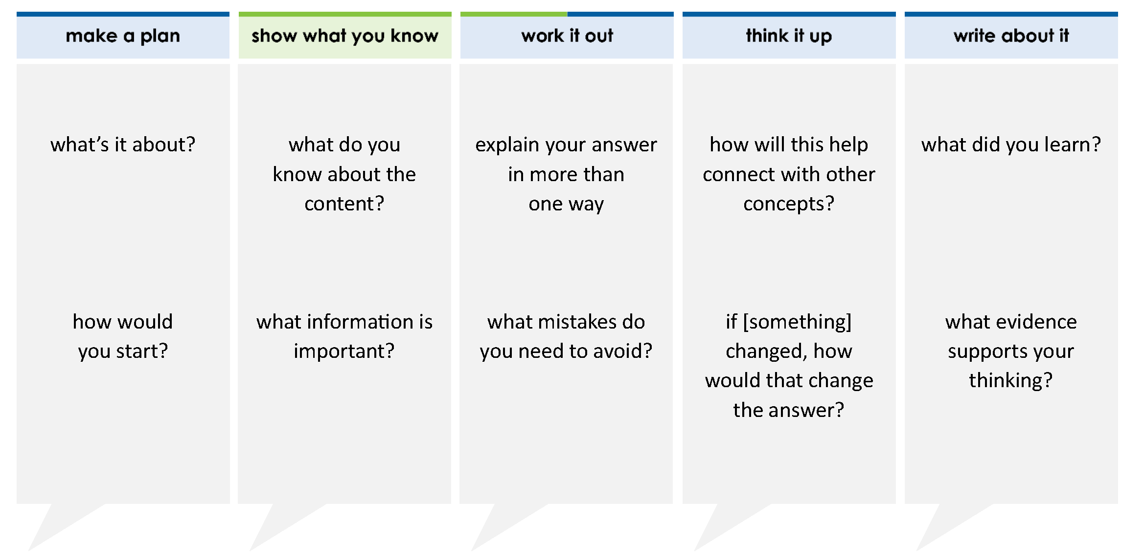
Alex paid $0.08 in sales tax when he bought a candy bar. Which fraction is equivalent to 0.08?
A 1/80
B 2/25
C 1/8
D 4/5
thinkalong routine
stimulus
Notes:
Throughout the week, use the guiding questions from the thinkalong routine to lead student thinking and discussion around the selected stimulus (problem, text, or visual) aligned to a high-impact standard/concept.

Slide 3
make a plan
Notes:
make a plan
The goal of the first 5-10 minutes of the routine is just for students to explore. We are engaging the “tools to know” process standards and using the selected problem, text, or visual to activate memory around the designated content for the week.
If you’re using a problem as the stimulus, students don’t solve the problem or even see the answer choices yet! In this part of the routine, students practice making a plan, getting started, and thinking about what they will need to answer the question based on the vocabulary and/or visuals included.

Slide 4
what’s it about?
Alex paid $0.08 in sales tax when he bought a candy bar. Which fraction is equivalent to 0.08?
how would you start?
Notes:
make a plan: Use the guiding questions on the routine to drive the thinking and discussion with students as you explore the selected stimulus.
This item was selected to address, loopback, or intervene on finding equivalent fractions and decimals because:
Being able to change fractions to decimals or decimals to fractions helps students be flexible when solving problems. It allows them to use the forms of the numbers interchangeably.
The prompt includes a distractor. This problem is about equivalent fractions and decimals, not finding the amount of sales tax.
This is a common problem structure on assessments.
It’s a high leverage skill that will be used in both 7th and 8th grades and in real life.

Slide 5
show what you know
Notes:
show what you know
The goal of the second 10 minutes in the routine is for students to talk using the problem, text, or visual to show what they know about this concept! This part of the routine allows students and teacher to talk about, share, and clarify the content (vocabulary, visuals, activities, common mistakes, connections, key ideas, important info/details, etc.).

Slide 6
what do you know about the content?
Alex paid $0.08 in sales tax when he bought a candy bar. Which fraction is equivalent to 0.08?
A 1/80
B 2/25
C 1/8
D 4/5
what information is important?
Notes:
show what you know - option 1: Use these questions from the routine, along with the selected stimulus, to activate memory, review content, correct learning mistakes, and clarify misconceptions. Be sure discussion includes important information related to the selected stimulus.
important information about this item:
Clues include and require an understanding of important academic vocabulary: decimal, fraction, equivalent
Students must read and clarify all of the clues:
The fraction and decimal are equivalent
The decimal is 0.08
Students would benefit from:
Knowing what tax is; they do not need to know how to calculate it
Knowing how to read the decimal correctly: 8-hundredths
Recognizing that the name of the decimal tells them the name of the fraction: 8/100
Knowing how to simplify fractions: 8/100 = 2/25

Slide 7



FACT
FIB
Notes:
show what you know - option 2: fact or fib (rehearsal and practice instructional strategy)
purpose
Students review important content and clarify misconceptions by determining which statements are facts and which are fibs in a fact or fib showdown game. Fact or fib is an effective strategy for brain dumping and to activate memory, review content, correct learning mistakes, and clarify misconceptions and that will engage students with the guiding questions from the “show what you know” column and selected weekly stimulus.
instructions
Students create FACT and FIB cards using post it notes, index cards, scratch paper, white boards or use their fingers.
They hold their cards while teacher presents students with a statement (fact or fib) relating to the concept, visual, text, or test item.
Allow students 5-8 seconds to infer if the statement is a fact or a fib.
Students think and prepare to justify their answer until the teacher calls out, “One! Two! Three! Showdown!” at which time all students hold up either the fact or fib card to represent their choice.
Students then take turns explaining and justifying their thinking with a partner or small group.
Observe students’ thinking and clarify/verify as appropriate.
Reveal correct answer and provide rationale.

Slide 8
0.08 is the same as
8
100
FACT!
1-2-3 SHOWDOWN
Notes:
show what you know - option 2, round 1 rationale
This is a FACT because the 8 is in the hundredths place. 0.08 is correctly read as “8-hundredths.”

Slide 9
FIB!
8
100
cannot be simplified
1-2-3 SHOWDOWN
Notes:
show what you know - option 2, round 2 rationale
This is a FIB because 8 and 100 have common factors – 2 and 4 – which can be divided out of the numerator and the denominator.

Slide 10
work it out
Notes:
work it out
The goal of the third 10 minutes of the routine is for students to work out the problem and defend their answer. We want students to prove why their chosen response is right and explain why the incorrect answers are wrong.

Slide 11
explain your answer in more than one way
Alex paid $0.08 in sales tax when he bought a candy bar. Which fraction is equivalent to 0.08?
A 1/80
B 2/25
C 1/8
D 4/5
what mistakes do you need to avoid?
Notes:
work it out - option 1: Correct learning mistakes and clarify misconceptions by answering the question but be sure students not only solve but also prove why their chosen response is right and explain why the incorrect answers are wrong.
Be sure discussion includes:
The meaning of percent. Eight hundredths is equal to 8 over 100; simplifying that creates two twenty fifths.
Answer choice A and C can be eliminated because the student just used the numbers from the stimulus and made a fraction.
Eight tenths is simplified to 4 fifths, so answer D is a place value misconception between 8 hundredths and 8 tenths.

Slide 12
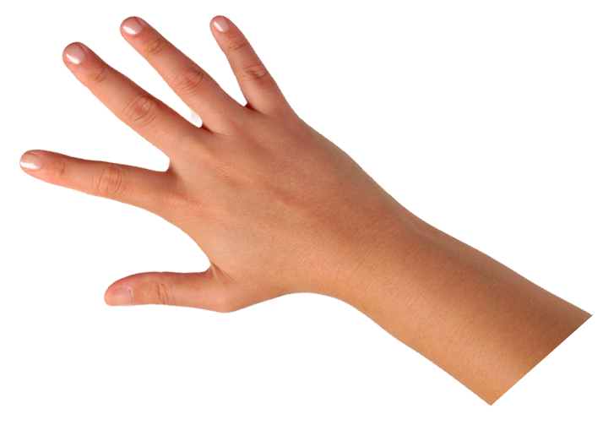
  IQ slap down
A
B
C
D
Round 1 - Worst Answer
Round 2 - Best Distractor
Round 3 - Correct Answer
Notes:
work it out - option 2: IQ slap down (learning from mistakes instructional strategy)
purpose
Students analyze or practice assessment questions by determining the worst answer, the distractor, and the correct answer through a slap-down game.
instructions
Students create a set of A-B-C-D cards using sticky notes, index cards, or scratch paper.
Organize students into thinking partners or small groups.
Facilitate 3 rounds of IQ Slap Down with the selected weekly assessment item:
Round 1: At teacher’s signal, students slap down the WORST answer, justify with their partner, and pick up their cards. Teacher clarifies.
Round 2: At teacher’s signal, students slap down the DISTRACTOR answer, justify with their partner, and pick up their cards. Teacher clarifies.
Round 3: At teacher’s signal, students slap down the CORRECT answer, justify with their partner, and pick up their cards. Teacher clarifies.
Observe students’ thinking and clarify/verify as appropriate.
Answer “work it out questions” from think along routine.

Slide 13


Alex paid $0.08 in sales tax when he bought a candy bar. Which fraction is equivalent to 0.08?
A 1/80
B 2/25
C 1/8
D 4/5
4/5 is almost 1 whole.
0.08 is a small amount of 1 whole.
Round 1 Worst Answer
1-2-3 Slap Down
Notes:
work it out - option 2: round 1 rationale
D is the worst answer because students should recognize that 4/5 is almost 1 whole, and that the decimal in the problem is almost 0. If students sketch a model of the decimal and the fraction, they will see the difference in the magnitude of the numbers.

Slide 14
Alex paid $0.08 in sales tax when he bought a candy bar. Which fraction is equivalent to 0.08?
A 1/80
B 2/25
C 1/8
D 4/5
Round 2 Best Distractor
1-2-3 Slap Down
Notes:
work it out - option 2: round 1 rationale
C is the best distractor because...
Reason 1: 1/8 means that the whole is divided into 8 equal-sized parts. If you divide this grid into eighths, each eighth would be more than 10 squares.
Reason 2: Students should recognize that even though the digits are the same in the numbers, that doesn’t mean that the decimal and fraction are equivalent. There is no evidence that 1/8 is equivalent to 0.08.

Slide 15
0.08
Alex paid $0.08 in sales tax when he bought a candy bar. Which fraction is equivalent to 0.08?
A 1/80
B 2/25
C 1/8
D 4/5
8
100
=
8
100
4
50
2
25
=
=
Round 3 Correct Answer
1-2-3 Slap Down
Notes:
work it out - option 2: round 3 rationale
B is the correct answer because 0.08 is eight hundredths which simplifies to 4/50 which then simplifies to 2/25.
After IQ slap down, answer the “work it out” questions from the thinkalong routine:
explain your answer in more than one way – 0.08 = 8/100; 8/100 can be simplified to 2/25; using reasonableness/estimation can help remove distractor answers
what mistakes do you need to avoid? – being distracted by the digits in the answer choices; be aware of the magnitude of the decimals and the fractions

Slide 16
think it up
Notes:
think it up
The goal of the fourth 10 minutes of the routine is for us to change things up so students can practice with novelty and transfer.

Slide 17
how will this help connect with percents?
Alex paid $0.08 in sales tax when he bought a candy bar. Which fraction is equivalent to 0.08?
A 1/80
B 2/25
C 1/8
D 4/5
if the 8 moved to the tenths place, how would that change the answer?
Notes:
think it up - option 1: Use the guiding questions on the routine to drive the thinking and discussion with students as they reflect on the work of the routine so far -- the thinking around the content and the problem, text or visual. Then, have students analyze how all of that can help them as they work on or think through other content or solving future problems.

Slide 18
  compare/contrast model
Alex paid $0.08 in sales tax when he bought a candy bar. Which fraction is equivalent to 0.08?
A 1/80
B 2/25
C 1/8
D 4/5
In Max’s class, 5/8 of the students have a pet. Which value is equivalent to 5/8?
A 625/100
B 0.58
C 6 25/100
D 0.625
Notes:
think it up - option 2: compare/contrast model (extending thinking instructional strategy)
purpose
This is an effective strategy to facilitate a structured, supported, and engaging way for kids to answer the “think it up” questions and analyze 2 similar yet different items or visuals aligned to the same standard.
instructions
Divide students into groups of 3.
In each group, students CONTRAST the items by discussing/writing 2-3 attributes of each item.
In each group, students COMPARE the items by discussing/writing 2-3 attributes both items share.
Groups share out 1 of their differences and 1 of their similarities.
Observe and listen to students’ thinking and clarify/verify as appropriate.

Slide 19
write about it
Notes:
write about it
The goal of the last 10 minutes of the routine is for students to reflect on the routine and write about how it affected their understanding and confidence around the content and problem-solving process.

Slide 20
what did you learn?
Alex paid $0.08 in sales tax when he bought a candy bar. Which fraction is equivalent to 0.08?
A 1/80
B 2/25
C 1/8
D 4/5
how will you start when you approach a problem like this?
what evidence supports your thinking?
how does the relationship between fractions and decimals help you solve this problem?
Notes:
write about it: The goal of the last 10 minutes of the routine is to solidify learning and have students practice communicating what they know in writing.
Ask students to:
think about the activities, questions, discussions, and the selected problem, text or visual for this week’s thinkalong routine
talk with a partner or in a small group about what they learned and the evidence that supports their thinking
write their answers on a piece of paper or in their notebooks
Review areas in which students may need more support.

