Slide 1





(click on a button to go directly to that step)
Notes:
The thinkalong toolkit includes assessment-style items with answer keys. A digital version (poster) of the thinkalong routine and daily questions for teacher and students’ reference is also included.

Slide 2
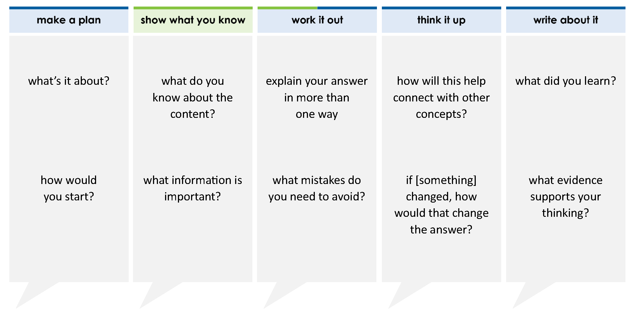
Jackson has 30 game cards. Of these cards, 70% are Basic Attack skills and 30% are Special Attack skills.
Complete the statement about the game cards Jackson owns.
Jackson has _____ game cards with Basic Attack skills and _____ game cards with Special Attack skills.
9
10
20
21
30
70
thinkalong routine
stimulus
Notes:
Throughout the week, use the guiding questions from the thinkalong routine to lead student thinking and discussion around the selected stimulus (problem, text, or visual) aligned to a high-impact standard/concept.

Slide 3
make a plan
Notes:
make a plan
The goal of the first 5-10 minutes of the routine is just for students to explore. We are engaging the “tools to know” process standards and using the selected problem, text, or visual to activate memory around the designated content for the week.
If you’re using a problem as the stimulus, students don’t solve the problem or even see the answer choices yet! In this part of the routine, students practice making a plan, getting started, and thinking about what they will need to answer the question based on the vocabulary and/or visuals included.

Slide 4
what’s it about?
Jackson has 30 game cards. Of these cards, 70% are Basic Attack skills and 30% are Special Attack skills.
Complete the statement about the game cards Jackson owns.
Jackson has _____ game cards with Basic Attack skills and _____ game cards with Special Attack skills.
how would you start?
Notes:
make a plan: Use the guiding questions on the routine to drive the thinking and discussion with students as you explore the selected stimulus.
This item was selected to address, loopback, or intervene on finding percents of a number because:
This is a useful life skill.
The structure of this problem is more complicated than other problems where students find percent of a number. Students don’t just find an answer. They have to figure out what answers the problem is looking for and where to place the answers in the sentence.
It’s a high leverage skill.

Slide 5
show what you know
Notes:
show what you know
The goal of the second 10 minutes in the routine is for students to talk using the problem, text, or visual to show what they know about this concept! This part of the routine allows students and teacher to talk about, share, and clarify the content (vocabulary, visuals, activities, common mistakes, connections, key ideas, important info/details, etc.).

Slide 6
what do you know about the content?
Jackson has 30 game cards. Of these cards, 70% are Basic Attack skills and 30% are Special Attack skills.
Complete the statement about the game cards Jackson owns.
Jackson has _____ game cards with Basic Attack skills and _____ game cards with Special Attack skills.
what information is important?
Notes:
show what you know - option 1: Use these questions from the routine, along with the selected stimulus, to activate memory, review content, correct learning mistakes, and clarify misconceptions. Be sure discussion includes important information related to the selected stimulus.
important information about this item:
Clues include and require an understanding of important academic vocabulary: %
Students don’t have to know anything about the game to solve the problem.
Students must read and clarify all of the clues:
Jackson has 30 cards.
30% are Basic Attack skills and 70% are Special Attack skills.
The problem wants you to find the number of Basic Attack skills cards and the number of Special Attack skills cards.
Students would benefit from:
Knowing that percents are a fraction of 100 where the denominator is understood, not written.
Knowing that they can use equivalent fractions to find percents.
Recognizing 30 is the whole and matches with 100 when writing equivalent fractions.
Recognizing the parts are the number and percent of each type of card.
Recognizing the percent of cards is known and they must find the number of cards.

Slide 7



FACT
FIB
Notes:
show what you know - option 2: fact or fib (rehearsal and practice instructional strategy)
purpose
Students review important content and clarify misconceptions by determining which statements are facts and which are fibs in a fact or fib showdown game. Fact or fib is an effective strategy for brain dumping and to activate memory, review content, correct learning mistakes, and clarify misconceptions and that will engage students with the guiding questions from the “show what you know” column and selected weekly stimulus.
instructions
Students create FACT and FIB cards using post it notes, index cards, scratch paper, white boards or use their fingers.
They hold their cards while teacher presents students with a statement (fact or fib) relating to the concept, visual, text, or test item.
Allow students 5-8 seconds to infer if the statement is a fact or a fib.
Students think and prepare to justify their answer until the teacher calls out, “One! Two! Three! Showdown!” at which time all students hold up either the fact or fib card to represent their choice.
Students then take turns explaining and justifying their thinking with a partner or small group.
Observe students’ thinking and clarify/verify as appropriate.
Reveal correct answer and provide rationale.

Slide 8
70% of 30 gives you the number of game cards with Special Attack skills
Jackson has 30 game cards. Of these cards, 70% are Basic Attack skills and 30% are Special Attack skills.
Complete the statement about the game cards Jackson owns.
Jackson has _____ game cards with Basic Attack skills and _____ game cards with Special Attack skills.
FIB!
1-2-3 SHOWDOWN
Notes:
show what you know - option 2, round 1 rationale
This is a FIB because Special Attack skills cards are 30% of the total number of cards.

Slide 9
you can use the following equivalent fractions to find the number of Basic Attack skills cards
70
100
x
30
FACT!
=
Jackson has 30 game cards. Of these cards, 70% are Basic Attack skills and 30% are Special Attack skills.
Complete the statement about the game cards Jackson owns.
Jackson has _____ game cards with Basic Attack skills and _____ game cards with Special Attack skills.
1-2-3 SHOWDOWN
Notes:
show what you know - option 2, round 2 rationale
This is a FACT because Basic Attack skills cards are 70% of the whole number of cards. 70% is equivalent to 70/100. Basic Attack skills cards are a fraction of the total number of cards (30). These two fractions are equivalent.

Slide 10
work it out
Notes:
work it out
The goal of the third 10 minutes of the routine is for students to work out the problem and defend their answer. We want students to prove why their chosen response is right and explain why the incorrect answers are wrong.

Slide 11
explain your answer in more than one way
Jackson has 30 game cards. Of these cards, 70% are Basic Attack skills and 30% are Special Attack skills.
Complete the statement about the game cards Jackson owns.
Jackson has _____ game cards with Basic Attack skills and _____ game cards with Special Attack skills.
9
10
20
21
30
70
what mistakes do you need to avoid?
Notes:
work it out - option 1: Correct learning mistakes and clarify misconceptions by answering the question but be sure students not only solve but also prove why their chosen response is right and explain why the incorrect answers are wrong.
Be sure discussion includes:
Students don’t have to know anything about playing the game to solve the problem.
30 is the total number of cards.
70% (a part) of the cards are Basic Attack skills. 30% (a part) of the cards are Special Attack skills.
When they add the number of Basic Attack skills cards and Special Attack skills cards, they get 30 (the whole).

Slide 12
make the case
Jackson has 30 game cards. Of these cards, 70% are Basic Attack skills and 30% are Special Attack skills.
Complete the statement about the game cards Jackson owns.
Jackson has _____ game cards with Basic Attack skills and _____ game cards with Special Attack skills.
defend why your answer might be correct/incorrect
what 1-2 pieces of evidence do you have?
9
10
20
21
30
70
Notes:
work it out - option 2: make the case (learning from mistakes instructional strategy)
free virtual dice available in the lead4ward app and at: www.lead4ward.com/dice
purpose
Students correct learning mistakes and clarify misconceptions by justifying/proving why their assigned response is right OR explain why their assigned response is an incorrect answer.
instructions
Organize students into groups (no larger than 4).
Assign each team a potential answer (choice). (The rectangle color around the numbers shows the possible answer choices.)
Groups huddle to determine if their answer choice is “correct/innocent” by explaining why and providing (at most) 2 pieces of evidence…or “incorrect/guilty” by explaining why and providing (at most) 2 pieces of evidence.
Students prosecute and defend arguments.
Observe students’ thinking/responses and clarify/verify as appropriate.
be sure discussion includes:
Visuals or models students might use to prove their justification.
Discourse around strategies, clues and/or vocabulary that support their justification.
The chosen incorrect answer(s) suggests a common misconception, guessing pattern, clue picking, stopping too soon, and relying on tricks.
Student-driven discourse.

Slide 13
think it up
Notes:
think it up
The goal of the fourth 10 minutes of the routine is for us to change things up so students can practice with novelty and transfer.

Slide 14
how will this help connect with other concepts?
Jackson has 30 game cards. Of these cards, 70% are Basic Attack skills and 30% are Special Attack skills.
Complete the statement about the game cards Jackson owns.
Jackson has _____ game cards with Basic Attack skills and _____ game cards with Special Attack skills.
why are some of the answer combinations tricky?
9
10
20
21
30
70
if the answers were 10 and 20, how would that change the problem?
Notes:
think it up - option 1: Use the guiding questions on the routine to drive the thinking and discussion with students as they reflect on the work of the routine so far -- the thinking around the content and the problem, text or visual. Then, have students analyze how all of that can help them as they work on or think through other content or solving future problems.

Slide 15
odd one out
Jackson has some game cards. 30% of them are Special Attack skills and the rest are Basic Attack cards. If 21 of the cards are Basic Attack cards, how many game cards does Jackson have?
Jackson has 30 game cards. 9 of them are Special Attack skills and the rest are Basic Attack skills. What percent of Jackson’s cards are Basic Attack skills?
Jackson has 30 game cards. 30% of them are Special Attack skills and the rest are Basic Attack skills. How many cards are Basic Attack skills?
Jackson has 30 game cards. Of these cards, 70% are Basic Attack skills and 30% are Special Attack skills. Complete the statement about the game cards Jackson owns.
Jackson has _____ game cards with Basic Attack skills and _____ game cards with Special Attack skills.
9
10
20
21
30
70
Notes:
think it up - option 2: odd one out (extending thinking instructional strategy)
purpose
Students compare/contrast four visuals, assessment questions, words, characters, historical figures, etc. and justify their thinking by defending which they think is the odd one out.
instructions
Divide students into groups of 4.
In each group, students divide the images/problems amongst their group and take turns describing their image/problem.
Students compare and contrast the images/problems.
Students determine which one is the odd one out and why.
Groups share out their selected odd one out and justification.
Observe and listen to students’ thinking and clarify/verify as appropriate.

Slide 16
write about it
Notes:
write about it
The goal of the last 10 minutes of the routine is for students to reflect on the routine and write about how it affected their understanding and confidence around the content and problem-solving process.

Slide 17
what did you learn?
Jackson has 30 game cards. Of these cards, 70% are Basic Attack skills and 30% are Special Attack skills.
Complete the statement about the game cards Jackson owns.
Jackson has game cards with Basic Attack skills and game cards with Special Attack skills.
how do you choose where to write the numbers when you set up a percent problem?
9
10
20
21
30
70
what evidence supports your answer?
21
9
how does knowing the parts and the whole help you understand the problem?
Notes:
write about it: The goal of the last 10 minutes of the routine is to solidify learning and have students practice communicating what they know in writing.
Ask students to:
think about the activities, questions, discussions, and the selected problem, text or visual for this week’s thinkalong routine
talk with a partner or in a small group about what they learned and the evidence that supports their thinking
write their answers on a piece of paper or in their notebooks
Review areas in which students may need more support.

