Slide 1





(click on a button to go directly to that step)
Notes:
The thinkalong toolkit includes assessment-style items with answer keys. A digital version (poster) of the thinkalong routine and daily questions for teacher and students’ reference is also included.

Slide 2
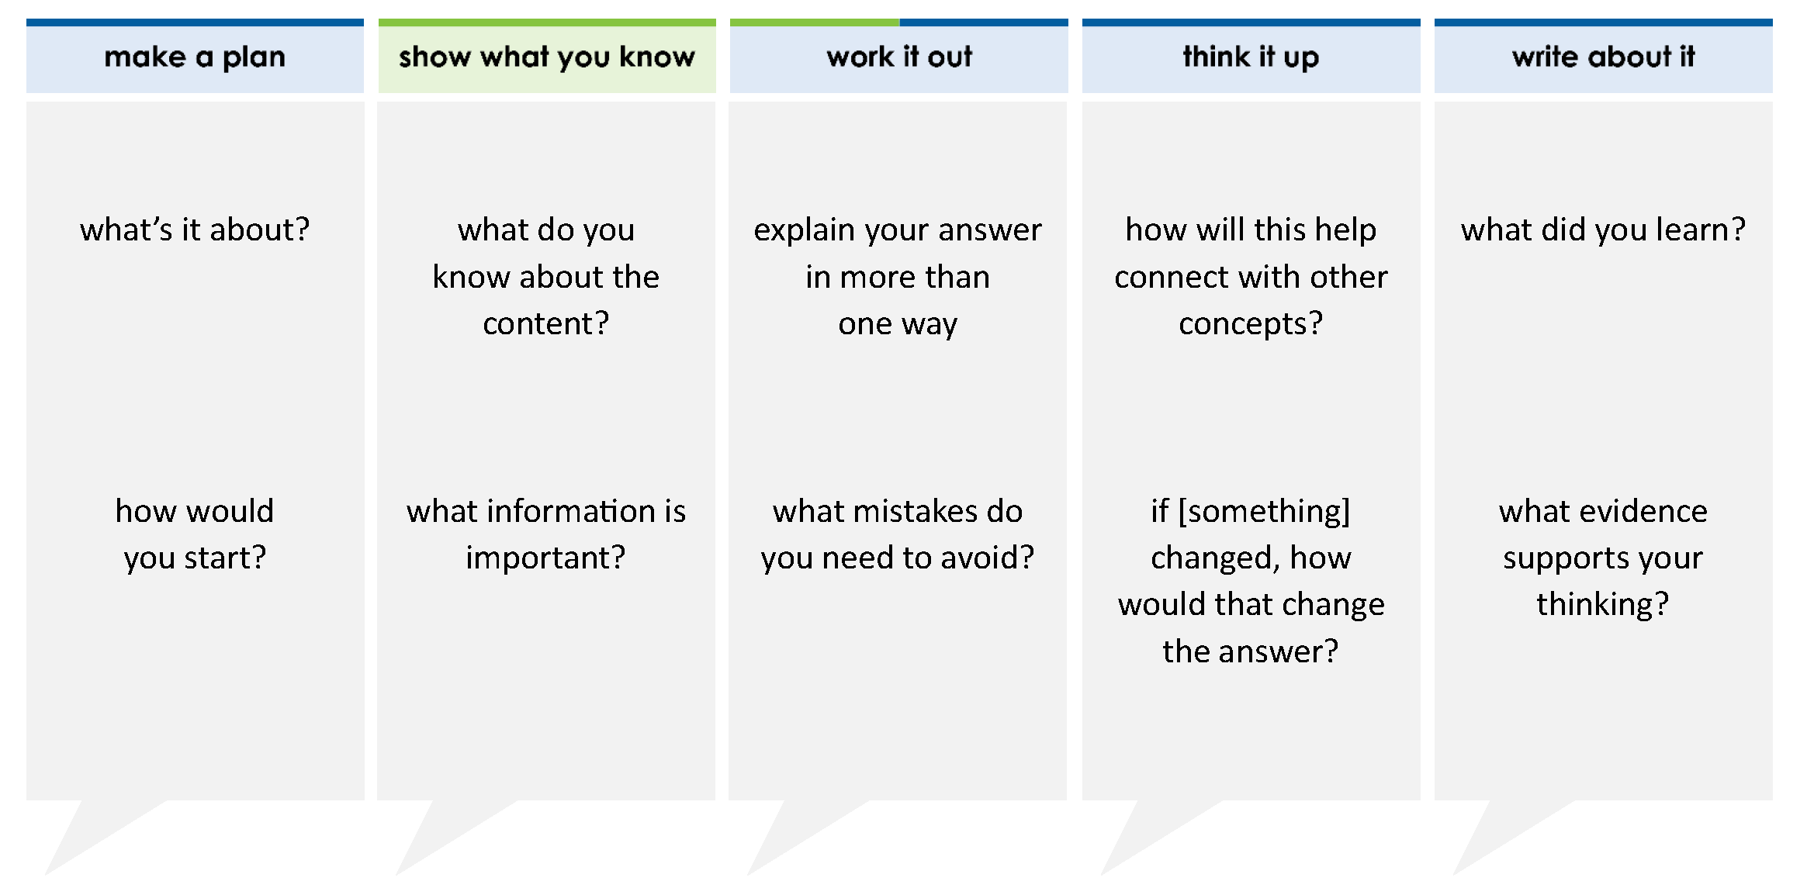
Arrange the numbers in order from greatest to least.
Move the correct answer to each box.
Greatest Least
–2.41 |  | 3 8 |  | 1 4 |  | 1.08 |  | 7 4
1
–
7 4 |  | 3 8 |  | 1.08 |  | 1 4 |  | –2.41
1
–
thinkalong routine
stimulus
Notes:
Throughout the week, use the guiding questions from the thinkalong routine to lead student thinking and discussion around the selected stimulus (problem, text, or visual) aligned to a high-impact standard/concept.

Slide 3
make a plan
Notes:
make a plan
The goal of the first 5-10 minutes of the routine is just for students to explore. We are engaging the “tools to know” process standards and using the selected problem, text, or visual to activate memory around the designated content for the week.
If you’re using a problem as the stimulus, students don’t solve the problem or even see the answer choices yet! In this part of the routine, students practice making a plan, getting started, and thinking about what they will need to answer the question based on the vocabulary and/or visuals included.

Slide 4
what’s it about?
Arrange the numbers in order from greatest to least.
–2.41 |  | 3 8 |  | 1 4 |  | 1.08 |  | 7 4
1
–
how would you start?
Notes:
make a plan: Use the guiding questions on the routine to drive the thinking and discussion with students as you explore the selected stimulus.
This item was selected to address, loopback, or intervene on comparing and ordering rational numbers because:
It includes many types of numbers (positive, negative, fractions, decimals)
The numbers are fairly complex (negative and fraction; negative and decimal; mixed number; fraction larger than 1)
This skill is tested in lots of different ways

Slide 5
show what you know
Notes:
show what you know
The goal of the second 10 minutes in the routine is for students to talk using the problem, text, or visual to show what they know about this concept! This part of the routine allows students and teacher to talk about, share, and clarify the content (vocabulary, visuals, activities, common mistakes, connections, key ideas, important info/details, etc.).

Slide 6
what do you know about the content?
Arrange the numbers in order from greatest to least.
–2.41 |  | 3 8 |  | 1 4 |  | 1.08 |  | 7 4
1
–
what information is important?
Notes:
show what you know - option 1: Use these questions from the routine, along with the selected stimulus, to activate memory, review content, correct learning mistakes, and clarify misconceptions. Be sure discussion includes important information related to the selected stimulus.
important information about this item:
Clues include and require an understanding of important academic vocabulary: greatest to least, in order.
Students must read and clarify all of the clues:
The numbers have to be put in order from greatest to least, not least to greatest. This means that the greatest number is placed first in the list.
Some numbers are positive, and some are negative.
Some numbers are fractions, and some are decimals.
Students would benefit from:
Knowing how to change fractions to decimals or decimals to fractions, whichever they decide to do.
Being able to use reasonableness to determine where some of the numbers belong.
Using a number line as tool.

Slide 7



FACT
FIB
Notes:
show what you know - option 2: fact or fib (rehearsal and practice instructional strategy)
purpose
Students review important content and clarify misconceptions by determining which statements are facts and which are fibs in a fact or fib showdown game. Fact or fib is an effective strategy for brain dumping and to activate memory, review content, correct learning mistakes, and clarify misconceptions and that will engage students with the guiding questions from the “show what you know” column and selected weekly stimulus.
instructions
Students create FACT and FIB cards using post it notes, index cards, scratch paper, white boards or use their fingers.
They hold their cards while teacher presents students with a statement (fact or fib) relating to the concept, visual, text, or test item.
Allow students 5-8 seconds to infer if the statement is a fact or a fib.
Students think and prepare to justify their answer until the teacher calls out, “One! Two! Three! Showdown!” at which time all students hold up either the fact or fib card to represent their choice.
Students then take turns explaining and justifying their thinking with a partner or small group.
Observe students’ thinking and clarify/verify as appropriate.
Reveal correct answer and provide rationale.

Slide 8
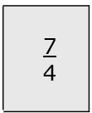

>
FACT!
Arrange the numbers in order from greatest to least.
–2.41 |  | 3 8 |  | 1 4 |  | 1.08 |  | 7 4
1
–
1-2-3 SHOWDOWN
Notes:
show what you know - option 2, round 1 rationale
This is a FACT because 7/4 is equivalent to 1 3/4. Since fourths are larger than eighths, 1 3/4 >1 3/8.

Slide 9


<
Arrange the numbers in order from greatest to least.
FIB!
–2.41 |  | 3 8 |  | 1 4 |  | 1.08 |  | 7 4
1
–
1-2-3 SHOWDOWN
Notes:
show what you know - option 2, round 2 rationale
This is a FIB because -1/4 is closer to 0 than -2.41. Because -2.41 is negative, it is 2 wholes less than 0. -¼ is only ¼ of a whole less than 0.

Slide 10
when you arrange numbers in order from greatest to least, the largest number is written first and the smallest number is written last
FACT!
Arrange the numbers in order from greatest to least.
–2.41 |  | 3 8 |  | 1 4 |  | 1.08 |  | 7 4
1
–
1-2-3 SHOWDOWN
Notes:
show what you know - option 2, round 3 rationale
This is a FACT because greatest to least means that the list of numbers is written from the largest to the smallest.
How could you change this FACT to a FIB?
When the numbers are arranged in order from greatest to least, the smallest number is written first and the largest number is written last.
When the numbers are arranged in order from least to greatest, the largest number is written first and the smallest number is written last.

Slide 11
work it out
Notes:
work it out
The goal of the third 10 minutes of the routine is for students to work out the problem and defend their answer. We want students to prove why their chosen response is right and explain why the incorrect answers are wrong.

Slide 12
Arrange the numbers in order from greatest to least.
Move the correct answer to each box.
Greatest Least
explain your answer in more than one way
–2.41 |  | 3 8 |  | 1 4 |  | 1.08 |  | 7 4
1
–
what mistakes do you need to avoid?
Notes:
work it out - option 1: Correct learning mistakes and clarify misconceptions by answering the question but be sure students not only solve but also prove why their chosen response is right and explain why the incorrect answers are wrong.
Be sure discussion includes:
How greatest to least is different from least to greatest
How the distance from 0 determines how large or small the negative number
How the distance from 0 determines the magnitude of fractions
How the size of the denominator determines the magnitude of fractions
Using reasonableness to place the numbers as much as possible lessens the workload and difficulty of the problem
That if students can’t place all the numbers in the correct order using reasonableness, they may have to change decimals to fractions or fractions to decimals
How to change fractions to decimals or decimals to fractions as needed

Slide 13
  make the case
Arrange the numbers in order from greatest to least.
Move the correct answer to each box.
–2.41 – 1 1.08
1 1.08 – –2.41
– –2.41 1.08 1
–2.41 – 1.08 1
defend why your answer might be correct/incorrect
what 1-2 pieces of evidence do you have?
–2.41 |  | 3 8 |  | 1 4 |  | 1.08 |  | 7 4
1
–
1
4
3
8
7
4
7
4
3
8
1
4
1
4
3
8
7
4
1
4
3
8
7
4
Notes:
work it out - option 2: make the case (learning from mistakes instructional strategy)
free virtual dice available in the lead4ward app and at: www.lead4ward.com/dice
purpose
Students correct learning mistakes and clarify misconceptions by justifying/proving why their assigned response is right OR explain why their assigned response is an incorrect answer.
instructions
Organize students into groups (no larger than 4).
Assign each team a potential answer (choice). (The rectangle color around the numbers shows the possible answer choices.)
Groups huddle to determine if their answer choice is “correct/innocent” by explaining why and providing (at most) 2 pieces of evidence…or “incorrect/guilty” by explaining why and providing (at most) 2 pieces of evidence.
Students prosecute and defend arguments.
Observe students’ thinking/responses and clarify/verify as appropriate.
be sure discussion includes:
Visuals or models students might use to prove their justification.
Discourse around strategies, clues and/or vocabulary that support their justification.
The chosen incorrect answer(s) suggests a common misconception, guessing pattern, clue picking, stopping too soon, and relying on tricks.
Student-driven discourse.

Slide 14
think it up
Notes:
think it up
The goal of the fourth 10 minutes of the routine is for us to change things up so students can practice with novelty and transfer.

Slide 15
how can this help connect to other concepts?
Arrange the numbers in order from greatest to least.
Move the correct answer to each box.
Greatest Least
how can you use reasonableness to place some of the numbers in the correct place?
–2.41 |  | 3 8 |  | 1 4 |  | 1.08 |  | 7 4
1
–
if the problem changed to putting the numbers in order from least to greatest, how would that change the answer?
Notes:
think it up - option 1: Use the guiding questions on the routine to drive the thinking and discussion with students as they reflect on the work of the routine so far -- the thinking around the content and the problem, text or visual. Then, have students analyze how all of that can help them as they work on or think through other content or solving future problems.

Slide 16
  compare/contrast model
Arrange the numbers in order from greatest to least.
Move the correct answer to each box.
Greatest Least
Place the correct number in the box to make a true statement.
–2.41 |  | 3 8 |  | 1 4 |  | 1.08 |  | 7 4
–2.41 |  | 3 8 |  | 1 4 |  | 1.08 |  | 7 4
1
–
1
–
–2.41 | < |  | < | 1.08
Notes:
think it up - option 2: compare/contrast model (extending thinking instructional strategy)
purpose
This is an effective strategy to facilitate a structured, supported, and engaging way for kids to answer the “think it up” questions and analyze 2 similar yet different items or visuals aligned to the same standard.
instructions
Divide students into groups of 3.
In each group, students CONTRAST the items by discussing/writing 2-3 attributes of each item.
In each group, students COMPARE the items by discussing/writing 2-3 attributes both items share.
Groups share out 1 of their differences and 1 of their similarities.
Observe and listen to students’ thinking and clarify/verify as appropriate.

Slide 17
write about it
Notes:
write about it
The goal of the last 10 minutes of the routine is for students to reflect on the routine and write about how it affected their understanding and confidence around the content and problem-solving process.

Slide 18
what did you learn?
Arrange the numbers in order from greatest to least.
Move the correct answer to each box.
Greatest Least
what was confusing but you now understand?
–2.41 |  | 3 8 |  | 1 4 |  | 1.08 |  | 7 4
1
–
what evidence supports your thinking?
7 4 |  | 3 8 |  | 1.08 |  | 1 4 |  | –2.41
1
–
how can a number line help you solve this problem?
Notes:
write about it: The goal of the last 10 minutes of the routine is to solidify learning and have students practice communicating what they know in writing.
Ask students to:
think about the activities, questions, discussions, and the selected problem, text or visual for this week’s thinkalong routine
talk with a partner or in a small group about what they learned and the evidence that supports their thinking
write their answers on a piece of paper or in their notebooks
Review areas in which students may need more support.

