Slide 1





(click on a button to go directly to that step)
Notes:
The thinkalong toolkit includes assessment-style items with answer keys. A digital version (poster) of the thinkalong routine and daily questions for teacher and students’ reference is also included.

Slide 2
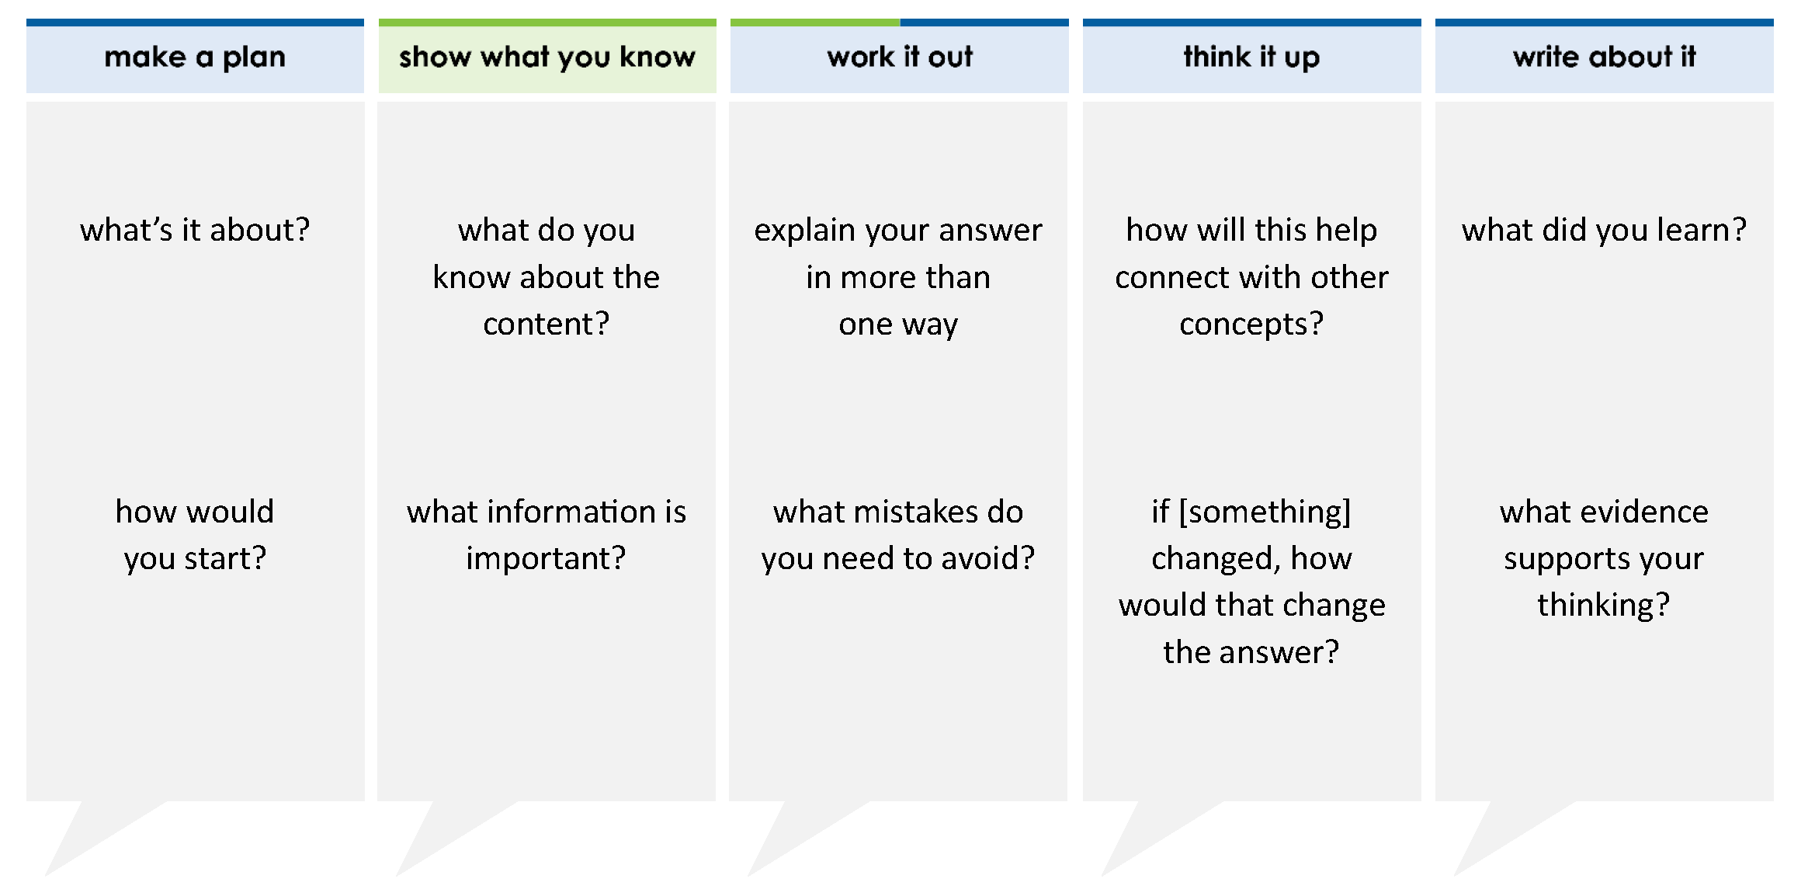
The table shows the distance between throws of a paper airplane for each person in the STEM club.
Name | Distance of Throws (feet)
Marcos | 3 4
Tyrion | 3.2
Jaylinda | 3
Jacob | 1.6
Charlsie | 1
1
8
5
6
Order the names of the students by throwing distance from least to greatest.
Least Greatest
thinkalong routine
Marcos |  | Tyrion |  | Jaylinda |  | Jacob |  | Charlsie
stimulus
Notes:
Throughout the week, use the guiding questions from the thinkalong routine to lead student thinking and discussion around the selected stimulus (problem, text, or visual) aligned to a high-impact standard/concept.

Slide 3
make a plan
Notes:
make a plan
The goal of the first 5-10 minutes of the routine is just for students to explore. We are engaging the “tools to know” process standards and using the selected problem, text, or visual to activate memory around the designated content for the week.
If you’re using a problem as the stimulus, students don’t solve the problem or even see the answer choices yet! In this part of the routine, students practice making a plan, getting started, and thinking about what they will need to answer the question based on the vocabulary and/or visuals included.

Slide 4
The table shows the distance between throws of a paper airplane for each person in the STEM club.
Paper Airplane Toss
Order the names of the students by throwing distance from least to greatest.
what’s it about?
Name | Distance of Throws (feet)
Marcos | 3 4
Tyrion | 3.2
Jaylinda | 3
Jacob | 1.6
Charlsie | 1
1
8
how would you start?
5
6
Notes:
make a plan: Use the guiding questions on the routine to drive the thinking and discussion with students as you explore the selected stimulus.
This item was selected to address, loopback, or intervene on comparing and ordering rational numbers because:
It includes many types of numbers (positive, fractions, decimals).
The numbers are fairly complex (different denominators; mixture of fractions and decimals; mixed numbers).
In this problem, students order the names based on the numbers.
This is an important skill that is tested in lots of different ways.

Slide 5
show what you know
Notes:
show what you know
The goal of the second 10 minutes in the routine is for students to talk using the problem, text, or visual to show what they know about this concept! This part of the routine allows students and teacher to talk about, share, and clarify the content (vocabulary, visuals, activities, common mistakes, connections, key ideas, important info/details, etc.).

Slide 6
The table shows the distance between throws of a paper airplane for each person in the STEM club.
Paper Airplane Toss
Order the names of the students by throwing distance from least to greatest.
what do you know about the content?
Name | Distance of Throws (feet)
Marcos | 3 4
Tyrion | 3.2
Jaylinda | 3
Jacob | 1.6
Charlsie | 1
1
8
what information is important?
5
6
Notes:
show what you know - option 1: Use these questions from the routine, along with the selected stimulus, to activate memory, review content, correct learning mistakes, and clarify misconceptions. Be sure discussion includes important information related to the selected stimulus.
important information about this item:
Clues include and require an understanding of important academic vocabulary: least to greatest, order.
Students must read and clarify all of the clues:
The names have to be put in order.
You are ordering the distance from least to greatest. This means that the person with the shortest throw is placed first in the list.
Some numbers are fractions, and some are decimals.
Students would benefit from:
Knowing how to change fractions to decimals or decimals to fractions, whichever they decide to do.
Being able to use reasonableness to determine where some of the numbers belong.
Using a number line as a tool.

Slide 7



FACT
FIB
Notes:
show what you know - option 2: fact or fib (rehearsal and practice instructional strategy)
purpose
Students review important content and clarify misconceptions by determining which statements are facts and which are fibs in a fact or fib showdown game. Fact or fib is an effective strategy for brain dumping and to activate memory, review content, correct learning mistakes, and clarify misconceptions and that will engage students with the guiding questions from the “show what you know” column and selected weekly stimulus.
instructions
Students create FACT and FIB cards using post it notes, index cards, scratch paper, white boards or use their fingers.
They hold their cards while teacher presents students with a statement (fact or fib) relating to the concept, visual, text, or test item.
Allow students 5-8 seconds to infer if the statement is a fact or a fib.
Students think and prepare to justify their answer until the teacher calls out, “One! Two! Three! Showdown!” at which time all students hold up either the fact or fib card to represent their choice.
Students then take turns explaining and justifying their thinking with a partner or small group.
Observe students’ thinking and clarify/verify as appropriate.
Reveal correct answer and provide rationale.

Slide 8
1
8
3.2 < 3
The table shows the distance between throws of a paper airplane for each person in the STEM club.
Paper Airplane Toss
Order the names of the students by throwing distance from least to greatest.
Name | Distance of Throws (feet)
Marcos | 3 4
Tyrion | 3.2
Jaylinda | 3
Jacob | 1.6
Charlsie | 1
FIB!
1
8
5
6
1-2-3 SHOWDOWN
Notes:
show what you know - option 2, round 1 rationale
This is a FIB because 3.2 = 3 2/10 or 3 1/5. 1/5 is larger than 1/8 and is further away from 0. So 3.2 > 3 1/8.

Slide 9
Tyrion had the longest throw and Marcos had the shortest throw
The table shows the distance between throws of a paper airplane for each person in the STEM club.
Paper Airplane Toss
Order the names of the students by throwing distance from least to greatest.
Name | Distance of Throws (feet)
Marcos | 3 4
Tyrion | 3.2
Jaylinda | 3
Jacob | 1.6
Charlsie | 1
FACT!
1
8
5
6
1-2-3 SHOWDOWN
Notes:
show what you know - option 2, round 2 rationale
This is a FACT because Tyrion’s throw was 3.2 feet and 3.2 > 3 1/8. Demarcos’ throw was less than 1 foot long.

Slide 10
5
6
1 > 1.6
The table shows the distance between throws of a paper airplane for each person in the STEM club.
Paper Airplane Toss
Order the names of the students by throwing distance from least to greatest.
Name | Distance of Throws (feet)
Marcos | 3 4
Tyrion | 3.2
Jaylinda | 3
Jacob | 1.6
Charlsie | 1
FIB!
1
8
5
6
1-2-3 SHOWDOWN
Notes:
show what you know - option 2, round 3 rationale
This is a FIB because 1 5/6 = 1.8333, and that is greater than 1.6 (or 1.6 = 1 6/10). Finding a common denominator, 1 50/60 < 1 36/60.

Slide 11
work it out
Notes:
work it out
The goal of the third 10 minutes of the routine is for students to work out the problem and defend their answer. We want students to prove why their chosen response is right and explain why the incorrect answers are wrong.

Slide 12
The table shows the distance between throws of a paper airplane for each person in the STEM club.
Paper Airplane Toss
Order the names of the students by throwing distance from least to greatest.
Least Greatest
Name | Distance of Throws (feet)
Marcos | 3 4
Tyrion | 3.2
Jaylinda | 3
Jacob | 1.6
Charlsie | 1
explain your answer in more than one way
1
8
what mistakes do you need to avoid?
5
6
Marcos |  | Tyrion |  | Jaylinda |  | Jacob |  | Charlsie
Notes:
work it out - option 1: Correct learning mistakes and clarify misconceptions by answering the question but be sure students not only solve but also prove why their chosen response is right and explain why the incorrect answers are wrong.
Be sure discussion includes:
How least to least is greatest from greatest to least.
How the distance from 0 determines the magnitude of fractions.
How the size of the denominator determines the magnitude of fractions.
Using reasonableness to place the numbers as much as possible lessens the workload and difficulty of the problem.
If students can’t place all the numbers in the correct order using reasonableness, they may have to change decimals to fractions or fractions to decimals.
How to change fractions to decimals or decimals to fractions as needed.
Tip: Have students write the names and distances on a piece of scratch paper!

Slide 13
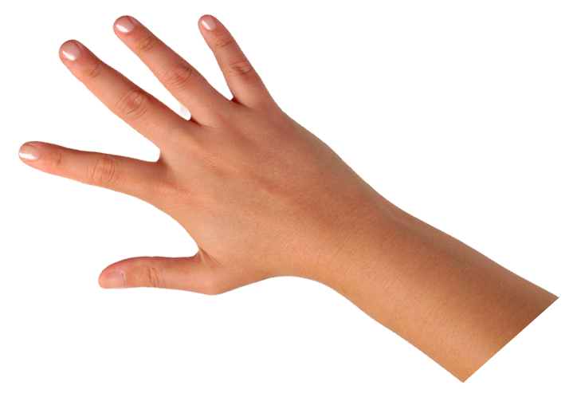
IQ slap down
A
B
C
D
Round 1 - Worst Answer
Round 2 - Best Distractor
Round 3 - Correct Answer
Notes:
work it out - option 1: IQ slap down (learning from mistakes instructional strategy)
purpose
Students analyze or practice assessment questions by determining the worst answer, the distractor, and the correct answer through a slap-down game.
instructions
Students create a set of A-B-C-D cards using sticky notes, index cards, or scratch paper.
Organize students into thinking partners or small groups.
Facilitate 3 rounds of IQ Slap Down with the selected weekly assessment item:
Round 1: At teacher’s signal, students slap down the WORST answer, justify with their partner, and pick up their cards. Teacher clarifies.
Round 2: At teacher’s signal, students slap down the DISTRACTOR answer, justify with their partner, and pick up their cards. Teacher clarifies.
Round 3: At teacher’s signal, students slap down the CORRECT answer, justify with their partner, and pick up their cards. Teacher clarifies.
Observe students’ thinking and clarify/verify as appropriate.
Answer “work it out questions” from think along routine.

Slide 14
Name | Distance of Throws (feet)
Marcos | 3 4
Tyrion | 3.2
Jaylinda | 3
Jacob | 1.6
Charlsie | 1
3.2 Tyrion |  | 3 Jaylinda |  | 1 Charlsie |  | 1.6 Jacob |  | 3 4 Marcos
1
8
5
6
1
8
5
6
A | Marcos |  | Charlsie |  | Jacob |  | Jaylinda |  | Tyrion
Order the names of the students by throwing distance from least to greatest.
Least Greatest
B | Tyrion |  | Jaylinda |  | Charlsie |  | Jacob |  | Marcos
C | Marcos |  | Jaylinda |  | Charlsie |  | Jacob |  | Tyrion
Marcos |  | Tyrion |  | Jaylinda |  | Jacob |  | Charlsie
D | Marcos |  | Jacob |  | Charlsie |  | Jaylinda |  | Tyrion
Round 1 Worst Answer
1-2-3 Slap Down
Notes:
work it out - option 1: round 1 rationale
B is the worst answer. The order is correct if the names are put in order from greatest to least. The student knew the content but put the numbers in the wrong order.
Students may be able to give a rationale for other answer choices being the worst.

Slide 15
Name | Distance of Throws (feet)
Marcos | 3 4
Tyrion | 3.2
Jaylinda | 3
Jacob | 1.6
Charlsie | 1
3 4 Marcos |  | 1 Charlsie |  | 1.6 Jacob |  | 3 Jaylinda |  | 3.2 Tyrion
5
6
1
8
1
8
5
6
A | Marcos |  | Charlsie |  | Jacob |  | Jaylinda |  | Tyrion
Order the names of the students by throwing distance from least to greatest.
Least Greatest
B | Tyrion |  | Jaylinda |  | Charlsie |  | Jacob |  | Marcos
Marcos |  | Tyrion |  | Jaylinda |  | Jacob |  | Charlsie
C | Marcos |  | Jaylinda |  | Charlsie |  | Jacob |  | Tyrion
D | Marcos |  | Jacob |  | Charlsie |  | Jaylinda |  | Tyrion
Round 2 Best Distractor
1-2-3 Slap Down
Notes:
work it out - option 1: round 2 rationale
A is the best distractor. Two names are mixed up, Jacob and Charlsie.
Students may be able to give a rationale for other answers choices being the best distractor.

Slide 16
Name | Distance of Throws (feet)
Marcos | 3 4
Tyrion | 3.2
Jaylinda | 3
Jacob | 1.6
Charlsie | 1
3 4 Marcos |  | 1.6 Jacob |  | 1 Charlsie |  | 3 Jaylinda |  | 3.2 Tyrion
5
6
1
8
1
8
5
6
A | Marcos |  | Charlsie |  | Jacob |  | Jaylinda |  | Tyrion
Order the names of the students by throwing distance from least to greatest.
Least Greatest
B | Tyrion |  | Jaylinda |  | Charlsie |  | Jacob |  | Marcos
Marcos |  | Tyrion |  | Jaylinda |  | Jacob |  | Charlsie
C | Marcos |  | Jaylinda |  | Charlsie |  | Jacob |  | Tyrion
D | Marcos |  | Jacob |  | Charlsie |  | Jaylinda |  | Tyrion
Round 3 Correct Answer
1-2-3 Slap Down
Notes:
work it out - option 1: round 3 rationale
D is the correct answer.
After IQ slap down, answer the “work it out” questions from the thinkalong routine:
explain your answer in more than one way
what mistakes do you need to avoid?

Slide 17
think it up
Notes:
think it up
The goal of the fourth 10 minutes of the routine is for us to change things up so students can practice with novelty and transfer.

Slide 18
The table shows the distance between throws of a paper airplane for each person in the STEM club.
Name | Distance of Throws (feet)
Marcos | 3 4
Tyrion | 3.2
Jaylinda | 3
Jacob | 1.6
Charlsie | 1
how will this help connect with other concepts?
1
8
if Marcos’ throw was 1 3/4 feet, how would that change the answer?
5
6
Order the names of the students by throwing distance from least to greatest.
Least Greatest
Marcos |  | Tyrion |  | Jaylinda |  | Jacob |  | Charlsie
Notes:
think it up - option 1: Use the guiding questions on the routine to drive the thinking and discussion with students as they reflect on the work of the routine so far -- the thinking around the content and the problem, text or visual. Then, have students analyze how all of that can help them as they work on or think through other content or solving future problems.

Slide 19
compare/contrast model
The table shows the distance between throws of a paper airplane for each person in the STEM club.
Arrange the numbers in order from greatest to least.
Move the correct answer to each box.
Greatest Least
Name | Distance of Throws (feet)
Marcos | 3 4
Tyrion | 3.2
Jaylinda | 3
Jacob | 1.6
Charlsie | 1
1
8
–2.41 |  | 3 8 |  | 1 4 |  | 1.08 |  | 7 4
1
–
5
6
Order the names of the students by throwing distance from least to greatest.
Least Greatest
Marcos |  | Tyrion |  | Jaylinda |  | Jacob |  | Charlsie
Notes:
think it up - option 2: compare/contrast model (extending thinking instructional strategy)
purpose
This is an effective strategy to facilitate a structured, supported, and engaging way for kids to answer the “think it up” questions and analyze 2 similar yet different items or visuals aligned to the same standard.
instructions
Divide students into groups of 3.
In each group, students CONTRAST the items by discussing/writing 2-3 attributes of each item.
In each group, students COMPARE the items by discussing/writing 2-3 attributes both items share.
Groups share out 1 of their differences and 1 of their similarities.
Observe and listen to students’ thinking and clarify/verify as appropriate.

Slide 20
write about it
Notes:
write about it
The goal of the last 10 minutes of the routine is for students to reflect on the routine and write about how it affected their understanding and confidence around the content and problem-solving process.

Slide 21
The table shows the distance between throws of a paper airplane for each person in the STEM club.
what did you learn?
Name | Distance of Throws (feet)
Marcos | 3 4
Tyrion | 3.2
Jaylinda | 3
Jacob | 1.6
Charlsie | 1
1
8
what evidence supports your thinking?
5
6
Order the names of the students by throwing distance from least to greatest.
Least Greatest
Marcos |  | Tyrion |  | Jaylinda |  | Jacob |  | Charlsie
Marcos |  | Jacob |  | Charlsie |  | Jaylinda |  | Tyrion
Notes:
write about it: The goal of the last 10 minutes of the routine is to solidify learning and have students practice communicating what they know in writing.
Ask students to:
think about the activities, questions, discussions, and the selected problem, text or visual for this week’s thinkalong routine
talk with a partner or in a small group about what they learned and the evidence that supports their thinking
write their answers on a piece of paper or in their notebooks
Review areas in which students may need more support.

