Slide 1





(click on a button to go directly to that step)
Notes:
The thinkalong toolkit includes assessment-style items with answer keys. A digital version (poster) of the thinkalong routine and daily questions for teacher and students’ reference is also included.

Slide 2
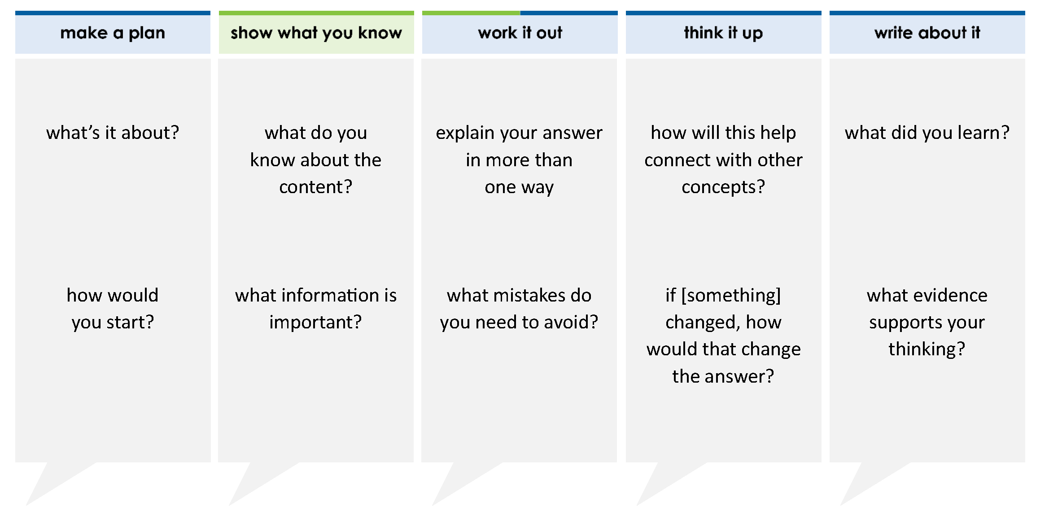
An equation is modeled below.
Which value of x makes this equation true?
A 3 B 2 C 6 D 4
= x
=
= 1
= –1
thinkalong routine
stimulus
Notes:
Throughout the week, use the guiding questions from the thinkalong routine to lead student thinking and discussion around the selected stimulus (problem, text, or visual) aligned to a high-impact standard/concept.

Slide 3
make a plan
Notes:
make a plan
The goal of the first 5-10 minutes of the routine is just for students to explore. We are engaging the “tools to know” process standards and using the selected problem, text, or visual to activate memory around the designated content for the week.
If you’re using a problem as the stimulus, students don’t solve the problem or even see the answer choices yet! In this part of the routine, students practice making a plan, getting started, and thinking about what they will need to answer the question based on the vocabulary and/or visuals included.

Slide 4
An equation is modeled below.
what’s it about?
= x
=
how would you start?
= 1
= –1
Notes:
make a plan: Use the guiding questions on the routine to drive the thinking and discussion with students as you explore the selected stimulus.
This item was selected to address, loopback, or intervene on solving equations because:
It’s a standard that has high leverage for future learning.
Fluency in solving equations and inequalities with two steps is expected in 8th grade.
Students will solve equations in every math class they take from now through college.

Slide 5
show what you know
Notes:
show what you know
The goal of the second 10 minutes in the routine is for students to talk using the problem, text, or visual to show what they know about this concept! This part of the routine allows students and teacher to talk about, share, and clarify the content (vocabulary, visuals, activities, common mistakes, connections, key ideas, important info/details, etc.).

Slide 6
An equation is modeled below.
what do you know about the content?
= x
=
what information is important?
= 1
= –1
Notes:
show what you know - option 1: Use these questions from the routine, along with the selected stimulus, to activate memory, review content, correct learning mistakes, and clarify misconceptions. Be sure discussion includes important information related to the selected stimulus.
important information about this item:
Clues include and require an understanding of important academic vocabulary: equation, model, = x, = 1, = –1.
Students must read and clarify all of the clues:
The white rectangles represent x
The white squares represent 1
The gray squares represent –1
What shape and color would represent –x? gray rectangle
Students would benefit from having practiced solving equations with models and writing the equation that this model represents.

Slide 7



FACT
FIB
Notes:
show what you know - option 2: fact or fib (rehearsal and practice instructional strategy)
purpose
Students review important content and clarify misconceptions by determining which statements are facts and which are fibs in a fact or fib showdown game. Fact or fib is an effective strategy for brain dumping and to activate memory, review content, correct learning mistakes, and clarify misconceptions and that will engage students with the guiding questions from the “show what you know” column and selected weekly stimulus.
instructions
Students create FACT and FIB cards using post it notes, index cards, scratch paper, white boards or use their fingers.
They hold their cards while teacher presents students with a statement (fact or fib) relating to the concept, visual, text, or test item.
Allow students 5-8 seconds to infer if the statement is a fact or a fib.
Students think and prepare to justify their answer until the teacher calls out, “One! Two! Three! Showdown!” at which time all students hold up either the fact or fib card to represent their choice.
Students then take turns explaining and justifying their thinking with a partner or small group.
Observe students’ thinking and clarify/verify as appropriate.
Reveal correct answer and provide rationale.

Slide 8
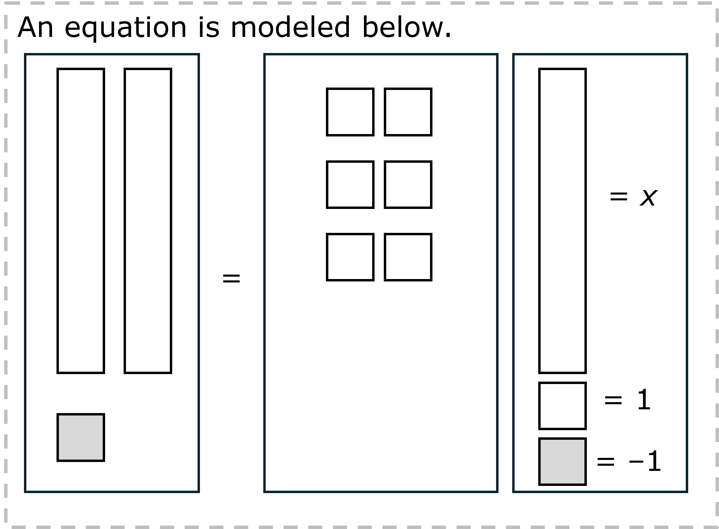
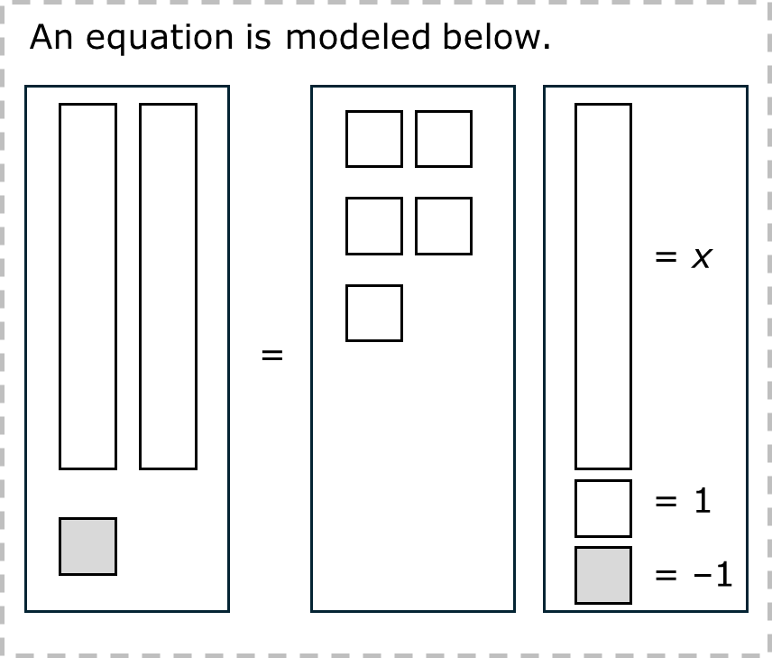
Start solving by adding a gray square to both boxes.
FIB!
makes
–2, not 0.
1-2-3 SHOWDOWN
Notes:
show what you know - option 2, round 1 rationale
This is a FIB because:
[Click to add gray squares.] Adding another gray square doesn’t make 0 and remove the original gray square.
[Click] It makes –2.
[Click] Add a white square to both sides of the =.
[Click] The white and gray square cancel each other out (1 + –1 = 0).

Slide 9
The equation represented by this model is 2x + 1 = 6.
The equation represented by this model is 2x – 1 = 6.
FIB!
1-2-3 SHOWDOWN
Notes:
show what you know - option 2, round 2 rationale
This is a FIB because the 1 is subtracted (or is negative) because it is gray.

Slide 10
work it out
Notes:
work it out
The goal of the third 10 minutes of the routine is for students to work out the problem and defend their answer. We want students to prove why their chosen response is right and explain why the incorrect answers are wrong.

Slide 11
An equation is modeled below.
Which value of x makes this equation true?
A 3 B 2 C 6 D 4
explain your answer in more than one way
= x
=
what mistakes do you need to avoid?
= 1
= –1
Notes:
work it out - option 1: Correct learning mistakes and clarify misconceptions by answering the question but be sure students not only solve but also prove why their chosen response is right and explain why the incorrect answers are wrong.
Be sure discussion includes:
The process to solve the model:
First, make a zero pair by adding a white square to both sides of the =.
Second, divide the ones evenly between each x.
Checking their work by writing the equation and solving it.

Slide 12
  make the case
An equation is modeled below.
Which value of x makes this equation true?
A 3 B 2 C 6 D 4
defend why your answer might be correct/incorrect
what 1-2 pieces of evidence do you have?
= x
=
= 1
= –1
Notes:
work it out - option 2: make the case (learning from mistakes instructional strategy)
free virtual dice available in the lead4ward app and at: www.lead4ward.com/dice
purpose
Students correct learning mistakes and clarify misconceptions by justifying/proving why their assigned response is right OR explain why their assigned response is an incorrect answer.
instructions
Organize students into groups (no larger than 4).
Assign each team a potential answer (choice).
Groups huddle to determine if their answer choice is “correct/innocent” by explaining why and providing (at most) 2 pieces of evidence…or “incorrect/guilty” by explaining why and providing (at most) 2 pieces of evidence.
Students prosecute and defend arguments.
Observe students’ thinking/responses and clarify/verify as appropriate.
be sure discussion includes:
Visuals or models students might use to prove their justification.
Discourse around strategies, clues and/or vocabulary that support their justification.
The chosen incorrect answer(s) suggests a common misconception, guessing pattern, clue picking, stopping too soon, and relying on tricks.
Student-driven discourse.
A is correct.
B is incorrect. Mistake was adding a gray tile (–1) to +5. Then dividing 4 by 2.
C is incorrect. Mistake was not dividing by 2.
D is incorrect. Mistakes were adding a gray tile (–1) to +5 and not dividing by 2.

Slide 13
think it up
Notes:
think it up
The goal of the fourth 10 minutes of the routine is for us to change things up so students can practice with novelty and transfer.

Slide 14
An equation is modeled below.
Which value of x makes this equation true?
A 3 B 2 C 6 D 4
how will this help connect to other concepts?
= x
=
if the x rectangles were negative, how would that change the way you solve the problem?
= 1
= –1
Notes:
think it up - option 1: Use the guiding questions on the routine to drive the thinking and discussion with students as they reflect on the work of the routine so far -- the thinking around the content and the problem, text or visual. Then, have students analyze how all of that can help them as they work on or think through other content or solving future problems.

Slide 15
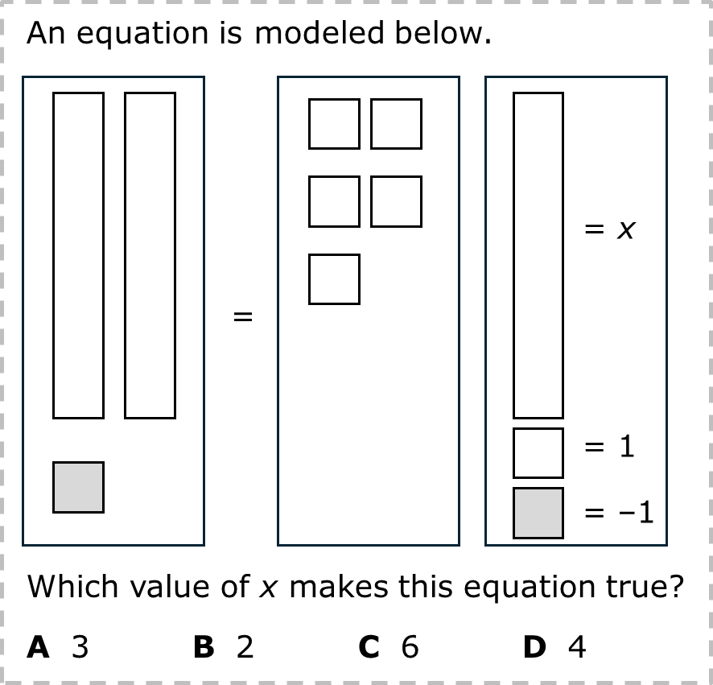
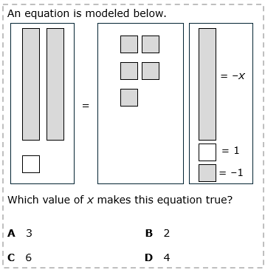
  compare/contrast model
Notes:
think it up - option 2: compare/contrast model (extending thinking instructional strategy)
purpose
This is an effective strategy to facilitate a structured, supported, and engaging way for kids to answer the “think it up” questions and analyze 2 similar yet different items or visuals aligned to the same standard.
instructions
Divide students into groups of 3.
In each group, students CONTRAST the items by discussing/writing 2-3 attributes of each item.
In each group, students COMPARE the items by discussing/writing 2-3 attributes both items share.
Groups share out 1 of their differences and 1 of their similarities.
Observe and listen to students’ thinking and clarify/verify as appropriate.
The original problem is on the left. The problems are essentially the same with the signs reversed. The answer doesn’t change.

Slide 16
write about it
Notes:
write about it
The goal of the last 10 minutes of the routine is for students to reflect on the routine and write about how it affected their understanding and confidence around the content and problem-solving process.

Slide 17
An equation is modeled below.
Which value of x makes this equation true?
A 3 B 2 C 6 D 4
what did you learn?
= x
what evidence supports your thinking?
=
= 1
how is using a model to solve an equation the same as solving the equation by writing?
how is it different?
= –1
Notes:
write about it: The goal of the last 10 minutes of the routine is to solidify learning and have students practice communicating what they know in writing.
Ask students to:
think about the activities, questions, discussions, and the selected problem, text or visual for this week’s thinkalong routine
talk with a partner or in a small group about what they learned and the evidence that supports their thinking
write their answers on a piece of paper or in their notebooks
Review areas in which students may need more support.

