Slide 1





(click on a button to go directly to that step)
Notes:
The thinkalong toolkit includes assessment-style items with answer keys. A digital version (poster) of the thinkalong routine and daily questions for teacher and students’ reference is also included.

Slide 2
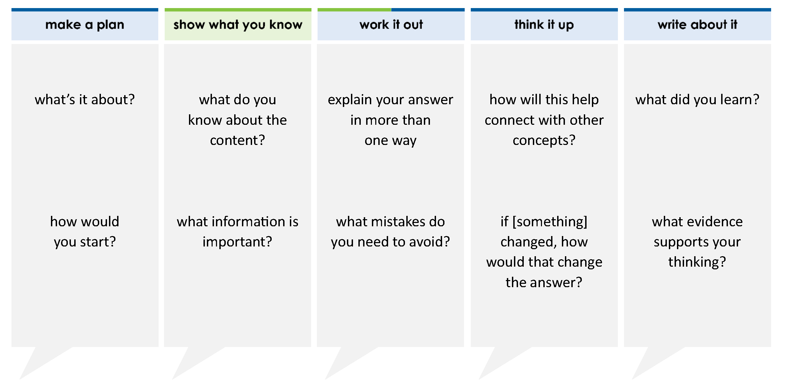
Katy has 50 dragon figures. The statements below shows how many she has:
0.3 of them are blue
of them are purple
the rest of them are orange
How many of the dragons are orange?
A 25
B 10
C 35
D 15
1
5
thinkalong routine
stimulus
Notes:
Throughout the week, use the guiding questions from the thinkalong routine to lead student thinking and discussion around the selected stimulus (problem, text, or visual) aligned to a high-impact standard/concept.

Slide 3
make a plan
Notes:
make a plan
The goal of the first 5-10 minutes of the routine is just for students to explore. We are engaging the “tools to know” process standards and using the selected problem, text, or visual to activate memory around the designated content for the week.
If you’re using a problem as the stimulus, students don’t solve the problem or even see the answer choices yet! In this part of the routine, students practice making a plan, getting started, and thinking about what they will need to answer the question based on the vocabulary and/or visuals included.

Slide 4
what’s it about?
Katy has 50 dragon figures. The statements below shows how many she has:
0.3 of them are blue
of them are purple
the rest of them are orange
1
5
how would you start?
what questions can you answer with the information given?
Notes:
make a plan: Use the guiding questions on the routine to drive the thinking and discussion with students as you explore the selected stimulus.
This item was selected to address, loopback, or intervene on operations with rational numbers because:
It includes a mixture of fractions, decimals, and whole numbers.
The structure of the problem is a common way that problems are asked on an assessment.
Being flexible and fluent with rational numbers is a useful skill in mathematics courses and real life.

Slide 5
show what you know
Notes:
show what you know
The goal of the second 10 minutes in the routine is for students to talk using the problem, text, or visual to show what they know about this concept! This part of the routine allows students and teacher to talk about, share, and clarify the content (vocabulary, visuals, activities, common mistakes, connections, key ideas, important info/details, etc.).

Slide 6
what do you know about the content?
Katy has 50 dragon figures. The statements below shows how many she has:
0.3 of them are blue
of them are purple
the rest of them are orange
1
5
what information is important?
Notes:
show what you know - option 1: Use these questions from the routine, along with the selected stimulus, to activate memory, review content, correct learning mistakes, and clarify misconceptions. Be sure discussion includes important information related to the selected stimulus.
important information about this item:
Clues include and require an understanding of important academic vocabulary: how many, ____ of them are ____, the rest are ____.
Students must read and clarify all of the clues:
Katy has 50 dragon figures.
Some of the 50 are blue (0.3 of them); 0.3 represents a relationship between the number of blue dragons and the total number of dragons.
Some of the 50 are purple (1/5 of them); 1/5 represents a relationship between the number of purple dragons and the total number of dragons.
The rest of the 50 dragons are orange.
Students would benefit from predicting that the question will probably be “How many orange dragon figures does she have?”

Slide 7



FACT
FIB
Notes:
show what you know - option 2: fact or fib (rehearsal and practice instructional strategy)
purpose
Students review important content and clarify misconceptions by determining which statements are facts and which are fibs in a fact or fib showdown game. Fact or fib is an effective strategy for brain dumping and to activate memory, review content, correct learning mistakes, and clarify misconceptions and that will engage students with the guiding questions from the “show what you know” column and selected weekly stimulus.
instructions
Students create FACT and FIB cards using post it notes, index cards, scratch paper, white boards or use their fingers.
They hold their cards while teacher presents students with a statement (fact or fib) relating to the concept, visual, text, or test item.
Allow students 5-8 seconds to infer if the statement is a fact or a fib.
Students think and prepare to justify their answer until the teacher calls out, “One! Two! Three! Showdown!” at which time all students hold up either the fact or fib card to represent their choice.
Students then take turns explaining and justifying their thinking with a partner or small group.
Observe students’ thinking and clarify/verify as appropriate.
Reveal correct answer and provide rationale.

Slide 8
half of Katy’s dragons are either blue or purple
FACT!
Katy has 50 dragon figures. The statements below shows how many she has:
0.3 of them are blue
of them are purple
the rest of them are orange
0.3 are blue
are purple
0.3 + = 0.3 + 0.2 = 0.5
0.5 =
1
5
1
5
1
5
1
2
1-2-3 SHOWDOWN
Notes:
show what you know - option 2, round 1 rationale
This is a FACT. 1/5 = 0.2.
0.2 + 0.3= 0.5
0.5 = 1/2

Slide 9
Katy has 0.3 blue dragons
0.3 × 50 = 15
Katy has 15 blue dragons
Katy has 50 dragon figures. The statements below shows how many she has:
0.3 of them are blue
of them are purple
the rest of them are orange
FIB!
1
5
1-2-3 SHOWDOWN
Notes:
show what you know - option 2, round 2 rationale
This is a FIB. The fraction of Katy’s dragons that are blue is 0.3, not the number of dragons.
0.3 x 50 = 15. Katy has 15 blue dragons.

Slide 10
Katy has 10 purple dragon figures
FACT!
Katy has 50 dragon figures. The statements below shows how many she has:
0.3 of them are blue
of them are purple
the rest of them are orange
1
5
1
5
1
5
50
1
× 50 = × = 10
1-2-3 SHOWDOWN
Notes:
show what you know - option 2, round 3 rationale
This is a FACT. 1/5 x 50 = 10

Slide 11
work it out
Notes:
work it out
The goal of the third 10 minutes of the routine is for students to work out the problem and defend their answer. We want students to prove why their chosen response is right and explain why the incorrect answers are wrong.

Slide 12
Katy has 50 dragon figures. The statements below shows how many she has:
0.3 of them are blue
of them are purple
the rest of them are orange
How many of the dragons are orange?
A 25
B 10
C 35
D 15
explain your answer in more than one way
1
5
what mistakes do you need to avoid?
Notes:
work it out - option 1: Correct learning mistakes and clarify misconceptions by answering the question but be sure students not only solve but also prove why their chosen response is right and explain why the incorrect answers are wrong.
Be sure discussion includes:
0.3 is the fraction of dragons that are blue, not the number of dragons.
1/5 is the fraction of dragons that are purple, not the number of dragons.
To find the number of orange dragons, students must know the number of purple dragons and blue dragons.

Slide 13
make the case
Katy has 50 dragon figures. The statements below shows how many she has:
0.3 of them are blue
of them are purple
the rest of them are orange
How many of the dragons are orange?
A 25
B 10
C 35
D 15
defend why your answer might be correct/incorrect
what 1-2 pieces of evidence do you have?
1
5
Notes:
work it out - option 2: make the case (learning from mistakes instructional strategy)
free virtual dice available in the lead4ward app and at: www.lead4ward.com/dice
purpose
Students correct learning mistakes and clarify misconceptions by justifying/proving why their assigned response is right OR explain why their assigned response is an incorrect answer.
instructions
Organize students into groups (no larger than 4).
Assign each team a potential answer (choice).
Groups huddle to determine if their answer choice is “correct/innocent” by explaining why and providing (at most) 2 pieces of evidence…or “incorrect/guilty” by explaining why and providing (at most) 2 pieces of evidence.
Students prosecute and defend arguments.
Observe students’ thinking/responses and clarify/verify as appropriate.
Be sure discussion includes:
Visuals or models students might use to prove their justification.
Discourse around strategies, clues and/or vocabulary that support their justification.
The chosen incorrect answer(s) suggests a common misconception, guessing pattern, clue picking, stopping too soon, and relying on tricks.
Student-driven discourse.
A is correct. It is the number of orange (left over) dragons.
B is incorrect. It is the number of purple dragons.
C is incorrect. It is a miscalculation error (if the students subtracted 50 – 25 and used an algorithm (rather than knowing half of 50 is 25) but forgot to regroup)
D is incorrect. It is the number of blue dragons

Slide 14
think it up
Notes:
think it up
The goal of the fourth 10 minutes of the routine is for us to change things up so students can practice with novelty and transfer.

Slide 15
how will this connect to other concepts?
Katy has 50 dragon figures. The statements below shows how many she has:
0.3 of them are blue
of them are purple
the rest of them are orange
How many of the dragons are orange?
A 25
B 10
C 35
D 15
did you need to change the form of 0.4 or 1/5 to solve the problem? why or why not?
1
5
if the total number of dragons changed to 100, how would the answer choices change?
Notes:
think it up - option 1: Use the guiding questions on the routine to drive the thinking and discussion with students as they reflect on the work of the routine so far -- the thinking around the content and the problem, text or visual. Then, have students analyze how all of that can help them as they work on or think through other content or solving future problems.

Slide 16
odd one out
Katy has 10 dragon figures. The statements below shows how many she has:
0.3 of them are blue
of them are purple
the rest of them are orange
How many of the dragons are orange?
A 3 B 2 C 6 D 5
Katy has 50 dragon figures. The statements below shows how many she has:
0.3 of them are blue
of them are purple
the rest of them are orange
How many of the dragons are orange?
A 25 B 10 C 35 D 15
1
5
1
5
Katy has 20 dragon figures. The statements below shows how many she has:
0.3 of them are blue
of them are purple
the rest of them are orange
How many of the dragons are orange?
A 6 B 4 C 10 D 8
Katy has 50 dragon figures. The statements below shows how many she has:
0.2 of them are blue
of them are purple
the rest of them are orange
How many of the dragons are orange?
A 25 B 20 C 35 D 15
1
5
2
5
Notes:
think it up - option 2: odd one out (extending thinking instructional strategy)
purpose
Students compare/contrast four visuals, assessment questions, words, characters, historical figures, etc. and justify their thinking by defending which they think is the odd one out.
instructions
Divide students into groups of 4.
In each group, students divide the images/problems amongst their group and take turns describing their image/problem.
Students compare and contrast the images/problems.
Students determine which one is the odd one out and why.
Groups share out their selected odd one out and justification.
Observe and listen to students’ thinking and clarify/verify as appropriate.
Upper right: This is the original question.
Left side: The relationships between the total number of dragons and the blue or purple dragons does not change. The only thing that changes is the total number of dragons. Students should be able to use proportional reasoning to solve those problems without having to do the arithmetic again.
Lower right: The fractional part of the blue or purple dragons is flipped. This doesn’t change the answer to the problem.

Slide 17
write about it
Notes:
write about it
The goal of the last 10 minutes of the routine is for students to reflect on the routine and write about how it affected their understanding and confidence around the content and problem-solving process.

Slide 18
what did you learn?
Katy has 50 dragon figures. The statements below shows how many she has:
0.3 of them are blue
of them are purple
the rest of them are orange
How many of the dragons are orange?
A 25
B 10
C 35
D 15
what clue told you 0.3 is the relationship between the total number of dragons and the number of blue dragons, NOT the number of blue dragons?
1
5
what evidence supports your thinking?
why do you have to pay careful attention to the question the problem asks?
Notes:
write about it: The goal of the last 10 minutes of the routine is to solidify learning and have students practice communicating what they know in writing.
Ask students to:
think about the activities, questions, discussions, and the selected problem, text or visual for this week’s thinkalong routine
talk with a partner or in a small group about what they learned and the evidence that supports their thinking
write their answers on a piece of paper or in their notebooks
Review areas in which students may need more support.

