Slide 1





(click on a button to go directly to that step)
Notes:
The thinkalong toolkit includes assessment-style items with answer keys. A digital version (poster) of the thinkalong routine and daily questions for teacher and students’ reference is also included.

Slide 2
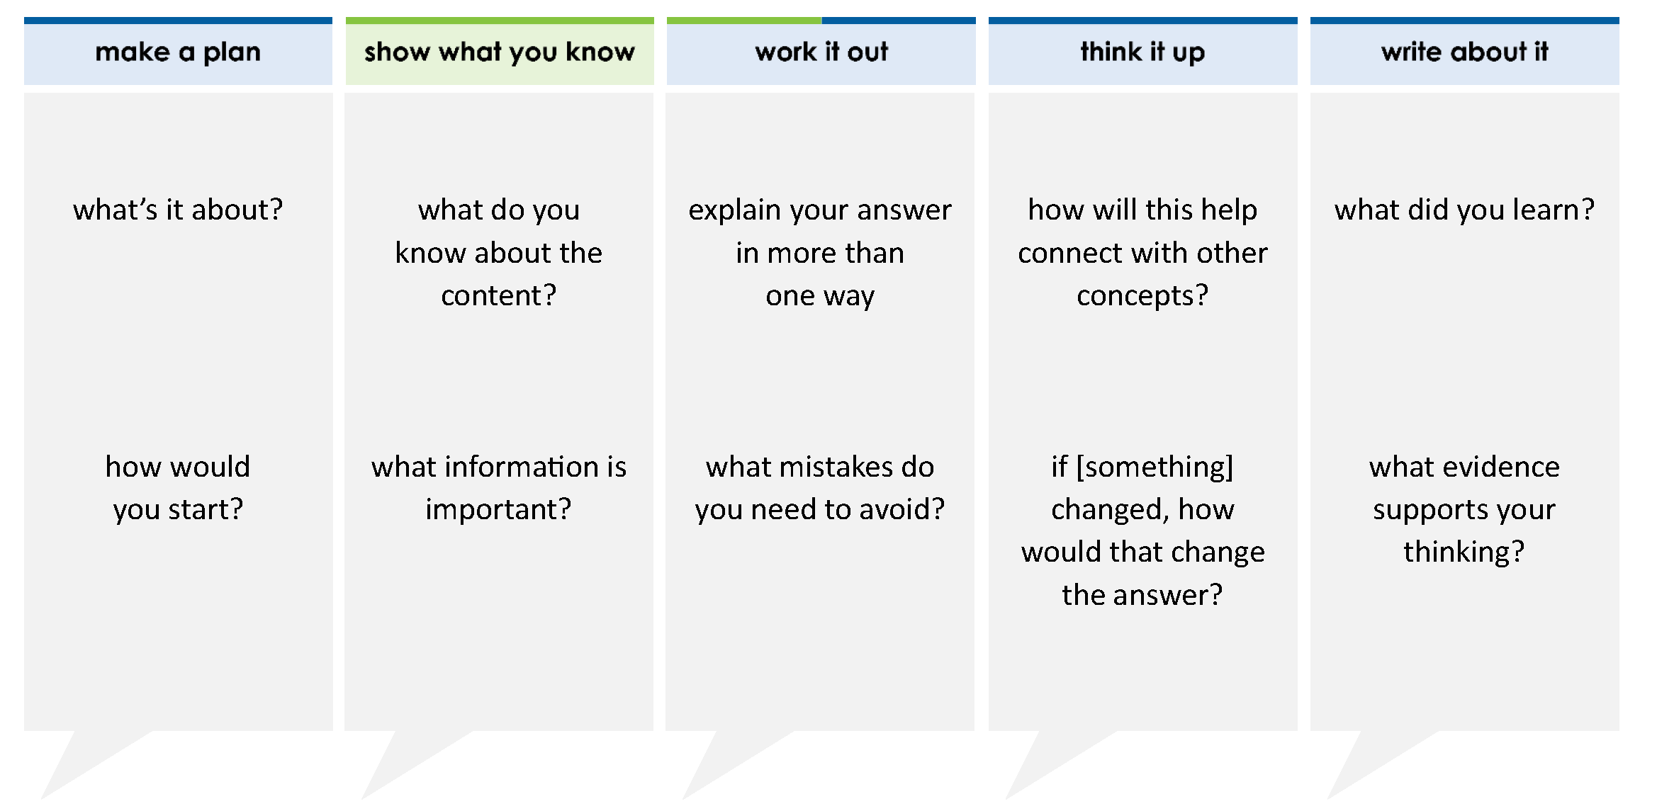
Sugar Shop has 2 bins of jawbreakers. One bin has 5 pounds of jawbreakers and the other one has 4 pounds of jawbreakers. The store sold 5 baggies of jawbreakers. Each baggie contains 1 pounds of jawbreakers.
How many pounds of jawbreakers does the store have now?
A 8 C 4
B 4 D 16
2
3
3
8
1
6
7
8
5
24
thinkalong routine
3
8
5
24
stimulus
Notes:
Throughout the week, use the guiding questions from the thinkalong routine to lead student thinking and discussion around the selected stimulus (problem, text, or visual) aligned to a high-impact standard/concept.

Slide 3
make a plan
Notes:
make a plan
The goal of the first 5-10 minutes of the routine is just for students to explore. We are engaging the “tools to know” process standards and using the selected problem, text, or visual to activate memory around the designated content for the week.
If you’re using a problem as the stimulus, students don’t solve the problem or even see the answer choices yet! In this part of the routine, students practice making a plan, getting started, and thinking about what they will need to answer the question based on the vocabulary and/or visuals included.

Slide 4
what’s it about?
Sugar Shop has 2 bins of jawbreakers. One bin has 5 pounds of jawbreakers, and the other one has 4 pounds of jawbreakers. The store sold 5 baggies of jawbreakers. Each baggie contains 1 pounds of jawbreakers.
2
3
3
8
how would you start?
1
6
what questions can you answer with the information given?
Notes:
make a plan: Use the guiding questions on the routine to drive the thinking and discussion with students as you explore the selected stimulus.
This item was selected to address, loopback, or intervene on operations with rational numbers because:
This is a multi-step problem.
The fractions have different denominators.

Slide 5
show what you know
Notes:
show what you know
The goal of the second 10 minutes in the routine is for students to talk using the problem, text, or visual to show what they know about this concept! This part of the routine allows students and teacher to talk about, share, and clarify the content (vocabulary, visuals, activities, common mistakes, connections, key ideas, important info/details, etc.).

Slide 6
what do you know about the content?
Sugar Shop has 2 bins of jawbreakers. One bin has 5 pounds of jawbreakers, and the other one has 4 pounds of jawbreakers. The store sold 5 baggies of jawbreakers. Each baggie contains 1 pounds of jawbreakers.
2
3
3
8
what information is important?
1
6
Notes:
show what you know - option 1: Use these questions from the routine, along with the selected stimulus, to activate memory, review content, correct learning mistakes, and clarify misconceptions. Be sure discussion includes important information related to the selected stimulus.
important information about this item:
While this item does not technically contain academic vocabulary, students must find the math in the relationships between the quantities (amounts in bins, amounts in baggies, number of baggies).
Students must read and clarify the clues:
There are two bins of jawbreakers. One has 5 2/3 pounds and one has 4 3/8 pounds.
The store sold 5 baggies that each weighed 1 1/6 pounds each.
Students would benefit from:
Recognizing that they will probably have to find the total amount of jawbreakers in the bins.
Recognizing that they will probably have to find the amount sold.
Although this problem contains fractions, students have seen this problem structure many times since 3rd grade. If the fractions confuse students, have them read the problem with the whole numbers only. The approach to solving the problem may become clearer then.

Slide 7



FACT
FIB
Notes:
show what you know - option 2: fact or fib (rehearsal and practice instructional strategy)
purpose
Students review important content and clarify misconceptions by determining which statements are facts and which are fibs in a fact or fib showdown game. Fact or fib is an effective strategy for brain dumping and to activate memory, review content, correct learning mistakes, and clarify misconceptions and that will engage students with the guiding questions from the “show what you know” column and selected weekly stimulus.
instructions
Students create FACT and FIB cards using post it notes, index cards, scratch paper, white boards or use their fingers.
They hold their cards while teacher presents students with a statement (fact or fib) relating to the concept, visual, text, or test item.
Allow students 5-8 seconds to infer if the statement is a fact or a fib.
Students think and prepare to justify their answer until the teacher calls out, “One! Two! Three! Showdown!” at which time all students hold up either the fact or fib card to represent their choice.
Students then take turns explaining and justifying their thinking with a partner or small group.
Observe students’ thinking and clarify/verify as appropriate.
Reveal correct answer and provide rationale.

Slide 8
+ 4 = 5 + 4
9 = 10
the total amount of jawbreakers at the store is 10 because there are 2 bins
5 × 2 = 10
2
3
3
8
16
24
9
24
2
3
25
24
1
24
2
3
2
3
Sugar Shop has 2 bins of jawbreakers. One bin has 5 pounds of jawbreakers, and the other one has 4 pounds of jawbreakers. The store sold 5 baggies of jawbreakers. Each baggie contains 1 pounds of jawbreakers.
FIB!
2
3
3
8
1
6
1-2-3 SHOWDOWN
Notes:
show what you know - option 2, round 1 rationale
This is a FIB. There are different amounts in each bin. The amounts must be added to find the total amount.

Slide 9
5 × 1 = ×
= 5
the total amount of jawbreakers sold is 5 because
5 × 1 means the same thing as 5 +
1
6
5
1
7
6
1
6
35
6
5
6
1
6
1
6
Sugar Shop has 2 bins of jawbreakers. One bin has 5 pounds of jawbreakers, and the other one has 4 pounds of jawbreakers. The store sold 5 baggies of jawbreakers. Each baggie contains 1 pounds of jawbreakers.
2
3
FIB!
3
8
1
6
1-2-3 SHOWDOWN
Notes:
show what you know - option 2, round 2 rationale
This is a FIB. Students must multiply 5 x 1 1/6. 5 x 1 1/6 means (5 groups of 1 1/6) or (5 groups of 1) + (5 groups of 1/6).
5 + 1/6 means 5 1/6.

Slide 10
work it out
Notes:
work it out
The goal of the third 10 minutes of the routine is for students to work out the problem and defend their answer. We want students to prove why their chosen response is right and explain why the incorrect answers are wrong.

Slide 11
Sugar Shop has 2 bins of jawbreakers. One bin has 5 pounds of jawbreakers and the other one has 4 pounds of jawbreakers. The store sold 5 baggies of jawbreakers. Each baggie contains 1 pounds of jawbreakers.
How many pounds of jawbreakers does the store have now?
A 8 C 4
B 4 D 16
2
3
3
8
explain your answer in more than one way
1
6
what mistakes do you need to avoid?
7
8
5
24
3
8
5
24
Notes:
work it out - option 1: Correct learning mistakes and clarify misconceptions by answering the question but be sure students not only solve but also prove why their chosen response is right and explain why the incorrect answers are wrong.
Be sure discussion includes each step of the solution process:
Step 1: Find the total pounds of jawbreakers.
Step 2: Find the pounds of jawbreakers that were sold.
Step 3: Subtract the pounds sold from the total pounds.

Slide 12
  make the case
Sugar Shop has 2 bins of jawbreakers. One bin has 5 pounds of jawbreakers, and the other one has 4 pounds of jawbreakers. The store sold 5 baggies of jawbreakers. Each baggie contains 1 pounds of jawbreakers.
How many pounds of jawbreakers does the store have now?
A 8 C 4
B 4 D 16
2
3
3
8
defend why your answer might be correct/incorrect
what 1-2 pieces of evidence do you have?
1
6
7
8
5
24
3
8
5
24
Notes:
work it out - option 2: make the case (learning from mistakes instructional strategy)
free virtual dice available in the lead4ward app and at: www.lead4ward.com/dice
purpose
Students correct learning mistakes and clarify misconceptions by justifying/proving why their assigned response is right OR explain why their assigned response is an incorrect answer.
instructions
Organize students into groups (no larger than 4).
Assign each team a potential answer (choice).
Groups huddle to determine if their answer choice is “correct/innocent” by explaining why and providing (at most) 2 pieces of evidence…or “incorrect/guilty” by explaining why and providing (at most) 2 pieces of evidence.
Students prosecute and defend arguments.
Observe students’ thinking/responses and clarify/verify as appropriate.
be sure discussion includes:
Visuals or models students might use to prove their justification.
Discourse around strategies, clues and/or vocabulary that support their justification.
The chosen incorrect answer(s) suggests a common misconception, guessing pattern, clue picking, stopping too soon, and relying on tricks.
Student-driven discourse.
A is incorrect. Students subtracted the weight of one bag from the total pounds at the store.
B is incorrect. Students found the total weight incorrectly.
C is the correct answer.
D is incorrect. Students added all the numbers in the problem together.

Slide 13
think it up
Notes:
think it up
The goal of the fourth 10 minutes of the routine is for us to change things up so students can practice with novelty and transfer.

Slide 14
Sugar Shop has 2 bins of jawbreakers. One bin has 5 pounds of jawbreakers, and the other one has 4 pounds of jawbreakers. The store sold 5 baggies of jawbreakers. Each baggie contains 1 pounds of jawbreakers.
How many pounds of jawbreakers does the store have now?
A 8 C 4
B 4 D 16
2
3
how will this help connect with other concepts?
3
8
1
6
work the problem again using estimation – did you get an answer close to the correct one?
how could you change the problem without changing the numbers?
7
8
5
24
3
8
5
24
Notes:
think it up - option 1: Use the guiding questions on the routine to drive the thinking and discussion with students as they reflect on the work of the routine so far -- the thinking around the content and the problem, text or visual. Then, have students analyze how all of that can help them as they work on or think through other content or solving future problems.

Slide 15
  odd one out
Sugar Shop has 2 bins of jawbreakers. One bin has 5 pounds of jawbreakers, and the other one has 4 pounds of jawbreakers. The store sold 5 baggies of jawbreakers. Each baggie contains 1 pounds of jawbreakers.
How many pounds of jawbreakers does the store have now?
2
3
Sugar Shop has 2 bins of jawbreakers with 5 pounds of jawbreakers in each bin. The jawbreakers in the bins are in baggies that hold 1 pounds of jawbreakers. How many baggies are there?
3
8
2
3
1
6
1
6
Sugar Shop has 2 bins of jawbreakers. One bin has 5 pounds of jawbreakers, and the other one holds the rest of the jawbreakers. The store sells 5 baggies of jawbreakers. Each baggie contains 1 pounds of jawbreakers and has 4 pounds leftover. How many pounds are in the second bin?
Sugar Shop has 2 bins of jawbreakers. One bin has 5 pounds of jawbreakers, and the other one has 4 pounds of jawbreakers. The store sells baggies of jawbreakers with 1 pounds of jawbreakers in each baggie.
How many baggies of jawbreakers can it sell?
2
3
2
3
3
8
1
6
1
6
5
24
Notes:
think it up - option 2: odd one out (extending thinking instructional strategy)
purpose
Students compare/contrast four visuals, assessment questions, words, characters, historical figures, etc. and justify their thinking by defending which they think is the odd one out.
instructions
Divide students into groups of 4.
In each group, students divide the images/problems amongst their group and take turns describing their image/problem.
Students compare and contrast the images/problems.
Students determine which one is the odd one out and why.
Groups share out their selected odd one out and justification.
Observe and listen to students’ thinking and clarify/verify as appropriate.
The original problem is in the upper right corner. The other problems use the same context and mostly the same numbers but ask different questions.

Slide 16
write about it
Notes:
write about it
The goal of the last 10 minutes of the routine is for students to reflect on the routine and write about how it affected their understanding and confidence around the content and problem-solving process.

Slide 17
Sugar Shop has 2 bins of jawbreakers. One bin has 5 pounds of jawbreakers, and the other one has 4 pounds of jawbreakers. The store sold 5 baggies of jawbreakers. Each baggie contains 1 pounds of jawbreakers.
How many pounds of jawbreakers does the store have now?
A 8 C 4
B 4 D 16
what did you learn?
2
3
3
8
how did you identify the clues in the problem that told which steps to do?
1
6
what evidence supports your thinking?
7
8
5
24
could this problem have been solved using only estimation? why or why not?
3
8
5
24
Notes:
write about it: The goal of the last 10 minutes of the routine is to solidify learning and have students practice communicating what they know in writing.
Ask students to:
think about the activities, questions, discussions, and the selected problem, text or visual for this week’s thinkalong routine
talk with a partner or in a small group about what they learned and the evidence that supports their thinking
write their answers on a piece of paper or in their notebooks
Review areas in which students may need more support.

