Slide 1





(click on a button to go directly to that step)
Notes:
The thinkalong toolkit includes assessment-style items with answer keys. A digital version (poster) of the thinkalong routine and daily questions for teacher and students’ reference is also included.

Slide 2
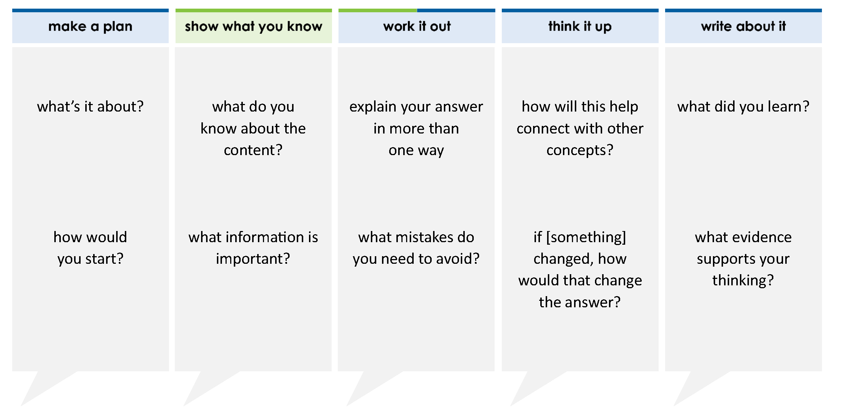
Alexa has a project due next week. The table shows the amount of the project she has completed.
How much of the project does Alexa still need to complete?
A 3 B 1 C 11 D 1
4 12 12 4
Project Completion
Day | Amount Completed
Monday | 1 8
Tuesday | 1 6
Wednesday | 1 12
Thursday | 3 8
thinkalong routine
stimulus
Notes:
Throughout the week, use the guiding questions from the thinkalong routine to lead student thinking and discussion around the selected stimulus (problem, text, or visual) aligned to a high-impact standard/concept.

Slide 3
make a plan
Notes:
make a plan
The goal of the first 5-10 minutes of the routine is just for students to explore. We are engaging the “tools to know” process standards and using the selected problem, text, or visual to activate memory around the designated content for the week.
If you’re using a problem as the stimulus, students don’t solve the problem or even see the answer choices yet! In this part of the routine, students practice making a plan, getting started, and thinking about what they will need to answer the question based on the vocabulary and/or visuals included.

Slide 4
Alexa has a project due next week. The table shows the amount of the project she has completed.
what’s it about?
Project Completion
Day | Amount Completed
Monday | 1 8
Tuesday | 1 6
Wednesday | 1 12
Thursday | 3 8
how would you start?
what questions can you answer with the information given?
Notes:
make a plan: Use the guiding questions on the routine to drive the thinking and discussion with students as you explore the selected stimulus.
This item was selected to address, loopback, or intervene on operations with rational numbers because:
It’s an important skill students will use in middle school, high school, college, and real life.
The fractions have different denominators.

Slide 5
show what you know
Notes:
show what you know
The goal of the second 10 minutes in the routine is for students to talk using the problem, text, or visual to show what they know about this concept! This part of the routine allows students and teacher to talk about, share, and clarify the content (vocabulary, visuals, activities, common mistakes, connections, key ideas, important info/details, etc.).

Slide 6
Alexa has a project due next week. The table shows the amount of the project she has completed.
what do you know about the content?
Project Completion
Day | Amount Completed
Monday | 1 8
Tuesday | 1 6
Wednesday | 1 12
Thursday | 3 8
what information is important?
Notes:
show what you know - option 1: Use these questions from the routine, along with the selected stimulus, to activate memory, review content, correct learning mistakes, and clarify misconceptions. Be sure discussion includes important information related to the selected stimulus.
important information about this item:
Clues include and require an understanding of important academic vocabulary: completed, amount completed.
Students must read and clarify all of the clues:
The project is due next week.
The project is not finished.
Alexa has worked on the project each day but there is still some left to complete.
Students would benefit from understanding what “complete” means in terms of numbers.

Slide 7



just the facts
Alexa has a project due next week. The table shows the amount of the project she has completed.
Project Completion
Day | Amount Completed
Monday | 1 8
Tuesday | 1 6
Wednesday | 1 12
Thursday | 3 8
Notes:
show what you know - option 2: just the facts (rehearsal and practice instructional strategy)
purpose
The purpose is to help student identify the most important details from a problem or visual.
instructions
Students read a text and observe an image.
They determine 3 facts (interesting, useful, most important) from the stem.
With a thinking partner, students justify why they chose a particular fact.
Observe students’ thinking and clarify/verify as appropriate.
Interesting fact: Alexa is going to have to work on the project over the weekend.
Useful fact: The sum of the fractions tells how much of the project is complete.
Most important fact: What number means “completed” in this problem? 1

Slide 8
work it out
Notes:
work it out
The goal of the third 10 minutes of the routine is for students to work out the problem and defend their answer. We want students to prove why their chosen response is right and explain why the incorrect answers are wrong.

Slide 9
Alexa has a project due next week. The table shows the amount of the project she has completed.
How much of the project does Alexa still need to complete?
A 3 B 1 C 11 D 1
4 12 12 4
Project Completion
Day | Amount Completed
Monday | 1 8
Tuesday | 1 6
Wednesday | 1 12
Thursday | 3 8
explain your answer in more than one way
what mistakes do you need to avoid?
Notes:
work it out - option 1: Correct learning mistakes and clarify misconceptions by answering the question but be sure students not only solve but also prove why their chosen response is right and explain why the incorrect answers are wrong.
Be sure discussion includes:
The common denominator is 24.
To find the amount Alexa needs to do, add the fractions in the table. Then subtract from 1.
The difference between 1 and the sum needs to be simplified.

Slide 10


IQ slap down
A
B
C
D
Round 1 - Worst Answer
Round 2 - Best Distractor
Round 3 - Correct Answer
Notes:
work it out - option 2: IQ slap down (learning from mistakes instructional strategy)
purpose
Students analyze or practice assessment questions by determining the worst answer, the distractor, and the correct answer through a slap-down game.
instructions
Students create a set of A-B-C-D cards using sticky notes, index cards, or scratch paper.
Organize students into thinking partners or small groups.
Facilitate 3 rounds of IQ Slap Down with the selected weekly assessment item:
Round 1: At teacher’s signal, students slap down the WORST answer, justify with their partner, and pick up their cards. Teacher clarifies.
Round 2: At teacher’s signal, students slap down the DISTRACTOR answer, justify with their partner, and pick up their cards. Teacher clarifies.
Round 3: At teacher’s signal, students slap down the CORRECT answer, justify with their partner, and pick up their cards. Teacher clarifies.
Observe students’ thinking and clarify/verify as appropriate.
Answer “work it out questions” from think along routine.

Slide 11
Alexa has a project due next week. The table shows the amount of the project she has completed.
How much of the project does Alexa still need to complete?
A 3 B 1 C 11 D 1
4 12 12 4
Least Common Multiples:
8: 8, 16, 24
6: 6, 12, 18, 24
12: 12, 24
Project Completion
Day | Amount Completed
Monday | 1 8
Tuesday | 1 6
Wednesday | 1 12
Thursday | 3 8
Round 1 Worst Answer
1-2-3 Slap Down
Notes:
work it out - option 2: round 1 rationale
C is the worst answer.
Reason 1: The common denominator is 24, not 12.
Reason 2: The distractor doesn’t include subtracting from 1.

Slide 12
Alexa has a project due next week. The table shows the amount of the project she has completed.
How much of the project does Alexa still need to complete?
A 3 B 1 C 11 D 1
4 12 12 4
1 1 1 3
6 12 8
3 4 2 9
24 24 24
18 3
24 4
Project Completion
Day | Amount Completed
Monday | 1 8
Tuesday | 1 6
Wednesday | 1 12
Thursday | 3 8
+
+
+
=
+
+
+
=
=
Round 2 Best Distractor
1-2-3 Slap Down
Notes:
work it out - option 2: round 2 rationale
A is the best distractor.
When the fractions are added together, they equal ¾. But ¾ is the amount completed, not the amount that Alexa needs to complete.

Slide 13
Alexa has a project due next week. The table shows the amount of the project she has completed.
How much of the project does Alexa still need to complete?
A 3 B 1 C 11 D 1
4 12 12 4
1 1 1 3
6 12 8
3 4 2 9
24 24 24
18 3
24 4
3 1
4 4
+
+
+
=
Project Completion
Day | Amount Completed
Monday | 1 8
Tuesday | 1 6
Wednesday | 1 12
Thursday | 3 8
+
+
+
=
=
1 –
=
Round 3 Correct Answer
1-2-3 Slap Down
Notes:
work it out - option 2: round 3 rationale
D is the correct answer. After adding the fractions in the table, subtract from 1. 1 represents the whole project completed.
After IQ slap down, answer the “work it out” questions from the thinkalong routine:
explain your answer in more than one way
what mistakes do you need to avoid?

Slide 14
think it up
Notes:
think it up
The goal of the fourth 10 minutes of the routine is for us to change things up so students can practice with novelty and transfer.

Slide 15
Alexa has a project due next week. The table shows the amount of the project she has completed.
How much of the project does Alexa still need to complete?
A 3 B 1 C 11 D 1
4 12 12 4
how will this help connect with other concepts?
Project Completion
Day | Amount Completed
Monday | 1 8
Tuesday | 1 6
Wednesday | 1 12
Thursday | 3 8
Why does “completed” mean 1?
if the problem asked how much of the project is completed, how would that change the answer?
Notes:
think it up - option 1: Use the guiding questions on the routine to drive the thinking and discussion with students as they reflect on the work of the routine so far -- the thinking around the content and the problem, text or visual. Then, have students analyze how all of that can help them as they work on or think through other content or solving future problems.

Slide 16
compare/contrast model
Alexa has a project due next week. The table shows the amount of the project she has completed.
How much of the project does Alexa still need to complete?
A 3 B 1 C 11 D 1
4 12 12 4
Devon also has a project due next week. The table shows the amount of the project he has completed.
How much of the project has Devon completed?
A 1 B 19 C 11 D 2
4 36 18 3
Project Completion
Day | Amount Completed
Monday | 1 8
Tuesday | 1 6
Wednesday | 1 12
Thursday | 3 8
Project Completion
Day | Amount Completed
Monday | 1 6
Tuesday | 2 9
Wednesday | 5 36
Thursday | 1 12
Notes:
think it up - option 2: compare/contrast model (extending thinking instructional strategy)
purpose
This is an effective strategy to facilitate a structured, supported, and engaging way for kids to answer the “think it up” questions and analyze 2 similar yet different items or visuals aligned to the same standard.
instructions
Divide students into groups of 3.
In each group, students CONTRAST the items by discussing/writing 2-3 attributes of each item.
In each group, students COMPARE the items by discussing/writing 2-3 attributes both items share.
Groups share out 1 of their differences and 1 of their similarities.
Observe and listen to students’ thinking and clarify/verify as appropriate.
The problems have the same context. The problem on the left asks how much is left to complete. The problem on the right asks how much as been completed.

Slide 17
write about it
Notes:
write about it
The goal of the last 10 minutes of the routine is for students to reflect on the routine and write about how it affected their understanding and confidence around the content and problem-solving process.

Slide 18
Alexa has a project due next week. The table shows the amount of the project she has completed.
How much of the project does Alexa still need to complete?
A 3 B 1 C 11 D 1
4 12 12 4
what did you learn?
Project Completion
Day | Amount Completed
Monday | 1 8
Tuesday | 1 6
Wednesday | 1 12
Thursday | 3 8
what evidence supports your thinking?
why does it make sense to use 1 as the value of completion?
Notes:
write about it: The goal of the last 10 minutes of the routine is to solidify learning and have students practice communicating what they know in writing.
Ask students to:
think about the activities, questions, discussions, and the selected problem, text or visual for this week’s thinkalong routine
talk with a partner or in a small group about what they learned and the evidence that supports their thinking
write their answers on a piece of paper or in their notebooks
Review areas in which students may need more support.

