Slide 1





(click on a button to go directly to that step)
Notes:
The thinkalong toolkit includes assessment-style items with answer keys. A digital version (poster) of the thinkalong routine and daily questions for teacher and students’ reference is also included.

Slide 2
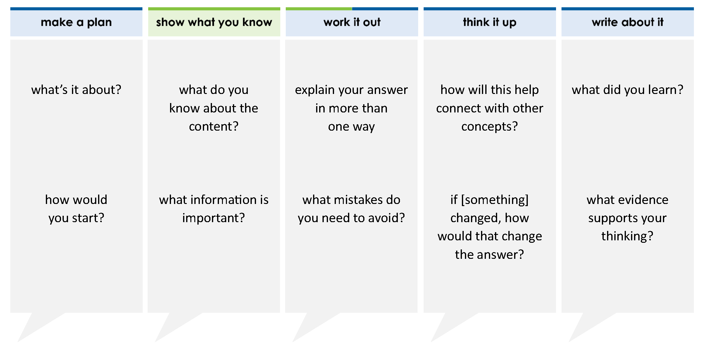
A model representing a linear equation is shown.
Based on the model, what is the value of x?
A 2 B 10 C – D -2
1
1
–1
–1
–x
–x
–x
1
1
=
x
x
–1
–1
1
1
thinkalong routine
2
5
stimulus
Notes:
Throughout the week, use the guiding questions from the thinkalong routine to lead student thinking and discussion around the selected stimulus (problem, text, or visual) aligned to a high-impact standard/concept.

Slide 3
make a plan
Notes:
make a plan
The goal of the first 5-10 minutes of the routine is just for students to explore. We are engaging the “tools to know” process standards and using the selected problem, text, or visual to activate memory around the designated content for the week.
If you’re using a problem as the stimulus, students don’t solve the problem or even see the answer choices yet! In this part of the routine, students practice making a plan, getting started, and thinking about what they will need to answer the question based on the vocabulary and/or visuals included.

Slide 4
what’s it about?
A model representing a linear equation is shown.
1
1
–1
–1
–x
–x
–x
1
1
=
x
x
–1
–1
how would you start?
1
1
what do you think you will have to do with this information?
Notes:
make a plan: Use the guiding questions on the routine to drive the thinking and discussion with students as you explore the selected stimulus.
This item was selected to address, loopback, or intervene on solving equations using models because:
It’s a skill/concept students need for future learning, and the models help students with deeper understanding.
Fluency in solving equations and inequalities with variables on both sides of the = is expected in higher courses.
Students will solve equations in every math class.

Slide 5
show what you know
Notes:
show what you know
The goal of the second 10 minutes in the routine is for students to talk using the problem, text, or visual to show what they know about this concept! This part of the routine allows students and teacher to talk about, share, and clarify the content (vocabulary, visuals, activities, common mistakes, connections, key ideas, important info/details, etc.).

Slide 6
A model representing a linear equation is shown.
what do you know about the content?
1
1
–1
–1
–x
–x
–x
1
1
=
x
x
–1
–1
1
1
what information is important?
Notes:
show what you know - option 1: Use these questions from the routine, along with the selected stimulus, to activate memory, review content, correct learning mistakes, and clarify misconceptions. Be sure discussion includes important information related to the selected stimulus.
important information about this item:
Clues include and require an understanding of important academic vocabulary: model, linear equation, x, –x, 1, –1.
Students must read and clarify all of the clues:
The models are labeled with their values, so there is no separate key. This is different from previous grades.
The = separates the two sides of the equation.
Students would benefit from practice:
Reading models of equations
Solving equations using models
Writing the equation that this model represents
Checking their work using models

Slide 7



FACT
FIB
Notes:
show what you know - option 2: fact or fib (rehearsal and practice instructional strategy)
purpose
Students review important content and clarify misconceptions by determining which statements are facts and which are fibs in a fact or fib showdown game. Fact or fib is an effective strategy for brain dumping and to activate memory, review content, correct learning mistakes, and clarify misconceptions and that will engage students with the guiding questions from the “show what you know” column and selected weekly stimulus.
instructions
Students create FACT and FIB cards using post it notes, index cards, scratch paper, white boards or use their fingers.
They hold their cards while teacher presents students with a statement (fact or fib) relating to the concept, visual, text, or test item.
Allow students 5-8 seconds to infer if the statement is a fact or a fib.
Students think and prepare to justify their answer until the teacher calls out, “One! Two! Three! Showdown!” at which time all students hold up either the fact or fib card to represent their choice.
Students then take turns explaining and justifying their thinking with a partner or small group.
Observe students’ thinking and clarify/verify as appropriate.
Reveal correct answer and provide rationale.

Slide 8
The x and the 1 are understood to be positive.
A model representing a linear equation is shown.
1
1
–1
–1
FACT!
–x
–x
–x
1
1
=
x
x
–1
–1
1
1
1-2-3 SHOWDOWN
Notes:
show what you know - option 2, round 1 rationale
This is a FACT. When numbers or tiles don’t have a visible negative sign or subtraction sign, they are considered to be positive.

Slide 9
Start this problem by multiplying by –1. This changes the signs only on the x tiles.
A model representing a linear equation is shown.
1
1
–1
–1
FIB!
–x
–x
–x
1
1
=
x
x
–1
–1
1
1
1-2-3 SHOWDOWN
Notes:
show what you know - option 2, round 2 rationale
This is a FIB. Multiplying by –1 changes the signs on ALL the tiles.
Why would you want to multiply by –1? It will make the x tiles on the left side of the = positive. Sometimes it’s easier to solve equations when the x’s on the left side are positive.
Do you HAVE to multiply by –1? No

Slide 10
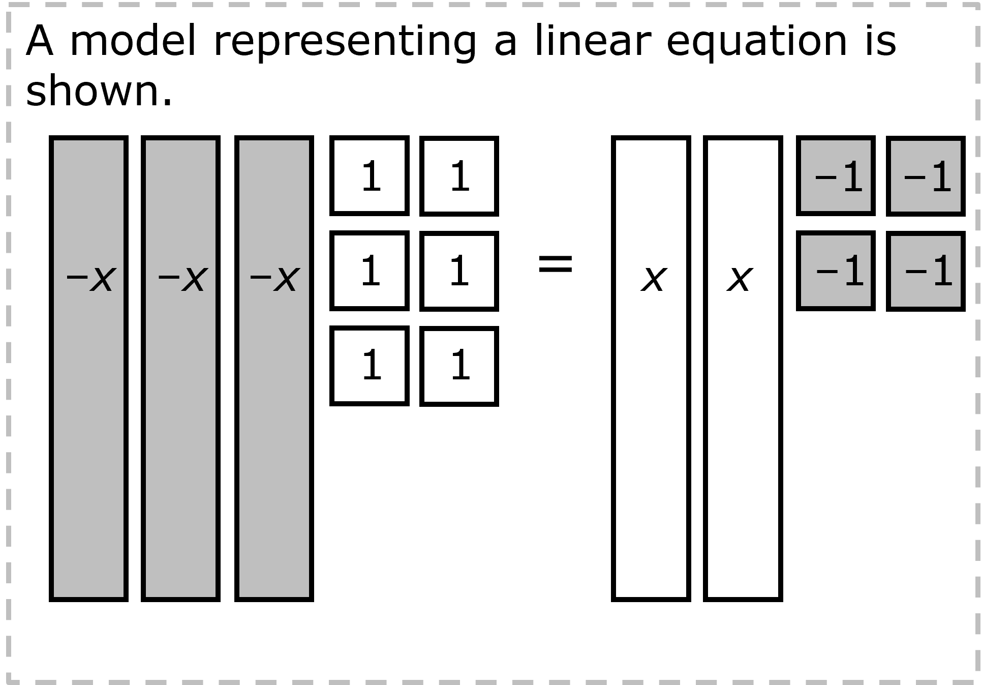
The second model below is equivalent to the original problem.
FACT!
–1
–1
–x
–x
–x
–x
–x
=
–1
–1
–1
–1
–1
–1
–1
–1
1-2-3 SHOWDOWN
Notes:
show what you know - option 2, round 3 rationale
This is a FACT. When the +x moved to the left side, they changed to –x. When the +1 moved to the right side, they changed to –1.
Notice that all the numbers are negative. IF we had multiplied the equation by –1, all the numbers would be positive.

Slide 11
work it out
Notes:
work it out
The goal of the third 10 minutes of the routine is for students to work out the problem and defend their answer. We want students to prove why their chosen response is right and explain why the incorrect answers are wrong.

Slide 12
A model representing a linear equation is shown.
Based on the model, what is the value of x?
A 2 B 10 C – D -2
explain your answer in more than one way
1
1
–1
–1
–x
–x
–x
1
1
=
x
x
–1
–1
1
1
what mistakes do you need to avoid?
2
5
Notes:
work it out - option 1: Correct learning mistakes and clarify misconceptions by answering the question but be sure students not only solve but also prove why their chosen response is right and explain why the incorrect answers are wrong.
Be sure discussion includes:
The addition of the equation to the problem.
The process to solve the model:
Add –2x to both sides.
Add –6 to both sides.
Divide the ones evenly with the x’s to get the answer.
Check the signs.
Substitute the answer into the model/problem to ensure the correct answer.
Students can multiply each term in the equation by –1 to change the signs on all the tiles before they start solving. This is often helpful when the variable on the left side of the equation has a negative coefficient. This will eliminate some or all the negatives in an equation. In this equation, it eliminates all the negatives.
How to check the answer.

Slide 13

IQ slap down
A
B
C
D
Round 1 - Worst Answer
Round 2 - Best Distractor
Round 3 - Correct Answer
Notes:
work it out - option 2: IQ slap down (learning from mistakes instructional strategy)
purpose
Students analyze or practice assessment questions by determining the worst answer, the distractor, and the correct answer through a slap-down game.
instructions
Students create a set of A-B-C-D cards using sticky notes, index cards, or scratch paper.
Organize students into thinking partners or small groups.
Facilitate 3 rounds of IQ Slap Down with the selected weekly assessment item:
Round 1: At teacher’s signal, students slap down the WORST answer, justify with their partner, and pick up their cards. Teacher clarifies.
Round 2: At teacher’s signal, students slap down the DISTRACTOR answer, justify with their partner, and pick up their cards. Teacher clarifies.
Round 3: At teacher’s signal, students slap down the CORRECT answer, justify with their partner, and pick up their cards. Teacher clarifies.
Observe students’ thinking and clarify/verify as appropriate.
Answer “work it out questions” from think along routine.

Slide 14
If B is the worst answer…
If C is the worst answer…
A model representing a linear equation is shown.
Based on the model, what is the value of x?
A 2 B 10 C – D -2
1
1
–1
–1
–1
–1
–1
–1
1
1
=
–1
–1
=
–x
–x
–x
x
x
=
–1
–1
–x
–x
–x
–x
–x
–1
–1
–x
–x
–x
x
x
1
1
1
1
–1
–1
1
1
–1
–1
1
1
–1
–1
2
5
Round 1 Worst Answer
1-2-3 Slap Down
Notes:
work it out - option 2: round 1 rationale
Either B or C are the worst answer. Both involve dropping negatives.
[Click] If B is the worst answer, then when the solver moved the +x to the left side, the solver didn’t change the signs.
[Click] If C is the worst answer, then when the solver moved the +6 to the right side, the solver didn’t change the signs.

Slide 15
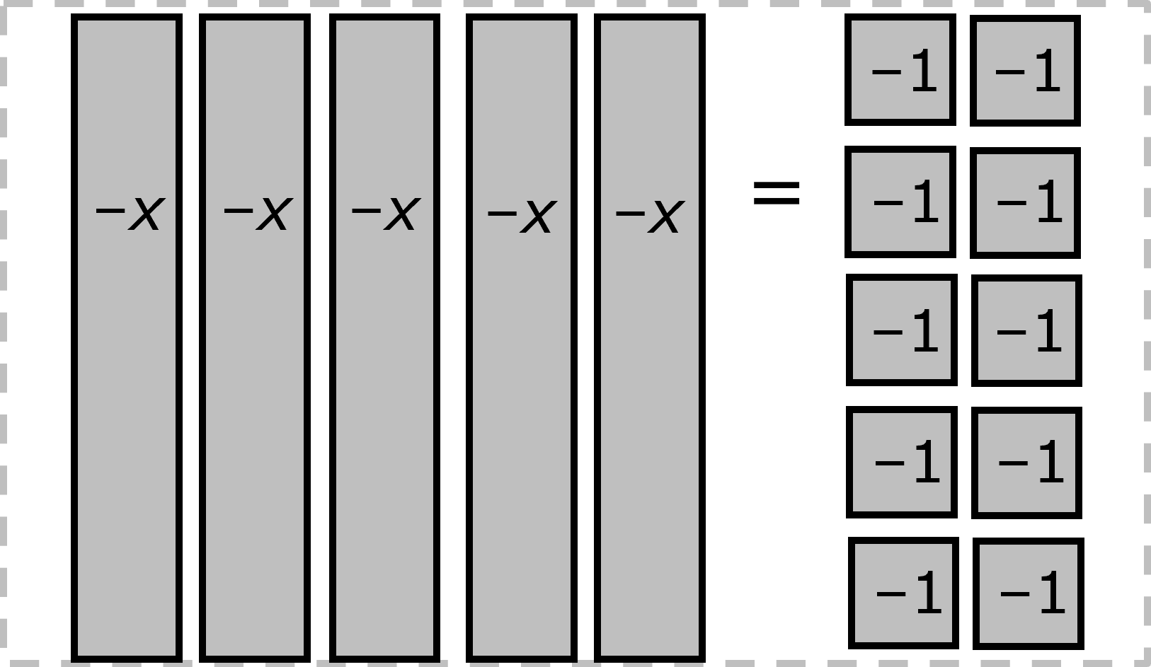
A model representing a linear equation is shown.
Based on the model, what is the value of x?
A 2 B 10 C – D -2
1
1
–1
–1
–x
–x
–x
1
1
=
x
x
–1
–1
1
1
Since –5x = –10, then 5x = 10. So, x must be +2.
2
5
Round 2 Best Distractor
1-2-3 Slap Down
Notes:
work it out - option 2: round 2 rationale
D is the best distractor.
[Click] The student did the hard work of moving the tiles to the correct side using the correct signs.
[Click] But dropped a negative at the end.

Slide 16
A model representing a linear equation is shown.
Based on the model, what is the value of x?
A 2 B 10 C – D -2
1
1
–1
–1
–x
–x
–x
1
1
=
x
x
–1
–1
1
1
–x
=
–1
x
=
1
–1
1
2
5
Round 3 Correct Answer
1-2-3 Slap Down
Notes:
work it out - option 2: round 3 rationale
A is the correct answer.
[Click to show equation with x’s on the left and 1’s on the right.]
[Click to show how each –5x = –10 and the division.]
[Click to show –x = –2.]
[Click to show x = 2.]
After IQ slap down, answer the “work it out” questions from the thinkalong routine:
explain your answer in more than one way
what mistakes do you need to avoid?

Slide 17
think it up
Notes:
think it up
The goal of the fourth 10 minutes of the routine is for us to change things up so students can practice with novelty and transfer.

Slide 18
how will this help connect with other concepts?
A model representing a linear equation is shown.
Based on the model, what is the value of x?
A 2 B 10 C – D -2
1
1
–1
–1
–x
–x
–x
1
1
=
x
x
–1
–1
does the model make more sense or does solving the equation? why?
1
1
if the = sign changed to ≥, how would that change the answer?
how do you know when it might make sense to multiply the equation by –1 when solving an equation?
2
5
Notes:
think it up - option 1: Use the guiding questions on the routine to drive the thinking and discussion with students as they reflect on the work of the routine so far -- the thinking around the content and the problem, text or visual. Then, have students analyze how all of that can help them as they work on or think through other content or solving future problems.

Slide 19
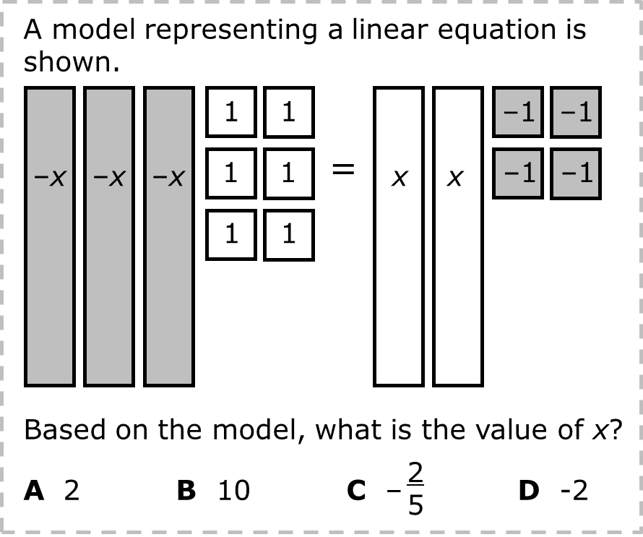
compare/contrast model
What value of x makes this equation true?
3x – 6 = –2x + 4
Notes:
think it up - option 2: compare/contrast model (extending thinking instructional strategy)
purpose
This is an effective strategy to facilitate a structured, supported, and engaging way for kids to answer the “think it up” questions and analyze 2 similar yet different items or visuals aligned to the same standard.
instructions
Divide students into groups of 3.
In each group, students CONTRAST the items by discussing/writing 2-3 attributes of each item.
In each group, students COMPARE the items by discussing/writing 2-3 attributes both items share.
Groups share out 1 of their differences and 1 of their similarities.
Observe and listen to students’ thinking and clarify/verify as appropriate.
The problems are essentially the same. In the one on the right, the equation from the model has been multiplied by –1.

Slide 20
write about it
Notes:
write about it
The goal of the last 10 minutes of the routine is for students to reflect on the routine and write about how it affected their understanding and confidence around the content and problem-solving process.

Slide 21
what did you learn?
A model representing a linear equation is shown.
Based on the model, what is the value of x?
A 2 B 10 C – D -2
1
1
–1
–1
–x
–x
–x
1
1
=
x
x
–1
–1
how is using a model to solve an equation the same as solving the equation by writing?
how is it different?
1
1
what evidence supports your thinking?
2
5
Notes:
write about it: The goal of the last 10 minutes of the routine is to solidify learning and have students practice communicating what they know in writing.
Ask students to:
think about the activities, questions, discussions, and the selected problem, text or visual for this week’s thinkalong routine
talk with a partner or in a small group about what they learned and the evidence that supports their thinking
write their answers on a piece of paper or in their notebooks
Review areas in which students may need more support.

