Slide 1





(click on a button to go directly to that step)
Notes:
The thinkalong toolkit includes assessment-style items with answer keys. A digital version (poster) of the thinkalong routine and daily questions for teacher and students’ reference is also included.

Slide 2
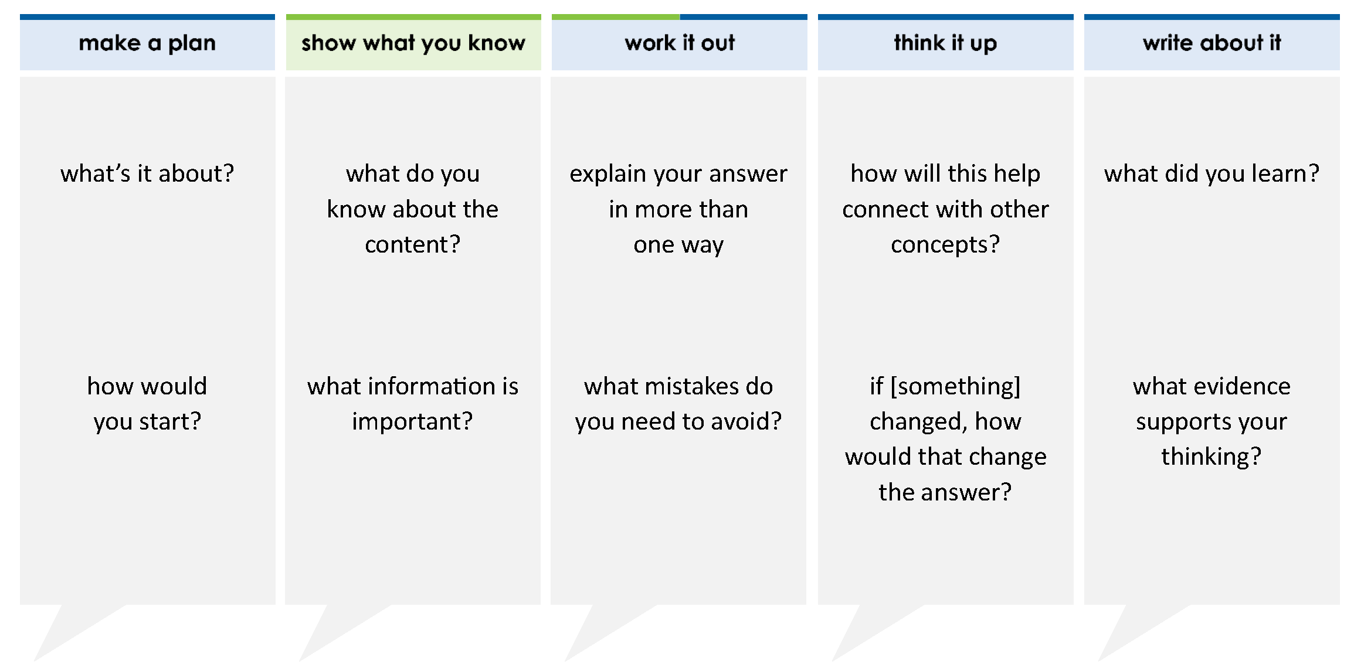
Emily buys notebooks that cost $7 each at the grocery store and uses a $10 coupon.
David buys the same notebooks online for $5 each. He pays $12 shipping.
They spend the same amount of money.
How many notebooks do Emily and David buy?
A 22
B 6
C 1
D 11
thinkalong routine
stimulus
Notes:
Throughout the week, use the guiding questions from the thinkalong routine to lead student thinking and discussion around the selected stimulus (problem, text, or visual) aligned to a high-impact standard/concept.

Slide 3
make a plan
Notes:
make a plan
The goal of the first 5-10 minutes of the routine is just for students to explore. We are engaging the “tools to know” process standards and using the selected problem, text, or visual to activate memory around the designated content for the week.
If you’re using a problem as the stimulus, students don’t solve the problem or even see the answer choices yet! In this part of the routine, students practice making a plan, getting started, and thinking about what they will need to answer the question based on the vocabulary and/or visuals included.

Slide 4
what’s it about?
Emily buys notebooks that cost $7 each at the grocery store and uses a $10 coupon.
David buys the same notebooks online for $5 each. He pays $12 shipping.
They spend the same amount of money.
how would you start?
Notes:
make a plan: Use the guiding questions on the routine to drive the thinking and discussion with students as you explore the selected stimulus.
This item was selected to address, loopback, or intervene on solving equations from word problems because:
It’s a skill/concept needed for future learning.
The word problem must be written as an equation and then solved.
Students will write equations to represent problems in every math class.

Slide 5
show what you know
Notes:
show what you know
The goal of the second 10 minutes in the routine is for students to talk using the problem, text, or visual to show what they know about this concept! This part of the routine allows students and teacher to talk about, share, and clarify the content (vocabulary, visuals, activities, common mistakes, connections, key ideas, important info/details, etc.).

Slide 6
what do you know about the content?
Emily buys notebooks that cost $7 each at the grocery store and uses a $10 coupon.
David buys the same notebooks online for $5 each. He pays $12 shipping.
They spend the same amount of money.
what do you know about the problem situation?
what information is important?
Notes:
show what you know - option 1: Use these questions from the routine, along with the selected stimulus, to activate memory, review content, correct learning mistakes, and clarify misconceptions. Be sure discussion includes important information related to the selected stimulus.
important information about this item:
Clues include and require an understanding of important academic vocabulary: cost ____ each, coupon, shipping, same amount, how many. This problem doesn’t contain technical math vocabulary. The mathematical relationships are written into the everyday language used.
Students must read and clarify the clues:
Emily’s notebooks are $7 per notebook.
Emily uses a $10 coupon.
David’s notebooks are $5 per notebook.
David pays an extra $12 shipping.
Emily and David spend the same amount of money.
Students would benefit from knowing what the variable represents in the problem (the number of notebooks that each person bought) and identifying the quantities that are equal (amount that each person spent).

Slide 7



FACT
FIB
Notes:
show what you know - option 2: fact or fib (rehearsal and practice instructional strategy)
purpose
Students review important content and clarify misconceptions by determining which statements are facts and which are fibs in a fact or fib showdown game. Fact or fib is an effective strategy for brain dumping and to activate memory, review content, correct learning mistakes, and clarify misconceptions and that will engage students with the guiding questions from the “show what you know” column and selected weekly stimulus.
instructions
Students create FACT and FIB cards using post it notes, index cards, scratch paper, white boards or use their fingers.
They hold their cards while teacher presents students with a statement (fact or fib) relating to the concept, visual, text, or test item.
Allow students 5-8 seconds to infer if the statement is a fact or a fib.
Students think and prepare to justify their answer until the teacher calls out, “One! Two! Three! Showdown!” at which time all students hold up either the fact or fib card to represent their choice.
Students then take turns explaining and justifying their thinking with a partner or small group.
Observe students’ thinking and clarify/verify as appropriate.
Reveal correct answer and provide rationale.

Slide 8
The algebraic expression that represents the amount that Emily spent is 7 – 10x.
7x
– 10
$7/notebook
coupon reduces price
Emily buys notebooks that cost $7 each at the grocery store and uses a $10 coupon.
David buys the same notebooks online for $5 each. He pays $12 shipping.
They spend the same amount of money.
FIB!
1-2-3 SHOWDOWN
Notes:
show what you know - option 2, round 1 rationale
This is a FIB.
[Click] Emily spends $7 per notebook = 7x
[Click] The coupon reduces the cost by $10 = – 10
The expression is 7x – 10.

Slide 9
The algebraic expression that represents the amount that David spent is 5x – 12.
5x
+ 12
$5/notebook
shipping costs extra
Emily buys notebooks that cost $7 each at the grocery store and uses a $10 coupon.
David buys the same notebooks online for $5 each. He pays $12 shipping.
They spend the same amount of money.
FIB!
1-2-3 SHOWDOWN
Notes:
show what you know - option 2, round 2 rationale
This is a FIB.
[Click] David spends $5 per notebook = 5x.
[Click] The shipping raises the cost by $12 = + 12.
The expression is 5x + 12.

Slide 10
The equation that represents the problem is 7x – 10 = 5x + 12
FACT!
Emily buys notebooks that cost $7 each at the grocery store and uses a $10 coupon.
David buys the same notebooks online for $5 each. He pays $12 shipping.
They spend the same amount of money.
Cost of Emily’s notebooks
Cost of David’s notebooks
7x
=
5x
+ 12
– 10
1-2-3 SHOWDOWN
Notes:
show what you know - option 2, round 3 rationale
This is a FACT.
[Click] Emily’s cost is 7x – 10.
[Click] David’s cost of 5x + 12.
[Click] The expressions are equal because the problem says that they spend the same amount of money.

Slide 11
work it out
Notes:
work it out
The goal of the third 10 minutes of the routine is for students to work out the problem and defend their answer. We want students to prove why their chosen response is right and explain why the incorrect answers are wrong.

Slide 12
Emily buys notebooks that cost $7 each at the grocery store and uses a $10 coupon.
David buys the same notebooks online for $5 each. He pays $12 shipping.
They spend the same amount of money.
How many notebooks do Emily and David buy?
A 22
B 6
C 1
D 11
explain your answer in more than one way
what mistakes do you need to avoid?
Notes:
work it out - option 1: Correct learning mistakes and clarify misconceptions by answering the question but be sure students not only solve but also prove why their chosen response is right and explain why the incorrect answers are wrong.
Be sure discussion includes:
The addition of the question to the problem.
Writing the equation.
The process to solve the equation:
Combining the variable terms on one side of the =
Combining the constants on the other side of the =
Dividing by the coefficient of the variable
Answering the right question
How to check the answer.

Slide 13
make the case
Emily buys notebooks that cost $7 each at the grocery store and uses a $10 coupon.
David buys the same notebooks online for $5 each. He pays $12 shipping.
They spend the same amount of money.
How many notebooks do Emily and David buy?
A 22
B 6
C 1
D 11
defend why your answer might be correct/incorrect
what 1-2 pieces of evidence do you have?
Notes:
work it out - option 2: make the case (learning from mistakes instructional strategy)
free virtual dice available in the lead4ward app and at: www.lead4ward.com/dice
purpose
Students correct learning mistakes and clarify misconceptions by justifying/proving why their assigned response is right OR explain why their assigned response is an incorrect answer.
instructions
Organize students into groups (no larger than 4).
Assign each team a potential answer (choice).
Groups huddle to determine if their answer choice is “correct/innocent” by explaining why and providing (at most) 2 pieces of evidence…or “incorrect/guilty” by explaining why and providing (at most) 2 pieces of evidence.
Students prosecute and defend arguments.
Observe students’ thinking/responses and clarify/verify as appropriate.
be sure discussion includes:
Visuals or models students might use to prove their justification.
Discourse around strategies, clues and/or vocabulary that support their justification.
The chosen incorrect answer(s) suggests a common misconception, guessing pattern, clue picking, stopping too soon, and relying on tricks.
Student-driven discourse.
A Incorrect: didn’t divide by 2
B Incorrect: didn’t add 10 to both sides of the =
C Incorrect: incorrectly solved the equation when moving the constants from one side of the = to the other
D is the correct answer.

Slide 14
think it up
Notes:
think it up
The goal of the fourth 10 minutes of the routine is for us to change things up so students can practice with novelty and transfer.

Slide 15
how will this help connect with other concepts?
Emily buys notebooks that cost $7 each at the grocery store and uses a $10 coupon.
David buys the same notebooks online for $5 each. He pays $12 shipping.
They spend the same amount of money.
How many notebooks do Emily and David buy?
A 22
B 6
C 1
D 11
when reading a word problem, how can you know what quantities are equal?
if the question was “How much did Emily and David each spend on the notebooks?” what would the answer be?
Notes:
think it up - option 1: Use the guiding questions on the routine to drive the thinking and discussion with students as they reflect on the work of the routine so far -- the thinking around the content and the problem, text or visual. Then, have students analyze how all of that can help them as they work on or think through other content or solving future problems.

Slide 16
compare/contrast model
Emily buys notebooks that cost $7 each at the grocery store and uses a $10 coupon.
David buys the same notebooks online for $5 each. He pays $12 shipping.
They spend the same amount of money.
How many notebooks do Emily and David buy?
Emily buys notebooks that cost $7 each at the grocery store and uses a $10 coupon.
David buys the same notebooks online for $5 each. He pays $12 shipping.
Together they spent $62.
How many notebooks do Emily and David each buy?
Notes:
think it up - option 2: compare/contrast model (extending thinking instructional strategy)
purpose
This is an effective strategy to facilitate a structured, supported, and engaging way for kids to answer the “think it up” questions and analyze 2 similar yet different items or visuals aligned to the same standard.
instructions
Divide students into groups of 3.
In each group, students CONTRAST the items by discussing/writing 2-3 attributes of each item.
In each group, students COMPARE the items by discussing/writing 2-3 attributes both items share.
Groups share out 1 of their differences and 1 of their similarities.
Observe and listen to students’ thinking and clarify/verify as appropriate.
The context and numbers are the same. The original problem says that Emily and David spent the same amount of money. The other problem gives a total amount spent. This changes to equation to 7x – 10 + 5x + 12 = 60.
After solving, the value for x, (5), must be plugged into the expression that represents the amount Emily spent and the expression that represents the amount that David spent to find out the amounts that each person spent. Because the problem doesn’t say that the amounts are equal, students can’t assume they spent the same amount of money.

Slide 17
write about it
Notes:
write about it
The goal of the last 10 minutes of the routine is for students to reflect on the routine and write about how it affected their understanding and confidence around the content and problem-solving process.

Slide 18
what did you learn?
Emily buys notebooks that cost $7 each at the grocery store and uses a $10 coupon.
David buys the same notebooks online for $5 each. He pays $12 shipping.
They spend the same amount of money.
How many notebooks do Emily and David buy?
A 22
B 6
C 1
D 11
what confused you before but you now understand?
what evidence supports your thinking?
how can you check to see if your answer makes sense in the problem?
Notes:
write about it: The goal of the last 10 minutes of the routine is to solidify learning and have students practice communicating what they know in writing.
Ask students to:
think about the activities, questions, discussions, and the selected problem, text or visual for this week’s thinkalong routine
talk with a partner or in a small group about what they learned and the evidence that supports their thinking
write their answers on a piece of paper or in their notebooks
Review areas in which students may need more support.

