Slide 1





(click on a button to go directly to that step)
Notes:
The thinkalong toolkit includes assessment-style items with answer keys. A digital version (poster) of the thinkalong routine and daily questions for teacher and students’ reference is also included.

Slide 2
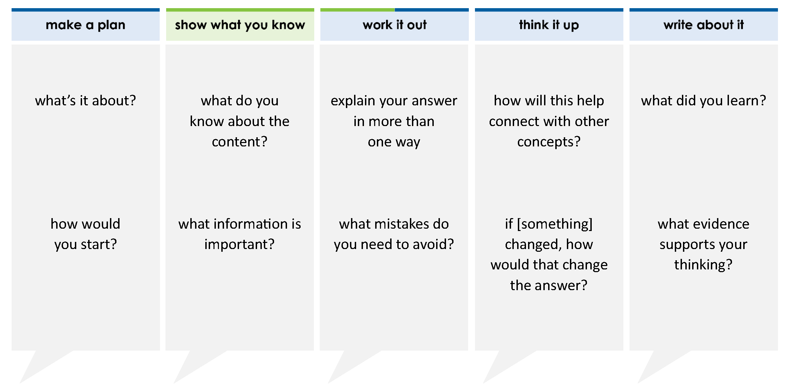
The table shows 100-meter dash times of some of the top 20 fastest times in the world.
Order the names of the athletes from fastest time to slowest time.
100-meter Dash Times
Athlete | Time (seconds)
Steve Mullings | 9.8
Nickel Ashmeade | 9
Asafa Powell | 9
Usain Bolt | 9.58
9
10
18
25
thinkalong routine
Mullings |  | Ashmeade |  | Powell |  | Bolt
stimulus
Notes:
Throughout the week, use the guiding questions from the thinkalong routine to lead student thinking and discussion around the selected stimulus (problem, text, or visual) aligned to a high-impact standard/concept.

Slide 3
make a plan
Notes:
make a plan
The goal of the first 5-10 minutes of the routine is just for students to explore. We are engaging the “tools to know” process standards and using the selected problem, text, or visual to activate memory around the designated content for the week.
If you’re using a problem as the stimulus, students don’t solve the problem or even see the answer choices yet! In this part of the routine, students practice making a plan, getting started, and thinking about what they will need to answer the question based on the vocabulary and/or visuals included.

Slide 4
The table shows 100-meter dash times of some of the top 20 fastest times in the world.
what’s it about?
100-meter Dash Times
Athlete | Time (seconds)
Steve Mullings | 9.8
Nickel Ashmeade | 9
Asafa Powell | 9
Usain Bolt | 9.58
9
10
how would you start?
18
25
what do you think you will have to do with this information
Notes:
make a plan: Use the guiding questions on the routine to drive the thinking and discussion with students as you explore the selected stimulus.
This item was selected to address, loopback, or intervene on comparing and ordering numbers because:
It’s a skill/concept needed for future learning.
It contains fractions and decimals.
When different types of numbers are together in one problem, the problem looks scary.

Slide 5
show what you know
Notes:
show what you know
The goal of the second 10 minutes in the routine is for students to talk using the problem, text, or visual to show what they know about this concept! This part of the routine allows students and teacher to talk about, share, and clarify the content (vocabulary, visuals, activities, common mistakes, connections, key ideas, important info/details, etc.).

Slide 6
The table shows 100-meter dash times of some of the top 20 fastest times in the world.
what do you know about the content?
100-meter Dash Times
Athlete | Time (seconds)
Steve Mullings | 9.8
Nickel Ashmeade | 9
Asafa Powell | 9
Usain Bolt | 9.58
9
10
what information is important?
18
25
Notes:
show what you know - option 1: Use these questions from the routine, along with the selected stimulus, to activate memory, review content, correct learning mistakes, and clarify misconceptions. Be sure discussion includes important information related to the selected stimulus.
important information about this item:
Clues include and require an understanding of important academic vocabulary. Although this problem doesn’t have any technical academic vocabulary, it lists various athlete’s running times and uses the word “fastest.”
Students must read and clarify all of the clues:
Athletes’ times are listed along with their names
The times are listed in decimals and fractions
Students would benefit from:
Discussing the connection between fastest, slowest, least, and greatest
Practice changing mixed numbers to decimals
Discussing how to organize the work on this problem

Slide 7



just the facts
The table shows 100-meter dash times of some of the top 20 fastest times in the world.
100-meter Dash Times
Athlete | Time (seconds)
Steve Mullings | 9.8
Nickel Ashmeade | 9
Asafa Powell | 9
Usain Bolt | 9.58
9
10
18
25
Notes:
show what you know - option 2: just the facts (rehearsal and practice instructional strategy)
purpose
The purpose is to help student identify the most important details from a problem or visual.
instructions
Students read a text and observe an image.
They determine 3 facts (interesting, useful, most important) from the stem.
With a thinking partner, students justify why they chose a particular fact.
Observe students’ thinking and clarify/verify as appropriate.
Interesting fact: All the times are more than 9 seconds and less than 10 seconds.
Useful fact: Students are probably going to have to put the time in order from fastest to slowest or slowest to fastest.
Most important fact: Fastest time = winner = least number; slowest time = loser = greatest number.

Slide 8
work it out
Notes:
work it out
The goal of the third 10 minutes of the routine is for students to work out the problem and defend their answer. We want students to prove why their chosen response is right and explain why the incorrect answers are wrong.

Slide 9
The table shows 100-meter dash times of some of the top 20 fastest times in the world.
Order the names of the athletes from fastest time to slowest time.
100-meter Dash Times
Athlete | Time (seconds)
Steve Mullings | 9.8
Nickel Ashmeade | 9
Asafa Powell | 9
Usain Bolt | 9.58
explain your answer in more than one way
9
10
18
25
what mistakes do you need to avoid?
Mullings |  | Ashmeade |  | Powell |  | Bolt
Notes:
work it out - option 1: Correct learning mistakes and clarify misconceptions by answering the question but be sure students not only solve but also prove why their chosen response is right and explain why the incorrect answers are wrong.
Be sure discussion includes:
Instead of the times being listed in the answer, the names of the athletes are listed.
Once the times are in decimal form, the times need to be placed from fastest to slowest and then add the names of the athletes.
The fastest time is the least number. The slowest time is the greatest number.

Slide 10

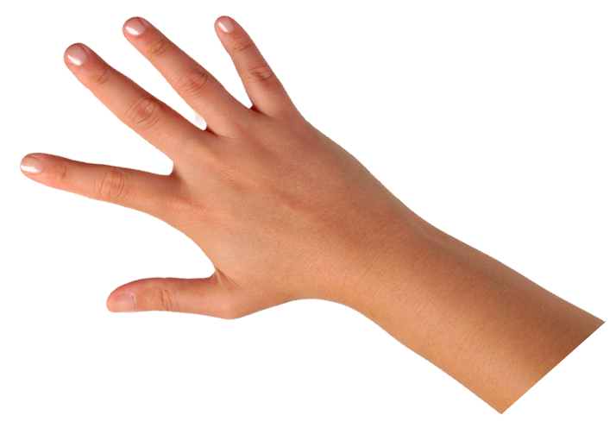
IQ slap down
A
B
C
D
Round 1 - Worst Answer
Round 2 - Best Distractor
Round 3 - Correct Answer
Notes:
work it out - option 2: IQ slap down (learning from mistakes instructional strategy)
purpose
Students analyze or practice assessment questions by determining the worst answer, the distractor, and the correct answer through a slap-down game.
instructions
Students create a set of A-B-C-D cards using sticky notes, index cards, or scratch paper.
Organize students into thinking partners or small groups.
Facilitate 3 rounds of IQ Slap Down with the selected weekly assessment item:
Round 1: At teacher’s signal, students slap down the WORST answer, justify with their partner, and pick up their cards. Teacher clarifies.
Round 2: At teacher’s signal, students slap down the DISTRACTOR answer, justify with their partner, and pick up their cards. Teacher clarifies.
Round 3: At teacher’s signal, students slap down the CORRECT answer, justify with their partner, and pick up their cards. Teacher clarifies.
Observe students’ thinking and clarify/verify as appropriate.
Answer “work it out questions” from think along routine.

Slide 11
The table shows 100-meter dash times of some of the top 20 fastest times in the world.
Order the names of the athletes from fastest time to slowest time.
Bolt |  | Mullings |  | Powell |  | Ashmeade
100-meter Dash Times
Athlete | Time (seconds)
Steve Mullings | 9.8
Nickel Ashmeade | 9
Asafa Powell | 9
Usain Bolt | 9.58
Bolt |  | Powell |  | Mullings |  | Ashmeade
Ashmeade |  | Mullings |  | Powell |  | Bolt
9
10
Bolt |  | Powell |  | Ashmeade |  | Mullings
9
10
18
25
9.8 9 9.58
9.9 9.8 9.72 9.58
slowest to fastest
18
25
Mullings |  | Ashmeade |  | Powell |  | Bolt
Round 1 Worst Answer
1-2-3 Slap Down
Notes:
work it out - option 2: round 1 rationale
The third one is the worst answer because the numbers are in order. But they are from slowest to fastest, not fastest to slowest. Students did the hard work of putting the numbers in order, just not the right order.
[Click to get worst answer.]
[Click to get explanation with times.]

Slide 12

The table shows 100-meter dash times of some of the top 20 fastest times in the world.
Order the names of the athletes from fastest time to slowest time.
Bolt |  | Mullings |  | Powell |  | Ashmeade
100-meter Dash Times
Athlete | Time (seconds)
Steve Mullings | 9.8
Nickel Ashmeade | 9
Asafa Powell | 9
Usain Bolt | 9.58
Bolt |  | Powell |  | Mullings |  | Ashmeade
Ashmeade |  | Mullings |  | Powell |  | Bolt
9
10
Bolt |  | Powell |  | Ashmeade |  | Mullings
18
25
18
25
9
10
9.58 9.8 9 9
9.8 9.72
Mullings |  | Ashmeade |  | Powell |  | Bolt
Round 2 Best Distractor
1-2-3 Slap Down
Notes:
work it out - option 2: round 2 rationale
The first one is the best distractor because the first and last time are correct. The ones in the middle are switched.
[Click to get best distractor.]
[Click to get time in the order of the distractor.] Here are the times for each person listed in the distractor.
[Click to get arrows showing the first and last are correct.] The first and last ones are correct.
[Click to show the numbers in the middle.] 9 18/25 is the same as 9.72. 9.72 < 9.8.

Slide 13
The table shows 100-meter dash times of some of the top 20 fastest times in the world.
Order the names of the athletes from fastest time to slowest time.
Bolt |  | Mullings |  | Powell |  | Ashmeade
100-meter Dash Times
Athlete | Time (seconds)
Steve Mullings | 9.8
Nickel Ashmeade | 9
Asafa Powell | 9
Usain Bolt | 9.58
Bolt |  | Powell |  | Mullings |  | Ashmeade
Ashmeade |  | Mullings |  | Powell |  | Bolt
9
10
Bolt |  | Powell |  | Ashmeade |  | Mullings
18
25
9
10
9.58 9 9.8 9
9.58 9.72 9.8 9.9
fastest to slowest
18
25
Mullings |  | Ashmeade |  | Powell |  | Bolt
Round 3 Correct Answer
1-2-3 Slap Down
Notes:
work it out - option 2: round 3 rationale
The second one is the correct answer.
[Click to reveal the answer and the rationale.]
After IQ slap down, answer the “work it out” questions from the thinkalong routine:
explain your answer in more than one way
what mistakes do you need to avoid?

Slide 14
think it up
Notes:
think it up
The goal of the fourth 10 minutes of the routine is for us to change things up so students can practice with novelty and transfer.

Slide 15
The table shows 100-meter dash times of some of the top 20 fastest times in the world.
Order the names of the athletes from fastest time to slowest time.
how will this help connect with other concepts?
100-meter Dash Times
Athlete | Time (seconds)
Steve Mullings | 9.8
Nickel Ashmeade | 9
Asafa Powell | 9
Usain Bolt | 9.58
how can you remember what “fastest to slowest” means in decimals?
9
10
18
25
if 9.8 changed to 9.08, how would that change the answer?
why is one of the distractors the times in order from slowest to fastest?
Mullings |  | Ashmeade |  | Powell |  | Bolt
Notes:
think it up - option 1: Use the guiding questions on the routine to drive the thinking and discussion with students as they reflect on the work of the routine so far -- the thinking around the content and the problem, text or visual. Then, have students analyze how all of that can help them as they work on or think through other content or solving future problems.

Slide 16
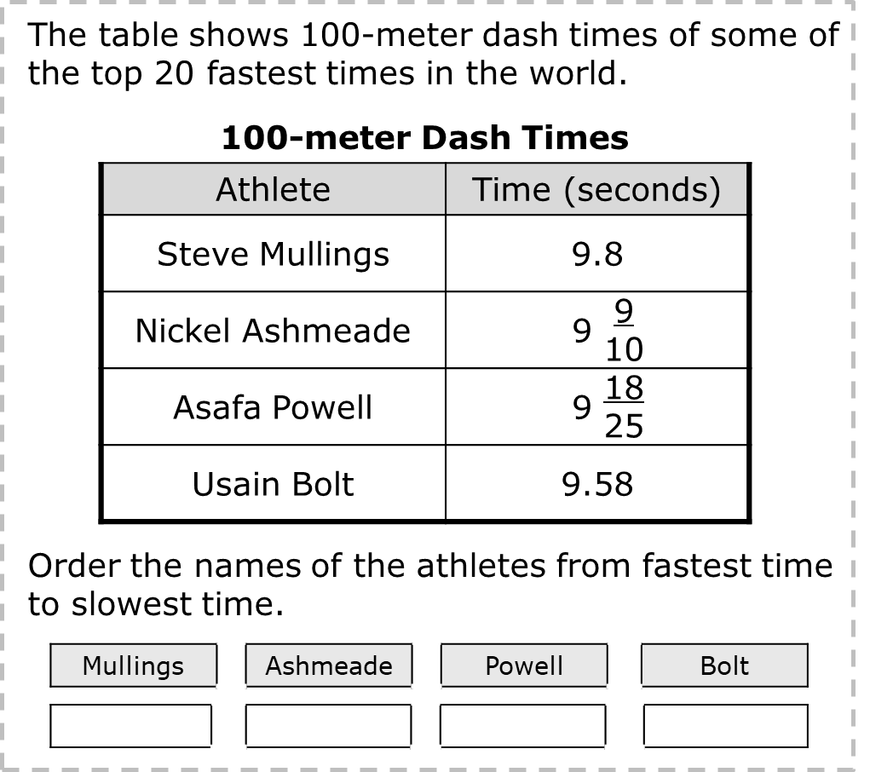
compare/contrast model
Which values of x make the inequality true?
x > 9
Select TWO correct answers
18
25
9.8 |  | 9 |  |  |  | 9.58
9
10
97
10
Notes:
think it up - option 2: compare/contrast model (extending thinking instructional strategy)
purpose
This is an effective strategy to facilitate a structured, supported, and engaging way for kids to answer the “think it up” questions and analyze 2 similar yet different items or visuals aligned to the same standard.
instructions
Divide students into groups of 3.
In each group, students CONTRAST the items by discussing/writing 2-3 attributes of each item.
In each group, students COMPARE the items by discussing/writing 2-3 attributes both items share.
Groups share out 1 of their differences and 1 of their similarities.
Observe and listen to students’ thinking and clarify/verify as appropriate.
These problems require the same work: changing the numbers to decimals. In the new problem, students choose all the numbers that are greater than 9 18/25.

Slide 17
write about it
Notes:
write about it
The goal of the last 10 minutes of the routine is for students to reflect on the routine and write about how it affected their understanding and confidence around the content and problem-solving process.

Slide 18
The table shows 100-meter dash times of some of the top 20 fastest times in the world.
Order the names of the athletes from fastest time to slowest time.
what did you learn?
100-meter Dash Times
Athlete | Time (seconds)
Steve Mullings | 9.8
Nickel Ashmeade | 9
Asafa Powell | 9
Usain Bolt | 9.58
9
10
what evidence supports your thinking?
18
25
does your thinking change when putting names in order instead of only the numbers?
Mullings |  | Ashmeade |  | Powell |  | Bolt
Bolt |  | Powell |  | Mullings |  | Ashmeade
Notes:
write about it: The goal of the last 10 minutes of the routine is to solidify learning and have students practice communicating what they know in writing.
Ask students to:
think about the activities, questions, discussions, and the selected problem, text or visual for this week’s thinkalong routine
talk with a partner or in a small group about what they learned and the evidence that supports their thinking
write their answers on a piece of paper or in their notebooks
Review areas in which students may need more support.

