Slide 1





(click on a button to go directly to that step)
Notes:
The thinkalong toolkit includes assessment-style items with answer keys. A digital version (poster) of the thinkalong routine and daily questions for teacher and students’ reference is also included.

Slide 2
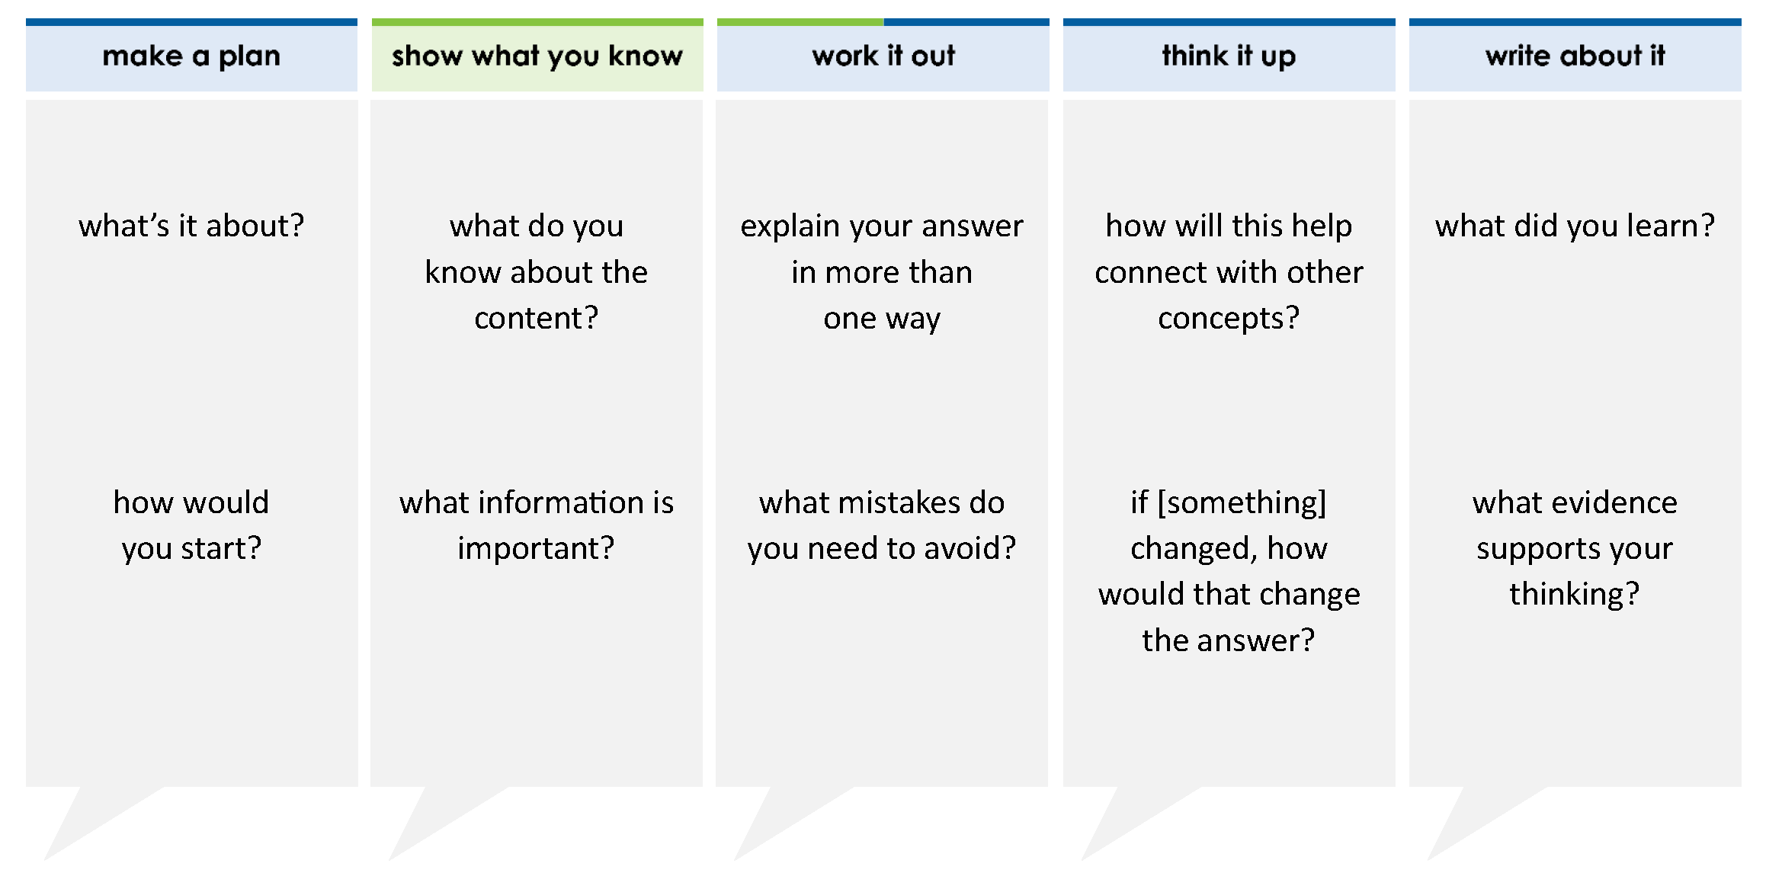
Which list shows these numbers in order from greatest to least?
, –0.5, –1 , √3
A –0.5, –1 , √3,
B –1 , –0.5, , √3
C –0.5, –1 , , √3
D √3, , –0.5, –1
5
3
1
3
1
3
5
3
1
3
5
3
1
3
5
3
5
3
1
3
thinkalong routine
stimulus
Notes:
Throughout the week, use the guiding questions from the thinkalong routine to lead student thinking and discussion around the selected stimulus (problem, text, or visual) aligned to a high-impact standard/concept.

Slide 3
make a plan
Notes:
make a plan
The goal of the first 5-10 minutes of the routine is just for students to explore. We are engaging the “tools to know” process standards and using the selected problem, text, or visual to activate memory around the designated content for the week.
If you’re using a problem as the stimulus, students don’t solve the problem or even see the answer choices yet! In this part of the routine, students practice making a plan, getting started, and thinking about what they will need to answer the question based on the vocabulary and/or visuals included.

Slide 4
what’s it about?
Which list shows these numbers in order from greatest to least?
, –0.5, –1 , √3
5
3
1
3
how would you start?
Notes:
make a plan: Use the guiding questions on the routine to drive the thinking and discussion with students as you explore the selected stimulus.
This item was selected to address, loopback, or intervene on comparing and ordering numbers because:
It’s a skill/concept students need for future learning.
It contains many types of numbers (fractions, decimals, square roots, positive and negative numbers).
When different types of numbers are together in one problem, the problem looks scary.

Slide 5
show what you know
Notes:
show what you know
The goal of the second 10 minutes in the routine is for students to talk using the problem, text, or visual to show what they know about this concept! This part of the routine allows students and teacher to talk about, share, and clarify the content (vocabulary, visuals, activities, common mistakes, connections, key ideas, important info/details, etc.).

Slide 6
what do you know about the content?
Which list shows these numbers in order from greatest to least?
, –0.5, –1 , √3
5
3
1
3
what information is important?
Notes:
show what you know - option 1: Use these questions from the routine, along with the selected stimulus, to activate memory, review content, correct learning mistakes, and clarify misconceptions. Be sure discussion includes important information related to the selected stimulus.
important information about this item:
Clues include and require an understanding of important academic vocabulary: order, greatest to least.
Students must read and clarify all of the clues:
There is a list of numbers
Students must put the numbers in order from greatest to least
Students would benefit from:
Practice using their calculators to change fractions into decimals
Practice using their calculators to find square roots
Reviewing integers on a number line
Rounding decimals
Discussing how to organize the work on this problem

Slide 7



FACT
FIB
Notes:
show what you know - option 2: fact or fib (rehearsal and practice instructional strategy)
purpose
Students review important content and clarify misconceptions by determining which statements are facts and which are fibs in a fact or fib showdown game. Fact or fib is an effective strategy for brain dumping and to activate memory, review content, correct learning mistakes, and clarify misconceptions and that will engage students with the guiding questions from the “show what you know” column and selected weekly stimulus.
instructions
Students create FACT and FIB cards using post it notes, index cards, scratch paper, white boards or use their fingers.
They hold their cards while teacher presents students with a statement (fact or fib) relating to the concept, visual, text, or test item.
Allow students 5-8 seconds to infer if the statement is a fact or a fib.
Students think and prepare to justify their answer until the teacher calls out, “One! Two! Three! Showdown!” at which time all students hold up either the fact or fib card to represent their choice.
Students then take turns explaining and justifying their thinking with a partner or small group.
Observe students’ thinking and clarify/verify as appropriate.
Reveal correct answer and provide rationale.

Slide 8
“greatest to least” means that the largest number goes first in the list
FACT!
Which list shows these numbers in order from greatest to least?
, –0.5, –1 , √3
5
3
1
3
–2
–1
0
1
2
least greatest
1-2-3 SHOWDOWN
Notes:
show what you know - option 2, round 1 rationale
This is a FACT.
When writing numbers from greatest to least, start with the highest number and list them down to the lowest number on the number line.
[Click to show number line.]
[Click to show greatest to least arrow.]

Slide 9
The greatest number is either
or √3.
5
3
FACT!
Which list shows these numbers in order from greatest to least?
, –0.5, –1 , √3
negative numbers
positive numbers
5
3
1
3
–2
–1
0
1
2
least greatest
1-2-3 SHOWDOWN
Notes:
show what you know - option 2, round 2 rationale
This is a FACT.
5/3 and √3 are positive, and the other numbers are negative.
[Click to show number line, and positive and negative.]

Slide 10
1
3
–1 > – 0.5
1
3
–2
–1
–1
–0.5
0
1
3
–1 < – 0.5
Which list shows these numbers in order from greatest to least?
, –0.5, –1 , √3
FIB!
5
3
1
3
1-2-3 SHOWDOWN
Notes:
show what you know - option 2, round 3 rationale
This is a FIB.
[Click] Both numbers are negative, so they are both below 0 on the number line.
[Click] –0.5 is between 0 and –1.
[Click] –1 1/3 is smaller than –1 and larger than –2.
[Click] Because –0.5 is closer to 0 than –1 1/3 is, –0.5 is larger than –1 1/3.

Slide 11
work it out
Notes:
work it out
The goal of the third 10 minutes of the routine is for students to work out the problem and defend their answer. We want students to prove why their chosen response is right and explain why the incorrect answers are wrong.

Slide 12
Which list shows these numbers in order from greatest to least?
, –0.5, –1 , √3
A –0.5, –1 , √3,
B –1 , –0.5, , √3
C –0.5, –1 , , √3
D √3, , –0.5, –1
explain your answer in more than one way
5
3
1
3
1
3
5
3
what mistakes do you need to avoid?
1
3
5
3
1
3
5
3
5
3
1
3
Notes:
work it out - option 1: Correct learning mistakes and clarify misconceptions by answering the question but be sure students not only solve but also prove why their chosen response is right and explain why the incorrect answers are wrong.
Be sure discussion includes:
The greatest number must be listed first
Using the calculator to change each number in the problem to a decimal and writing the decimal below the number
Using a number line to keep track of the magnitude of the numbers
The negative number that “looks the greatest” is actually the least number

Slide 13

IQ slap down
A
B
C
D
Round 1 - Worst Answer
Round 2 - Best Distractor
Round 3 - Correct Answer
Notes:
work it out - option 2: IQ slap down (learning from mistakes instructional strategy)
purpose
Students analyze or practice assessment questions by determining the worst answer, the distractor, and the correct answer through a slap-down game.
instructions
Students create a set of A-B-C-D cards using sticky notes, index cards, or scratch paper.
Organize students into thinking partners or small groups.
Facilitate 3 rounds of IQ Slap Down with the selected weekly assessment item:
Round 1: At teacher’s signal, students slap down the WORST answer, justify with their partner, and pick up their cards. Teacher clarifies.
Round 2: At teacher’s signal, students slap down the DISTRACTOR answer, justify with their partner, and pick up their cards. Teacher clarifies.
Round 3: At teacher’s signal, students slap down the CORRECT answer, justify with their partner, and pick up their cards. Teacher clarifies.
Observe students’ thinking and clarify/verify as appropriate.
Answer “work it out questions” from think along routine.

Slide 14
Which list shows these numbers in order from greatest to least?
, –0.5, –1 , √3
A –0.5, –1 , √3,
B –1 , –0.5, , √3
C –0.5, –1 , , √3
D √3, , –0.5, –1
5
3
1
3
1
3
√3
–1
–0.5
1
3
5
3
5
3
–2
–1
0
1
2
1
3
5
3
least greatest
1
3
5
3
5
3
1
3
Round 1 Worst Answer
1-2-3 Slap Down
Notes:
work it out - option 2: round 1 rationale
Worst answer may vary.
B is the worst answer because the numbers are in order. But they are from least to greatest, not greatest to least. Students did the hard work of putting the numbers in order, just not the right order.
[Click to show number line.]
[Click to show placement of numbers on the number line.]
[Click to show arrow that shows the direction to write the numbers.]

Slide 15
Which list shows these numbers in order from greatest to least?
, –0.5, –1 , √3
A –0.5, –1 , √3,
B –1 , –0.5, , √3
C –0.5, –1 , , √3
D √3, , –0.5, –1
5
3
1
3
1
3
–1
–0.5
1
3
5
3
–2
–1
0
1
2
1
3
5
3
least greatest
1
3
5
3
5
3
1
3
Round 2 Best Distractor
1-2-3 Slap Down
Notes:
work it out - option 2: round 2 rationale
Best Distractor may vary.
C is the best distractor because the order of the negative numbers is incorrect.
[Click to show number line and placement of the points for -1 1/3 and -0.5.]
[Click to show arrow from -1 1/3 to 0.] The magnitude/size of negative numbers is determined by their distances from 0. Here is the arrow that shows how far –1 1/3 is from 0.
[Click to show arrow from -0.5 to 0.] –1 1/3 is further away from 0 than -0.5 is. Therefore, it is less than -0.5.

Slide 16
Which list shows these numbers in order from greatest to least?
, –0.5, –1 , √3
A –0.5, –1 , √3,
B –1 , –0.5, , √3
C –0.5, –1 , , √3
D √3, , –0.5, –1
5
3
1
3
1
3
√3
–1
–0.5
1
3
5
3
5
3
–2
–1
0
1
2
1
3
5
3
least greatest
1
3
5
3
5
3
1
3
Round 3 Correct Answer
1-2-3 Slap Down
Notes:
work it out - option 2: round 3 rationale
D is the correct answer.
[Click to show correct answer and number line.]
After IQ slap down, answer the “work it out” questions from the thinkalong routine:
explain your answer in more than one way
what mistakes do you need to avoid?

Slide 17
think it up
Notes:
think it up
The goal of the fourth 10 minutes of the routine is for us to change things up so students can practice with novelty and transfer.

Slide 18
how will this help connect with other concepts?
Which list shows these numbers in order from greatest to least?
, –0.5, –1 , √3
A –0.5, –1 , √3,
B –1 , –0.5, , √3
C –0.5, –1 , , √3
D √3, , –0.5, –1
how and why does a number line help you place the numbers in the correct order?
5
3
1
3
1
3
5
3
if square root of 3 was changed to square root of 2, how will that change the answer?
1
3
5
3
1
3
5
3
5
3
1
3
why is one of the distractors to show the numbers placed in order from least to greatest?
Notes:
think it up - option 1: Use the guiding questions on the routine to drive the thinking and discussion with students as they reflect on the work of the routine so far -- the thinking around the content and the problem, text or visual. Then, have students analyze how all of that can help them as they work on or think through other content or solving future problems.

Slide 19
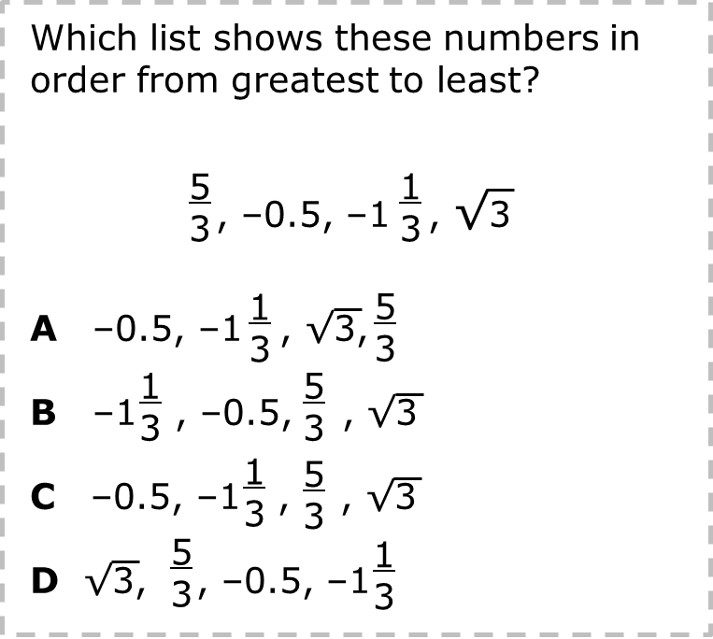
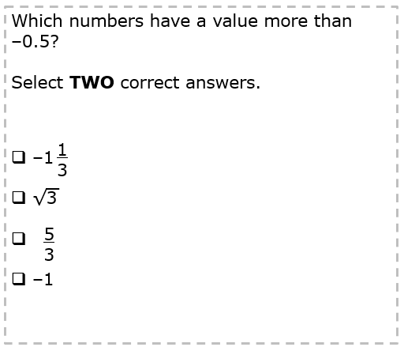
compare/contrast model
Notes:
think it up - option 2: compare/contrast model (extending thinking instructional strategy)
purpose
This is an effective strategy to facilitate a structured, supported, and engaging way for kids to answer the “think it up” questions and analyze 2 similar yet different items or visuals aligned to the same standard.
instructions
Divide students into groups of 3.
In each group, students CONTRAST the items by discussing/writing 2-3 attributes of each item.
In each group, students COMPARE the items by discussing/writing 2-3 attributes both items share.
Groups share out 1 of their differences and 1 of their similarities.
Observe and listen to students’ thinking and clarify/verify as appropriate.
These problems require the same work: changing the numbers to decimals. In the new problem, they choose all the numbers that are greater than –0.5.

Slide 20
write about it
Notes:
write about it
The goal of the last 10 minutes of the routine is for students to reflect on the routine and write about how it affected their understanding and confidence around the content and problem-solving process.

Slide 21
what did you learn?
Which list shows these numbers in order from greatest to least?
, –0.5, –1 , √3
A –0.5, –1 , √3,
B –1 , –0.5, , √3
C –0.5, –1 , , √3
D √3, , –0.5, –1
5
3
1
3
what was confusing but you now understand?
1
3
5
3
what evidence supports your thinking?
1
3
5
3
1
3
5
3
5
3
1
3
how can you figure out the correct order of the numbers?
Notes:
write about it: The goal of the last 10 minutes of the routine is to solidify learning and have students practice communicating what they know in writing.
Ask students to:
think about the activities, questions, discussions, and the selected problem, text or visual for this week’s thinkalong routine
talk with a partner or in a small group about what they learned and the evidence that supports their thinking
write their answers on a piece of paper or in their notebooks
Review areas in which students may need more support.

